Slide 1
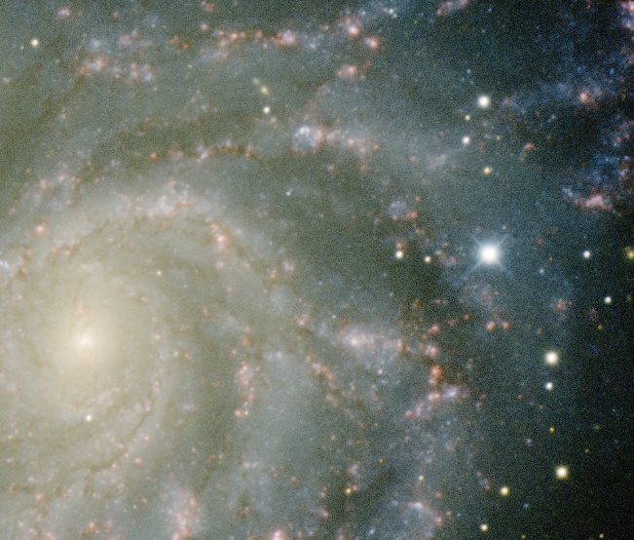
Cosmological measurements with Supernovae Ia
What is a SNIa?
Distance and cosmology
Observations
Standardisation (x1,c)
Hubble diagram
Spectra: SNfactory
Variability/spectra
G. Smadja (IPNL)

Slide 2
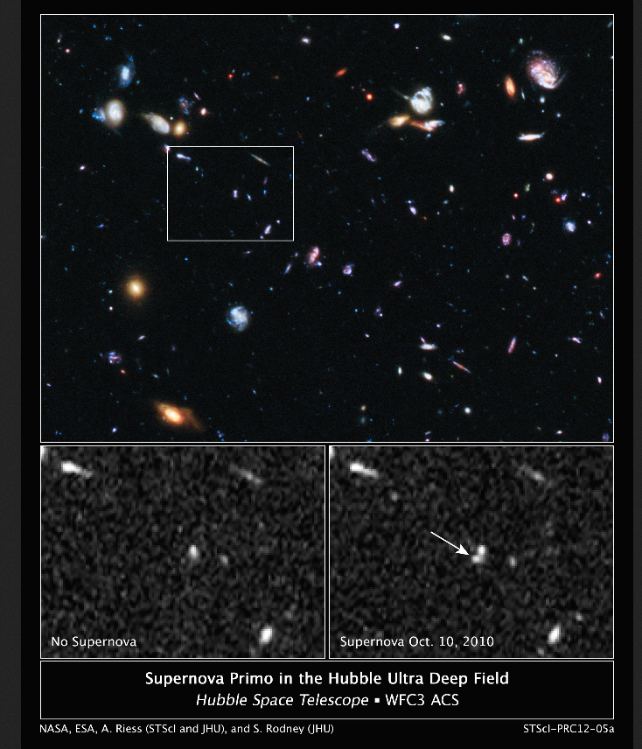
Supernovae Ia Luminosity
f
Extremely luminous (10¹⁰ L_{A})
L comparable to a large galaxy during a few days days
Most distant:
SNPrimo (Hubble Space Telescope, 2010)
redshift z = 1.55 ( ~9.4 10⁹ years ago)
A good candidate probe for the distant
universe : almost standard
[SNII : core collapse of massive star, neutron
star or Black Hole, major role of neutrinos,
not standard, not used for cosmology at present]
SNe Ia: Thermonuclear supernovae: explosive fusion of C+O white dwarf
time scale < 1s , no beta decay, n and p conserved, few neutrinos in (early)
explosion production of Ni,Co,Fe…

Slide 3
Progenitor system (standard model)
White Darf (WD) + companion system
White Dwarf:
C+O core
gravitation/ degenerate e⁻ gas
Equations of state (Quantum mechanics) p = r^{g}
Eddington g = 4/3(NR), Chandrasekhar g= 5/3 (UR)
r ~ 5 10⁹ g/cm³ (central), T = 10⁴-10⁶ K R ~ 6000-10000 km
Maximal mass M_{Chandrasekhar} = 1.44 M_{A}
Companion: WD or Red Giant (nearby or WD inside RG) ?
No red Giant SN2011fe (Li W. et al. 2011)
Strong limits on progenitor SN2011fe
(Nugent et al. 2011,Bloom et al. 2011
(Almost ) forces WD
No sign of outside layer
with H or He (blown away)
Compatible with WD
?
C
O

Slide 4
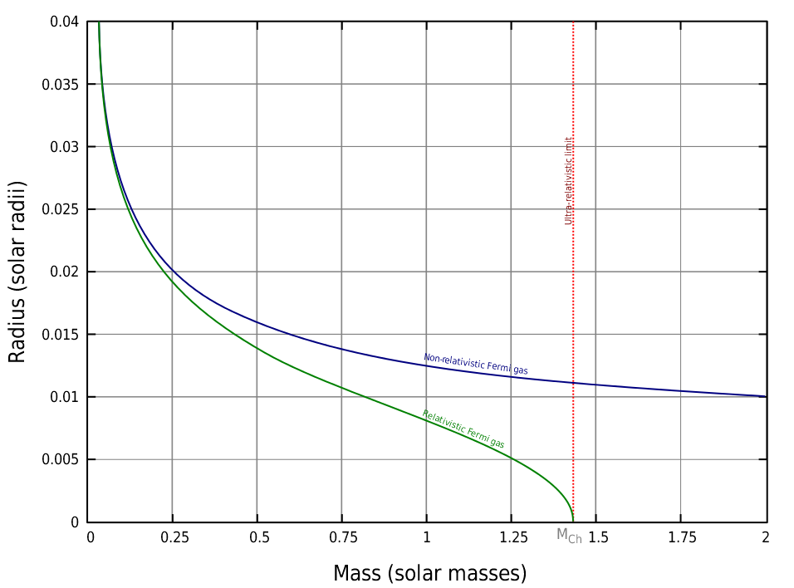
Accretion/M_{Chandrasekhar}
As M increases M_{Chandrasekhar}
radius R 0
Standard character : Quantum mechanics +
gravitation (Chandrasekhar mass)
(+ equation of state of WD matter)
Intrinsic variability ? : Trigger, Initial mass , initial
composition (C+O+…), turbulence,
propagation of explosion (deflagration +
detonation )…
[not yet separated from extrinsic, host extinction]
Accreting system configuration?
SD : white dwarf-Red giant less and less likely
no residual companion ever seen (study is
involved: velocity/composition of neighbouring stars).
destroyed in explosion ?
DD: White-dwarf-White dwarf
CD: Core degenerate WD inside Red Giant (Dilday et al, 2012, PTF11kx)
One case with a Red Giant candidate:
SN1572 (Tycho-Brahe) candidate Red subgiant (Ruiz Lapuente et al. )
Red Giants now suspected NOT to be the dominant mode (else destroyed)
M_{Chandrasekhar}~1.44 M_{A}

Slide 5
Explosion: Luminosity
Thermonuclear Energy: C to Fe: E = 0.12*M_{C}c² O to Fe: 0.08 M_{O} c²
10% of the WD mass converted to kinetic Energy (+ radiation)
Total Nuclear power E_{N} released:
E_{N} = (1.74 f_{Fe} + 1.56 f_{Ni} + 1.24 f_{Si})(M_{WD}/M_{Solar}) 10⁵¹ ergs (Maeda,Iwamoto 2009)
E_{N} = E_{Radiation} + E_{Gravitation} + E_{Kinetic}
E_{N} ~ 4 10 ⁵¹ ergs
1% optical L_{max} ~ 10¹⁰ L_{A}
E_{G} (Binding) ~0.04 E_{N}
E_{kinetic}: v ~10000-20000km/s (E_{n} = 1% E_{N})
Almost standard from Physics (M ~M_{Ch}~1.44 M_{A} )
Observed luminosity provides a distance.

Slide 6
Cosmological parameters
Relation red shift/distance: history of expansion:
3 cosmological parameters
slowing by matter + gravitation
non relativistic matter content
r_{c} : critical density, if r_{M}= r_{c} classical expansion stops at t = h
Acceleration from the cosmological constant
Curvature (0?)
For a cosmological constant
Observables: Redshift
scale factor (= ‘Doppler’ red shift from expansion)
observed luminosity
Equation of state of dark energy

Slide 7
Distance and cosmology
Luminosity distance= history of expansion
(slightly modified if curvature )
Factor : time dilatation and Doppler reddening
At small redshifts: is proportional to the redshift z
(inverse square law, H(z)~H₀)
Observed luminosity gives distance for a standard source
if
SN luminosity measurements are sensitive to w
Look back age = 9.3 Gy, d_{L} = 36.7Gy, (acceleration since z = 0.60)

Slide 8
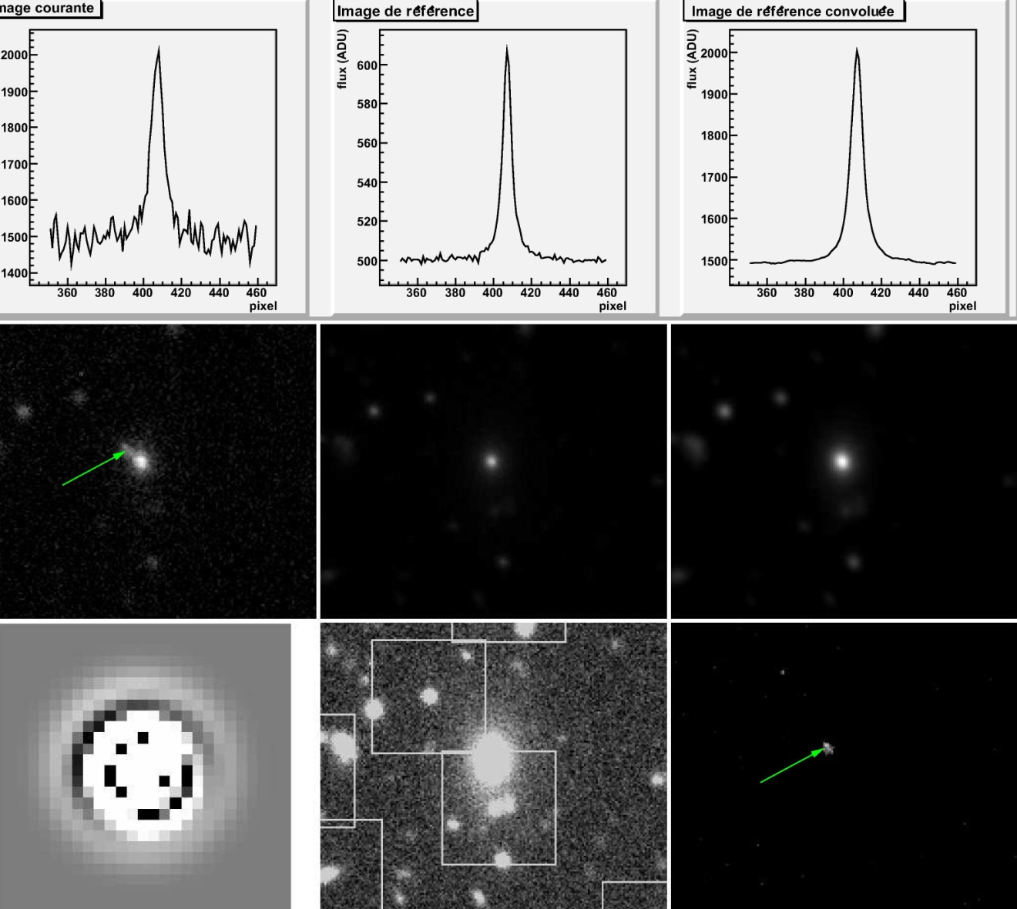
Detection : subtraction/reference image
Select a field in the sky
Select a filter
(wavelength range)
Observe SN +
galaxy
reference
image
(taken before)
Degrade reference
image to observation
PSF
Convolution
Kernel
(map PSF,
Not only images)
Subtract
Host for
SN image

Slide 9
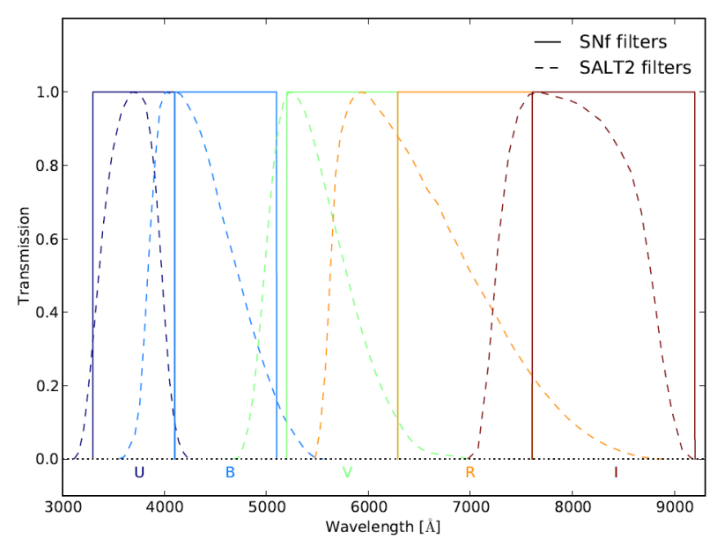
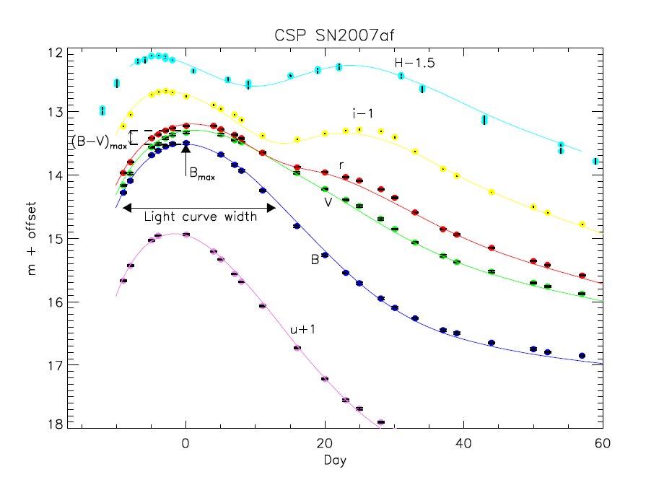
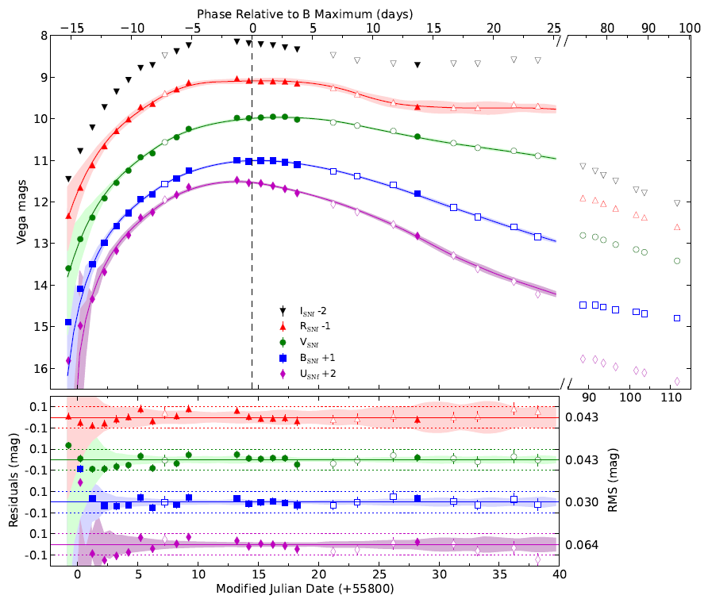
Light curves
Interplay opacity/radioactivity
Rise to maximum ~15 days
Decay lifetimes
< 30 days ~⁵⁶Ni ~8.8 days
> 30 days ~⁵⁶Co~111 days
From photometry
(Stritzinger et al.,CSP,2011)
from synthetic spectrophotometry
(R. Pereira,Nearby Supernovae Snfactory,2012 )
SN2011fe
z ~10⁻⁴
X1
Typical measurement accuracy photometry: ~1%
spectrum uncertainties convert to errors of 2-3%

Slide 10
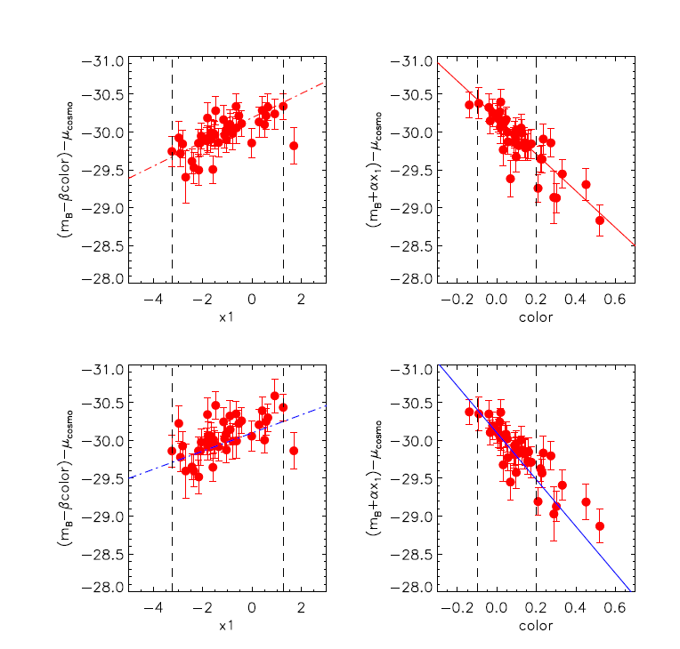
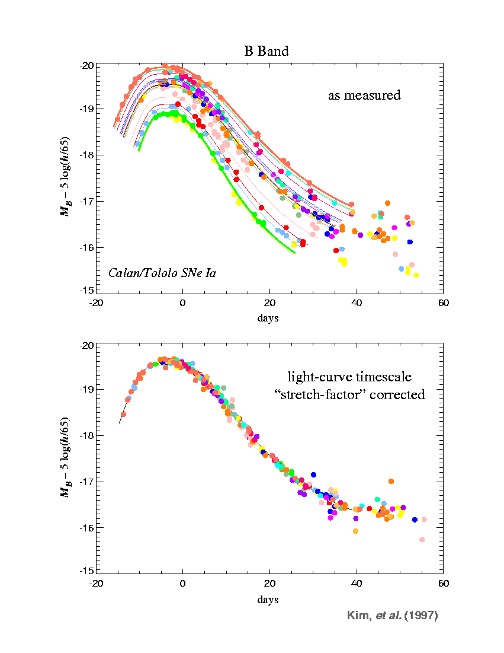
Standardisation: time scale (stretch,x1,Dm15)/colour
Stretch = characteristic duration/mean
~x1 = time scale
brighter/slower
Colour = B-V =
Intrinsic properties
+ host galaxy extinction
brighter bluer
~universal B light curve after time scale
+ colour corrections
X₁~time scale
Colour = B-V
Scatter
40%
Scatter
15%
(intrinsic?)
Probably not
Only intrinsic
(Lampeitl, SDSS-II,2010)
(Perlmutter et al. ,AAS,1998)

Slide 11
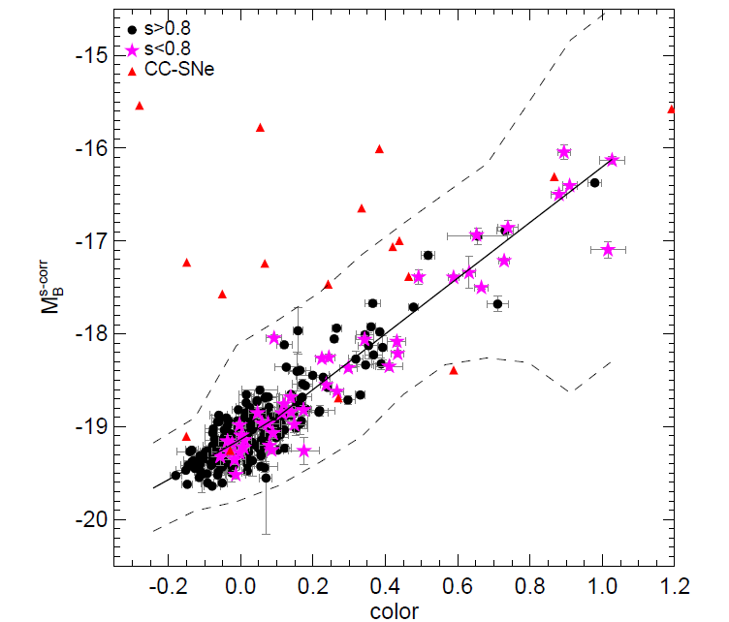
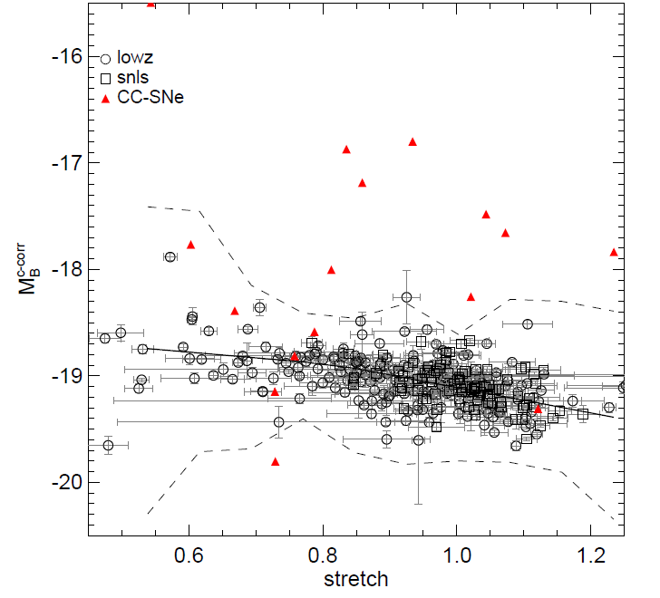
Standardisation /variability
Intrinsic variability. Down from 40% to 14-15% after stretch/colour corrections
remains significant Reduced to ~10-12% today with spectral
information, progress expected/corrections to ntrinsic
and extinction scatter’
A few outliers : underluminous Prototype SN1991bg CC = = Core collapse
stretch 0.45-0.8 (artificial contamination)
overluminous SN2006gz,SN2009dc
Low stretch/
low luminosity
intrinsic
Large colour
= extinction =
Low luminosity
extrinsic
S. Gonzalez-Gaitan et al., SNLS, 2010)

Slide 12
Past/recent/ongoing collaborations
All redshifts : SCP (almost over?), High z (mostly CTIO , 4m, Atacama,Chili)
z<0.1 : CfA, SNfactory (ongoing,UH,2.2m)
z ~ 0.2 to 0.4 SDSS 2m ongoing
z~ 0.2 to 0.8 DES: Dark Energy Survey (CTIO,4m) (starting)
Z~ 0.05 to 0.2 PTF: (Palomar,2m)
z~ 0.4 to 0.8 SNLS (CFHT,4m, just completed)
z~1 Essence (HST,2m,space)
z~1 GOODS (HST,2m,space)
SCP = Supernovae Cosmology Project
CTIO = Cerro Tololo inter-American Observatory
CfA = Center for Astrophysics,Harvard
CFHT= Canadian-French-Hawxaii telescope
PTF: Palomar Transient Factory

Slide 13
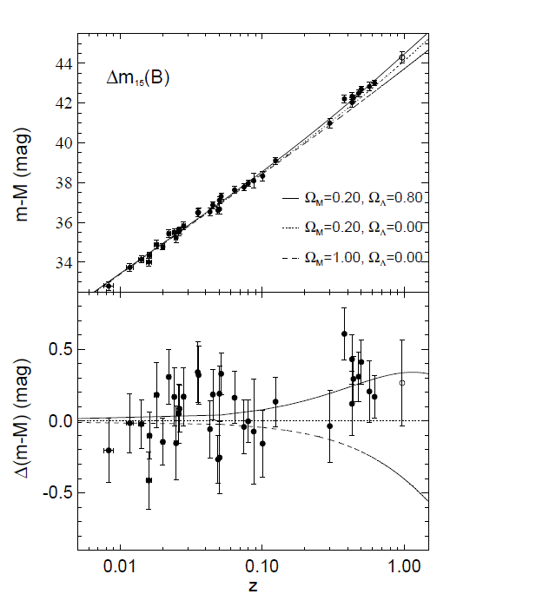
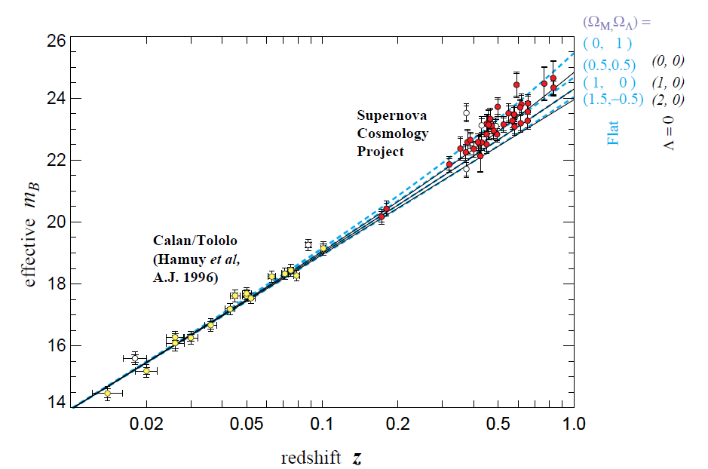
‘Historical ‘ publications (Nobel 2011)
M_{eff} = M_{obs} –ax₁ –b(B-V)
S. Perlmutter et al. (1998)
A.Riess et al. (1998)
Effect is ~20-25% from flat universe with W_{M}=1

Slide 14
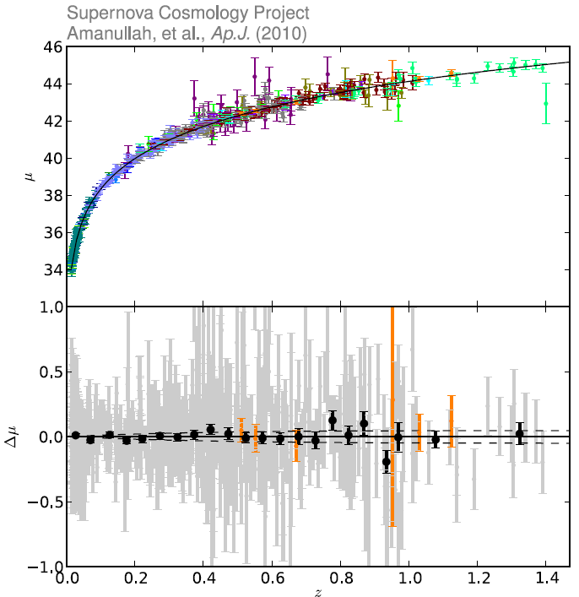
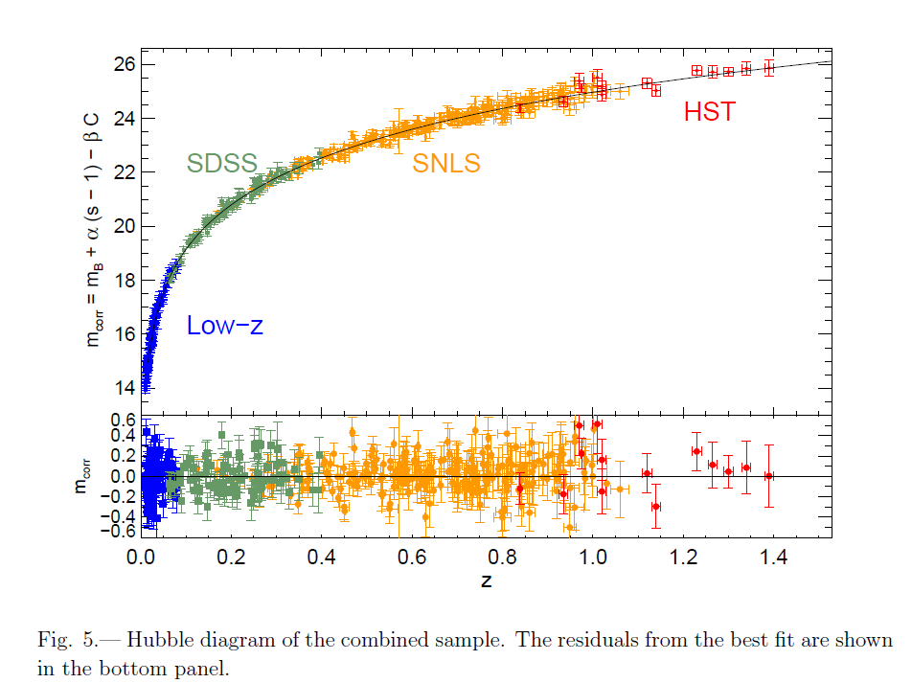
Cosmology fromSNIa : Hubble Diagram
Residuals
Amanullah et al., SCP,2010 ApJ 716,712
(Conley et al.,SNLS,2011)
From Union and SNLS collaborations
Curve = cosmological fit
Typical residual scatter ~15%
M_{std} = M_{obs} –ax₁ –b(B-V)

Slide 15
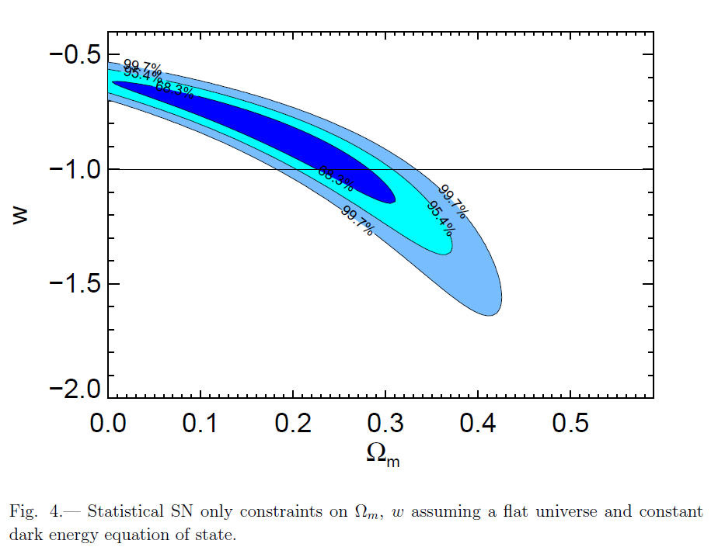
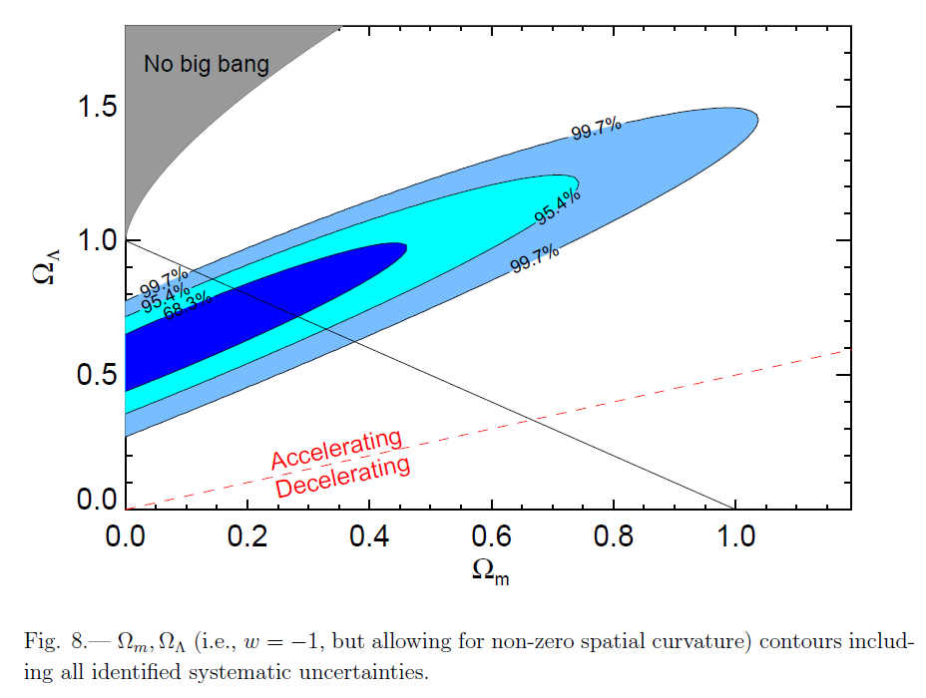
Cosmological parameters SNLS3-SDSS+ lowz
(Conley et al., SNLS, 2011)
Strong correlations between the measured values
Accuracy issues
Extra assumptions (no curvature)/other cosmological information helps!
Expansion definitely accelerating in the ‘standard’ description
Not anticipated before first results on SNe Ia

Slide 16
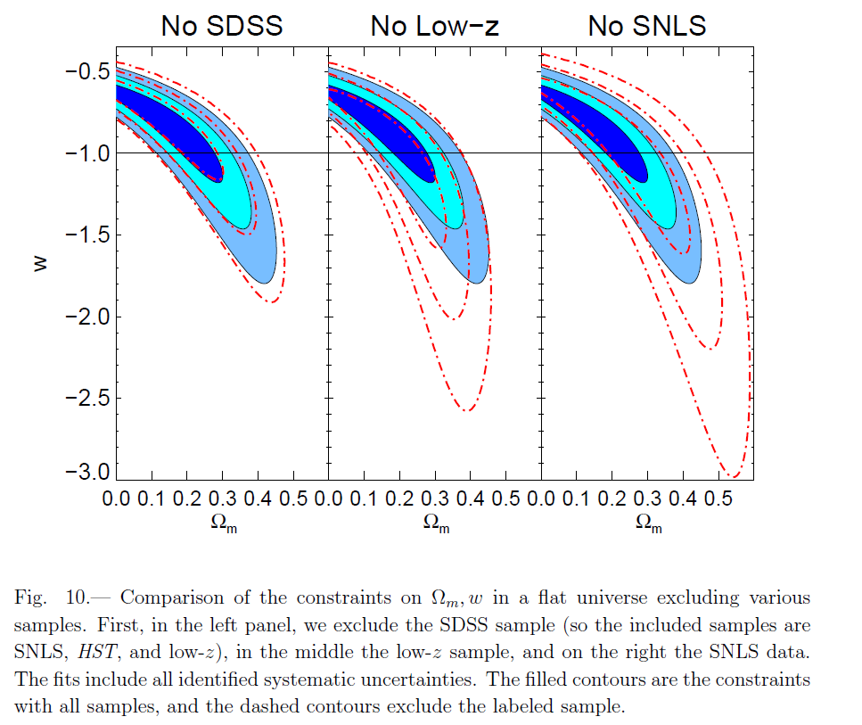
SNLS/SDSS/HST (Conley et al., SNLS, 2011)
SNLS by far the
best existing
data .
(French/Canadian
success)
Errors still large
with Sne Ia alone
Relevance of Low z for cosmology

Slide 17
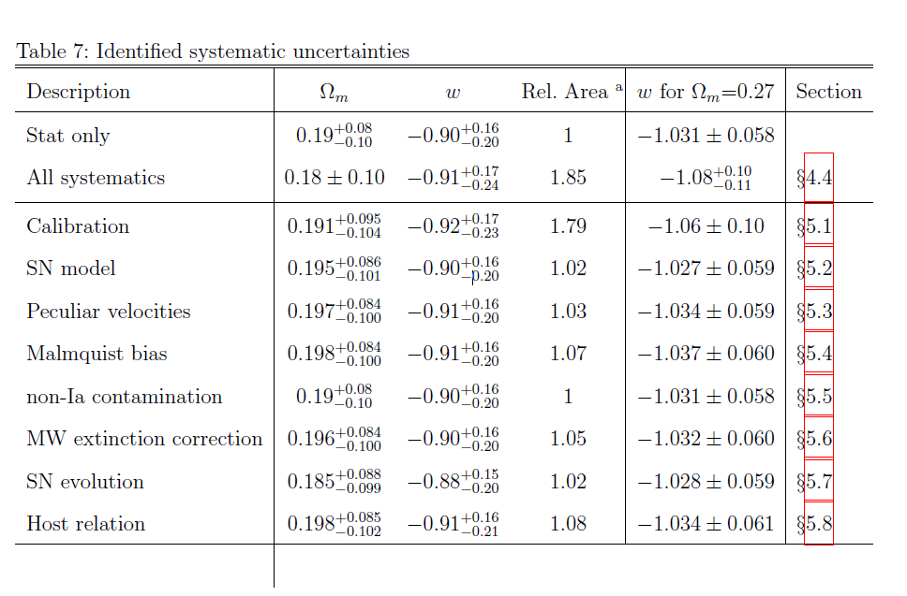
Systematics (SNLS 2010)
Templates/spectral corrections included in SN model
In each line : stat + corresponding syst
Changing the weight of each SN changes the Hubble fit result!
(average value differs from average of values…)

Slide 18
Results and errors (Sne Ia alone, not exhaustive)
NSN W_{M} w collaboration
115 SNLS(2006)
162 ESSENCE (2007,MLCS2)
178 ESSENCE(2007,SALT)
288 SDSS (Kessler et al. 2009,MLCS2)
288 SDSS(2009,SALT)
557 UNION2(2010, compilation)
242 SNLS (Conley et al, 2011)
Spread of results: assumptions in fitting algorithms + systematics
warning/similar assumptions (filters, templates, fitters (SALT,MLCS2) )
w compatible with -1, pinning down with high accuracy implies major improvements
Need for other cosmological measurements (CMB,BAO)

Slide 19
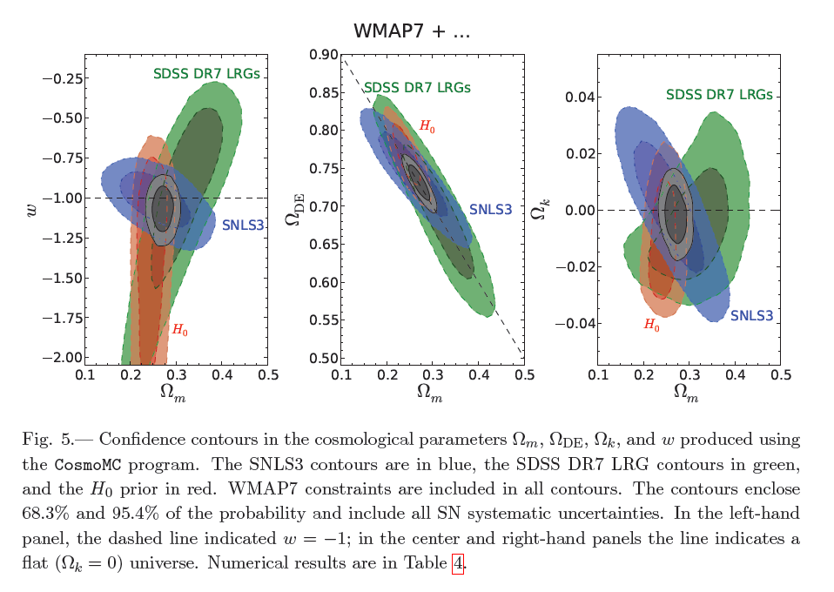
Consistent overall picture
M. Sullivan,SNLS3 + WMAP,BAO,2011
LRG = large Red
Galaxies
(BAO)
Room for further improvement from SNe Ia
Is universe really flat ( ) ?

Slide 20
More information/variability ? Spectra
Outliers: what is happening ? (subluminous, SuperChandrasekar)
Super Chandra scenario? Continuity with standard SNIa?
Variability: Different progenitors? (SD,DD,CD) no sign in data yet
Better understanding needed: spectroscopic data
Accurate spectroscopic data requires IFU as in SNfactory
Blue PSF
displaced/
atmospheric
refraction
Integral Field
Spectrograph
SLIT
Red PSF

Slide 21
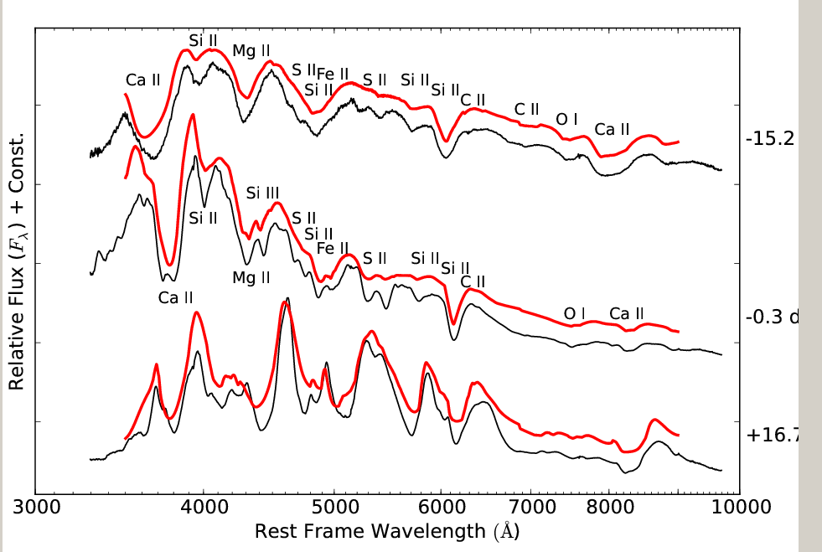
Typical SNIa spectra
(R. Pereira et al. ,SN2011fe,SNfactory,2012)
SN2011fe
-15.2 d
-0.3d
+16.7 d
A lot of information

Slide 22
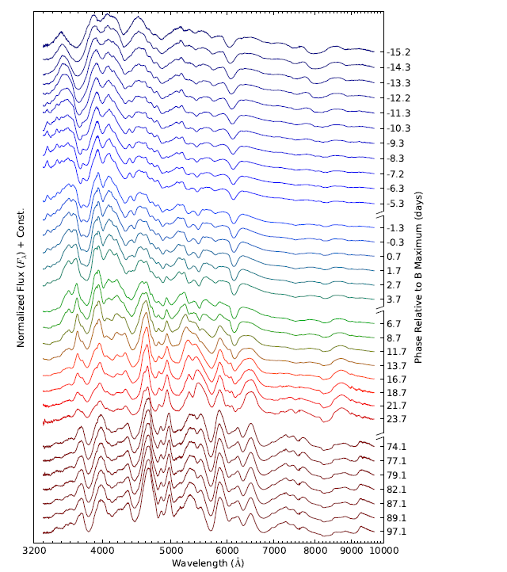
SN2011fe time serie (spectrophotometry)
R. Pereira et al., SNfactory, 2012
Ca SiII MgII SII SiII
Typical accuracy for synthetic filters
In spectrophotometry ~ 4-5%
(single measurement)
Fe
Fe
Ca (3750) and Si(6300) early spectra
Surging Fe lines in late spectra
Doppler broadened

Slide 23
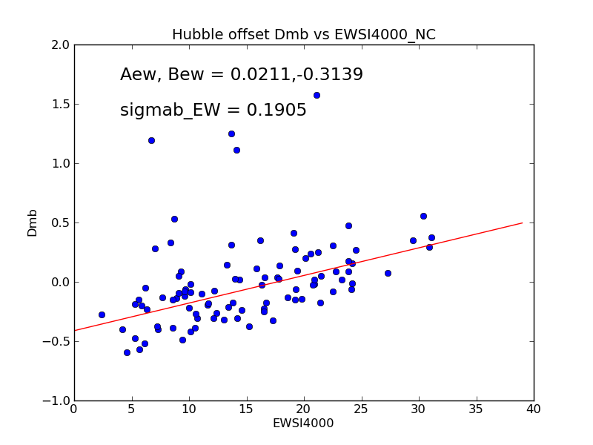
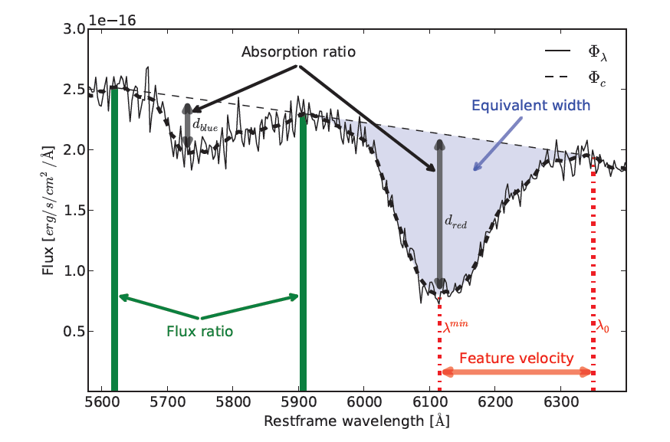
Spectral lines and Hubble fit residuals
Equivalent width
Correlation between Hubble fit residuals (before x1 and c corrections)
and EWSi4000
(N.Chotard, SNfactory,2011)

Slide 24
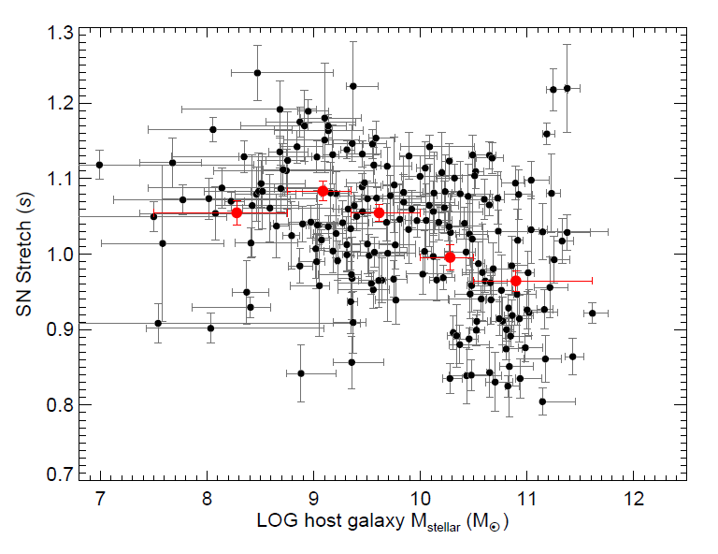
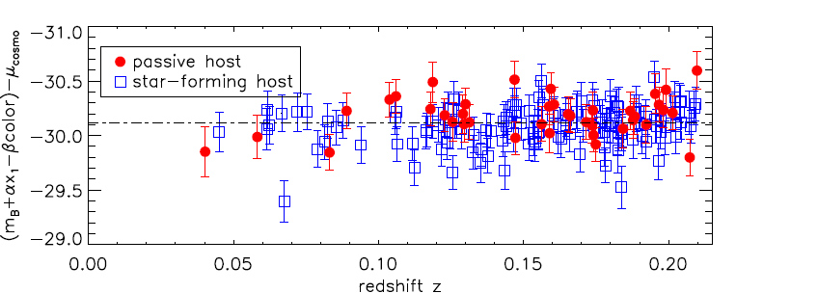
Connection with Host properties
(Sullivan,SNLS 2010)
(Lampeitl,SDSS,2010)
elliptical
spiral
Passive~elliptical~large and old
Higher mass galaxies
Smaller x1 (short time scale)
SN less luminous
Passive, observed mu smaller
more luminous after x1 correction
These effects are at percent level
This correlation is not understood. At present included in systematic
errors. Might suggest 2 families of SNeIa

Slide 25
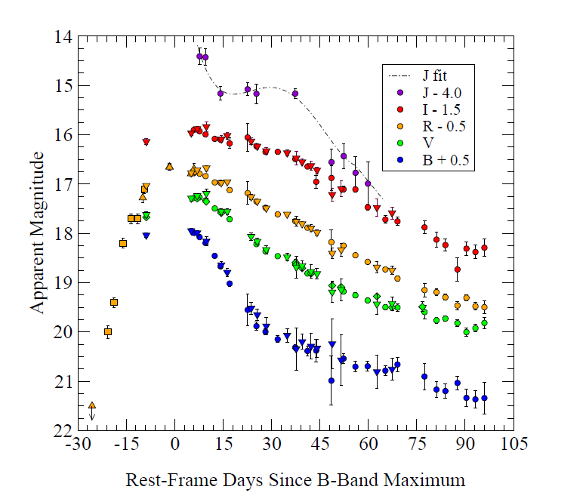
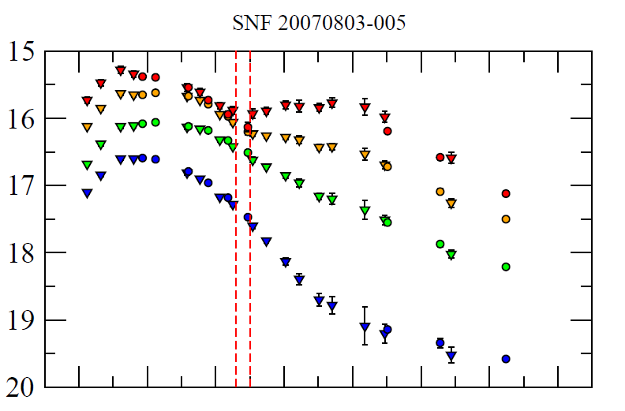
Outliers/SuperChandrasekhar SNe Ia a different binary progenitor?
(R Scalzo et al.,SNfactory2010, 2012)
SN2007if
B luminosity higher than 2.5xNormal

Slide 26
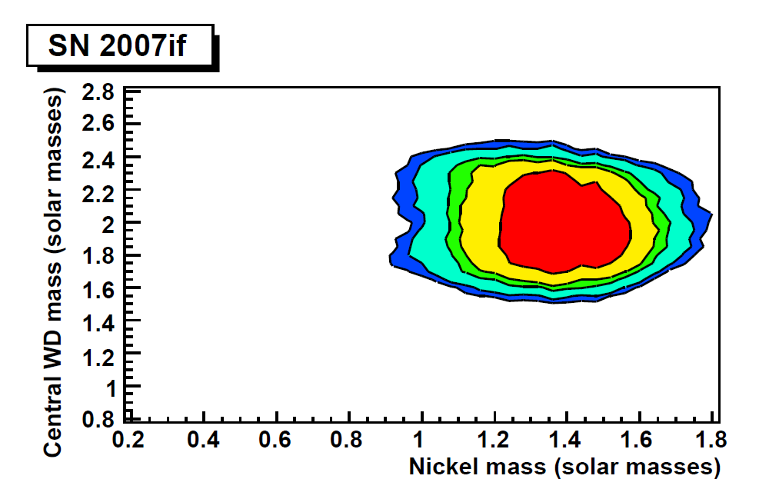
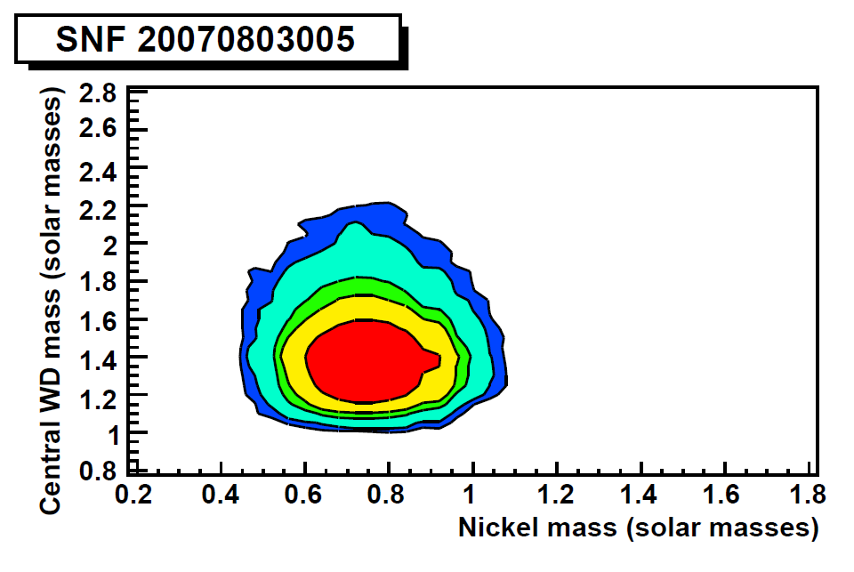
Super Chandrasekhar SNe Ia
(R. Scalzo et al. SNfactory,2012)
Simplified mass analysis from Luminosity, Light curve, and velocities
Is there a continuum from SuperChandra to standard SNeIa ?
Can only be monitored with spectra

Slide 27
Conclusion
SN Ia measurement of cosmological parameters = pure geometry
systematics: calibration, atmosphere, filters+ spectral knowledge
Instrumental contribution NOT the worst: SN Physics
Present data fully compatible with L_{CDM}
Accuracy in photometry limited by spectral uncertainties
at the 1-2% level (random /correlated)
Systematic accuracy also limited by evolution effects
(host galaxy correlation observed). Not yet controlled
to required accuracy for progress, nor understood
A better understanding of SNe Ia is needed.
(models + spectral data) + improved algorithms (> 2 parameters
standardisation).
Infrared observations will give improved handle, but difficult from
ground
Future: DES (now), LSST (2020?), EUCLID (2026?)
will help to constrain residual curvature W_{k} , w, etc…

Slide 28
Back up

Slide 29
Effect is ~20-25% from flat ,empty universe

