Slide 1



Effects of dynamical neutrino asymmetries for eV sterile neutrino production in the Early Universe
Lyon
22-24 October, 2012
Neutrinos at the forefront of
elementary particle physics and astrophysics
Ninetta Saviano
II Institut für Theoretische Physik, Universität Hamburg,
Dipartimento di Scienze Fisiche, Università di Napoli Federico II
Based on : A. Mirizzi, N.S., G. Miele, P.D. Serpico; PRD 86, 053009 (2012)

Slide 2
Experimental anomalies & sterile ν interpretation
Experimental data in tension with the standard 3ν scenario:
ν_{e} appearance signals
ν_{e} and ν_{e} disappearance signals
excess of ν_{e} originated by initial ν_{μ} : LSND/ MiniBooNE
(but no ν_{e} excess signal from ν_{μ} → ν_{e})
A. Aguilar et al., 2001
A. Aguilar et al., 2010
deficit in the ν_{e} fluxes from nuclear reactors (at short distance)
reduced solar ν_{e} event rate in Gallium experiments
Mention et al.2011
Acero, Giunti and Lavder, 2008
All these anomalies, if interpreted as oscillation signals, point towards the possible existence of 1 (or more) sterile neutrino with Δm² ~ O (eV²) and θ_{s}~ O (0.1)
Many analysis have been performed → 3+1, 3+2 schemes
Kopp, Maltoni & Schwetz 2011
Giunti and Laveder, 2012
Abazajian et al., 2012 (white paper)
Schwetz’s talk
for update fit see Giunti et al., 2012
Neutrinos at the forefront, 24 Oct 2012
Ninetta Saviano

Slide 3
Extra radiation
Sterile neutrinos can be produced via oscillations with active neutrinos in Early Universe
→ possible contribution to extra degrees of freedom ΔN
Mangano et al. 2005
non-e.m. energy density
Extra d.o.f. rebound on the cosmological observables :
BBN (through the expansion rate H and the direct effect of ν_{e} and ν_{e} on the n-p reactions)
CMB & LSS (sound horizon, anisotropic stress, equality redshift, damping tail)
Neutrinos at the forefront, 24 Oct 2012
Ninetta Saviano

Slide 4
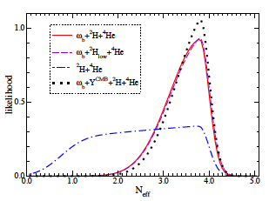
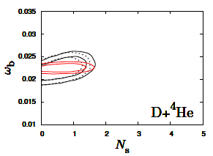


Cosmological hints for extra radiation
Current precision cosmological data show a preference for extra relativistic d.o.f :
BBN (standard) (T~1- 0.01 MeV)
Light element abundances are sensitive to an excess of relativistic energy density→
bound on N_{eff} from constrains on primordial yields of D and ⁴He
Mangano and Serpico, 2011
Hamman et al., 2011
(at 95% C.L)
with only a small significance preference for N^{eff} > stand.value
Mangano and Serpico, 2011
Hamman et al., 2011
Pettini and Cooke, 2012
ΔN_{eff} > 0 not favored by BBN alone
Neutrinos at the forefront, 24 Oct 2012
Ninetta Saviano

Slide 5
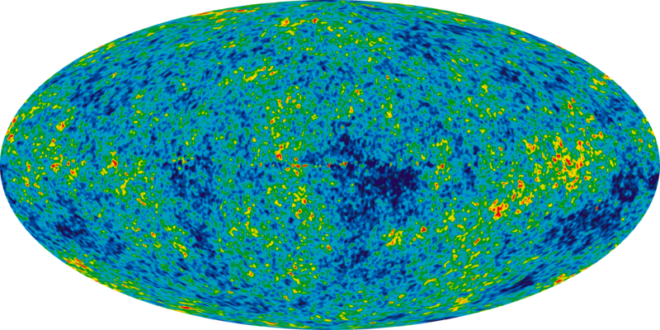
Cosmological hints for extra radiation
Current precision cosmological data show a preference for extra relativistic d.o.f :
CMB (T~1 eV)
Extra radiation impacts
the CMB anisotropies
Neutrinos at the forefront, 24 Oct 2012
Ninetta Saviano

Slide 6
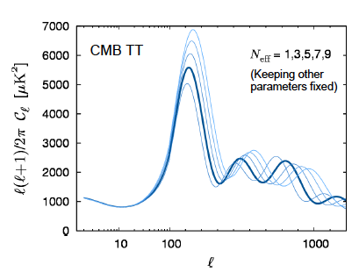
Cosmological hints for extra radiation
Current precision cosmological data show a preference for extra relativistic d.o.f :
CMB (T~1 eV)
Extra radiation impacts
the CMB anisotropies
N_{eff} from the
CMB Spectrum
Adapted from Y.YY Wong
CMB Spectrum for different N_{eff}
Neutrinos at the forefront, 24 Oct 2012
Ninetta Saviano

Slide 7

Cosmological hints for extra radiation
Current precision cosmological data show a preference for extra relativistic d.o.f :
CMB (T~1 eV)
Extra radiation impacts
the CMB anisotropies
N_{eff} from the
CMB Spectrum
Adapted from Y.YY Wong
CMB Spectrum for different N_{eff}
Same data used to measure
other cosmological parameters :
→ degeneracies
Neutrinos at the forefront, 24 Oct 2012
Ninetta Saviano

Slide 8
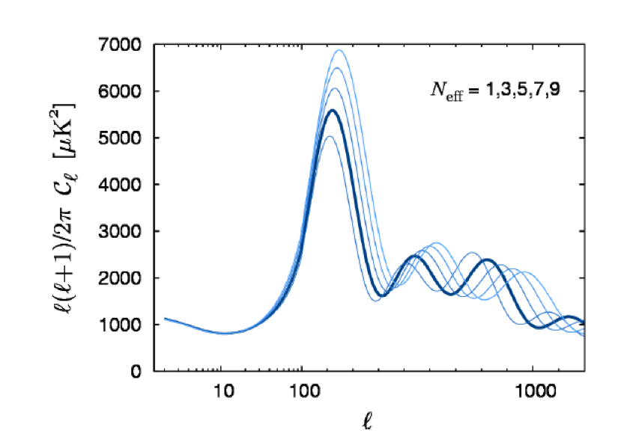
Neff effects on the CMB
Matter-radiation
equality
Sound horizon/angular positions of the peaks
degenerate with Ω_{mt}
degenerate with
Ω_{m}
Anisotropic stress
(partially) degenerate
with A_{s} and n_{s}
Damping tail
degenerate with Y_{p}
Neutrinos at the forefront, 24 Oct 2012
Ninetta Saviano

Slide 9
Neff effects on the CMB
Matter-radiation
equality
Sound horizon/angular positions of the peaks
degenerate with Ω_{m} and h
degenerate with
Ω_{m}
Anisotropic stress
(partially) degenerate
with A_{s} and n_{s}
Damping tail
degenerate with Y_{p}
Neutrinos at the forefront, 24 Oct 2012
Ninetta Saviano

Slide 10
Neff effects on the CMB
Matter-radiation
equality
Sound horizon/angular positions of the peaks
degenerate with Ω_{m} and h
degenerate with
Ω_{m}
Anisotropic stress
(partially) degenerate
with A_{s} and n_{s}
Damping tail
degenerate with Y_{p}
Neutrinos at the forefront, 24 Oct 2012
Ninetta Saviano

Slide 11
Neff effects on the CMB
Matter-radiation
equality
Sound horizon/angular positions of the peaks
degenerate with Ω_{m} and h
degenerate with
Ω_{m}
Anisotropic stress
(partially) degenerate
with A_{s} and n_{s}
Damping tail
degenerate with Y_{p}
Neutrinos at the forefront, 24 Oct 2012
Ninetta Saviano

Slide 12
Neff effects on the CMB
Matter-radiation
equality
Sound horizon/angular positions of the peaks
degenerate with Ω_{m} and h
degenerate with
Ω_{m}
Planck sensitivity to N_{eff}: σ_{Neff} ≈ 0.2-0.3
Anisotropic stress
(partially) degenerate
with A_{s} and n_{s}
Damping tail
degenerate with Y_{p}
Neutrinos at the forefront, 24 Oct 2012
Ninetta Saviano

Slide 13
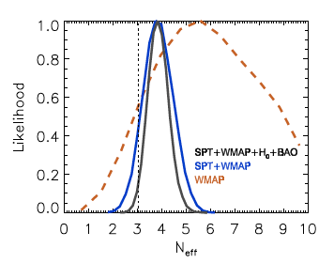
Cosmological hints for extra radiation
Current precision cosmological data show a preference for extra relativistic d.o.f :
CMB & LSS →
(at 98% C.L for ΛCDM + Neff)
Many models → central value N_{eff} ~ 4
WMAP7+ACT+ACBAR+H0+BAO
Exact values depend on the cosmological model and on the combination of data used
Keisler et al.2011
Hou, Keisler, Knox, et al. 2012
Neutrinos at the forefront, 24 Oct 2012
Ninetta Saviano

Slide 14
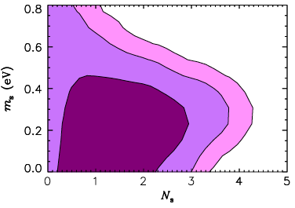
Extra radiation vs lab ν_{s}
The mass and mixing parameters preferred by experimental anomalies lead to the production and thermalization of ν_{s} (i.e., ΔN = 1, 2) in the Early Universe via ν_{a}-ν_{s} oscillations + ν_{a} scatterings
Barbieri & Dolgov 1990, 1991
Di Bari, 2002
Melchiorri et al 2009
Problem:
not easy to link the extra radiation with the lab-sterile ν in the simplest scenarios:
– 3+2: Too many for BBN (3+1 minimally accepted)
– 3+1, 3+2: Too heavy for CMB/LSS → m_{s} < 0.48 eV (at 95% C.L)
Hamman et al., 2010
versus lab best-fit m_{s} ~ 1 eV
Neutrinos at the forefront, 24 Oct 2012
Ninetta Saviano

Slide 15
It is possible to find an escape route to reconcile sterile ν’s with cosmology?
Neutrinos at the forefront, 24 Oct 2012
Ninetta Saviano

Slide 16
A possible answer: primordial neutrino asymmetry
Foot and Volkas, 1995
Suppress the thermalization of sterile neutrinos (Effective ν_{a}-ν_{s} mixing reduced by a large matter term L)
Introducing
Caveat : L can also generate MSW-like resonant flavor conversions among active
and sterile neutrinos enhancing their production
A lot of work has been done in this direction…..
Enqvist et al., 1990, 1991,1992; Foot, Thomson & Volkas, 1995;Bell, Volkas & Wong, 1998; Dolgov, Hansen, Pastor & Semikoz, 1999;Di Bari & Foot, 2000; Di Bari, Lipari and lusignoli , 2000;Kirilova & Chizhov, 2000; Di Bari, Foot, Volkas & Wong, 2001; Dolvgov & Villante, 2003; Abazajian, Bell, Fuller, Wong, 2005; Kishimoto, Fuller, Smith, 2006; Chu & Cirelli, 2006; Abazajian & Agrawal, 2008;
In a simplified scenario, L~10⁻⁴ was found to be enough in order to have a significant reduction of the sterile neutrino abundance
Chu & Cirelli, 2006
Neutrinos at the forefront, 24 Oct 2012
Ninetta Saviano

Slide 17
2 recent complementary papers on thermalization of ν_{s}
Hannestad, Tamborra and Tram, 2012
Mirizzi, N.S., Miele and Serpico 2012
1+1, “multi-momenta”
3+1, 2+1, “average momentum approx.”
Advantages
possibility to scan a broad range of
ν_{s} mass-mixing parameters
realistic account of the ν-ν coupling
opportunity to explore several scenarios
and effects:
- different and opposite asymmetries
- CP violation
Disadvantage
very simplified scenario: Not possible to
incorporate effects due to the mixing
of the ν_{s} with different ν_{a}
multi-momentum features (e.g. distortions
of the ν distributions) cannot be revealed
Neutrinos at the forefront, 24 Oct 2012
Ninetta Saviano

Slide 18

Equations of Motion
Describe the ν ensemble in terms of 4x4 density matrix
introduce the dimensionless variables with m = 1 eV,
a= scale factor, a(t)→1/T
denote the time derivative , with H the Hubble parameter
restrict to an “average momentum” approx. , based on
The EoM become
Sigl and Raffelt 1993;
McKellar & Thomson, 1994
Dolgov et al., 2002.
Gava and Volpe 2010
Neutrinos at the forefront, 24 Oct 2012
Ninetta Saviano

Slide 19
Equations of Motion
Describe the ν ensemble in terms of 4x4 density matrix
introduce the dimensionless variables with m = 1 eV,
a= scale factor, a(t)→1/T
denote the time derivative , with H the Hubble parameter
restrict to an “average momentum” approx. , based on
The EoM become
Vacuum term
with M neutrino mass matrix
U⁺ M² U
Sigl and Raffelt 1993;
McKellar & Thomson, 1994
Dolgov et al., 2002.
Gava and Volpe 2010
Neutrinos at the forefront, 24 Oct 2012
Ninetta Saviano

Slide 20
Equations of Motion
Describe the ν ensemble in terms of 4x4 density matrix
introduce the dimensionless variables with m = 1 eV,
a= scale factor, a(t)→1/T
denote the time derivative , with H the Hubble parameter
restrict to an “average momentum” approx. , based on
The EoM become
“symmetric” matter effect
(2th order term)
Sigl and Raffelt 1993;
McKellar & Thomson, 1994
Dolgov et al., 2002.
Gava and Volpe 2010
Neutrinos at the forefront, 24 Oct 2012
Ninetta Saviano

Slide 21
Equations of Motion
Describe the ν ensemble in terms of 4x4 density matrix
introduce the dimensionless variables with m = 1 eV,
a= scale factor, a(t)→1/T
denote the time derivative , with H the Hubble parameter
restrict to an “average momentum” approx. , based on
The EoM become
ν−ν term
    non-linear term
given by to the symmetric and
asymmetric terms
Sigl and Raffelt 1993;
McKellar & Thomson, 1994
Dolgov et al., 2002.
Gava and Volpe 2010
Neutrinos at the forefront, 24 Oct 2012
Ninetta Saviano

Slide 22
Equations of Motion
Describe the ν ensemble in terms of 4x4 density matrix
introduce the dimensionless variables with m = 1 eV,
a= scale factor, a(t)→1/T
denote the time derivative , with H the Hubble parameter
restrict to an “average momentum” approx. , based on
The EoM become
Sigl and Raffelt 1993;
McKellar & Thomson, 1994
Dolgov et al., 2002.
Gava and Volpe 2010
symmetric term
Neutrinos at the forefront, 24 Oct 2012
Ninetta Saviano

Slide 23
Equations of Motion
Describe the ν ensemble in terms of 4x4 density matrix
introduce the dimensionless variables with m = 1 eV,
a= scale factor, a(t)→1/T
denote the time derivative , with H the Hubble parameter
restrict to an “average momentum” approx. , based on
The EoM become
asymmetric term
Sigl and Raffelt 1993;
McKellar & Thomson, 1994
Dolgov et al., 2002.
Gava and Volpe 2010
Neutrinos at the forefront, 24 Oct 2012
Ninetta Saviano

Slide 24
Equations of Motion
Describe the ν ensemble in terms of 4x4 density matrix
introduce the dimensionless variables with m = 1 eV,
a= scale factor, a(t)→1/T
denote the time derivative , with H the Hubble parameter
restrict to an “average momentum” approx. , based on
The EoM become
Sigl and Raffelt 1993;
McKellar & Thomson, 1994
Dolgov et al., 2002.
Gava and Volpe 2010
Collisional term
Neutrinos at the forefront, 24 Oct 2012
Ninetta Saviano

Slide 25
Equations of Motion
Describe the ν ensemble in terms of 4x4 density matrix
introduce the dimensionless variables with m = 1 eV,
a= scale factor, a(t)→1/T
denote the time derivative , with H the Hubble parameter
restrict to an “average momentum” approx. , based on
The EoM become
Neutrinos at the forefront, 24 Oct 2012
Ninetta Saviano

Slide 26
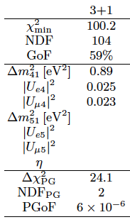
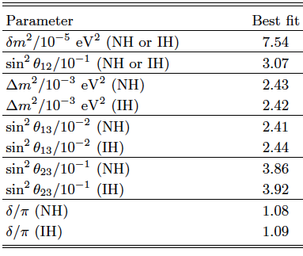
Vacuum term
Best-fit values of the mixing parameters in 3+1 fits of short-baseline oscil. data.
Global 3 ν oscillation analysis, in terms of best-fit values
Fogli et al., 2012
Giunti and Laveder, 2011
Neutrinos at the forefront, 24 Oct 2012
Ninetta Saviano

Slide 27
Matter term
ν
ν
MSW effect with ordinary background medium
(refractive effect)
W
l
l
Second order term
In the Early Universe the charged lepton asymmetry is subleading (O(10⁻⁹))→
the first order matter effect (ρ₋ - ρ₊) does not dominate at MeV temperature.
Moreover, at these temperatures, we consider only electrons and positrons background.
ν
ν
ν background medium
ν-ν interaction term
(Pantaleone 1992)
ν
ν
Off- diagonal refractive terms
→ non-linearity
in 3+1 scheme
Neutrinos at the forefront, 24 Oct 2012
Ninetta Saviano

Slide 28
Collisional term
Non- forward scattering and annihilation processes
ν
e⁺
ν
ν
e⁻ ⁽⁺⁾
e⁻ ⁽⁺⁾
ν
e⁻
( )
( )
ν
ν
ν
ν
where and
Neutrinos at the forefront, 24 Oct 2012
Ninetta Saviano

Slide 29
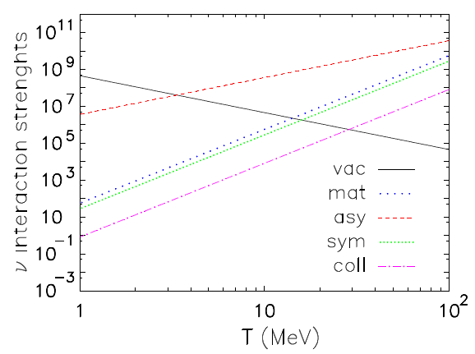
Strength of the different interactions
Mirizzi, N.S., Miele, Serpico 2012
L = -10⁻⁴
kept constant
Neutrinos at the forefront, 24 Oct 2012
Ninetta Saviano

Slide 30
Strength of the different interactions
Mirizzi, N.S., Miele, Serpico 2012
Resonance
V_{asy} ≈ V_{vac}
L = -10⁻⁴
kept constant
MSW effect on ν-ν asymmetric interaction term (V_{asy})
For L < 0 → resonance occurs in the anti– ν channel
For L > 0 → resonance occurs in the ν channel
Due to it’s dynamical nature , L changes sign → resonances in both ν and ν channels
Neutrinos at the forefront, 24 Oct 2012
Ninetta Saviano

Slide 31
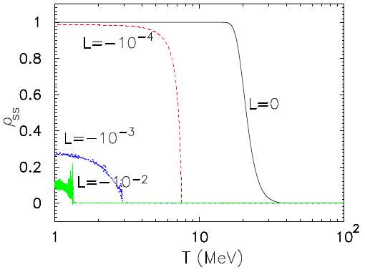
3 + 1 Scenario
Mirizzi, N.S., Miele, Serpico 2012
L = 0 ν_{s} copiously produced at T ≤ 30MeV (not resonantly)
L≠ 0 ν_{s} are produced “resonantly” when V_{asy} ≈ V_{vac}
Increasing L, the position of the resonance shifts towards lower T → less adiabatic resonance → ν_{s} production less efficient (Adiabaticity parameter scales as T)
Di Bari and Foot 2002
Neutrinos at the forefront, 24 Oct 2012
Ninetta Saviano

Slide 32
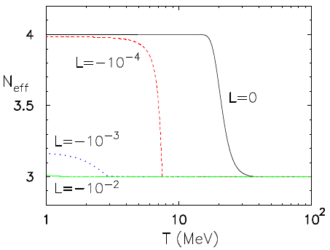
Consequences on N_{eff}
Mirizzi, N.S., Miele, Serpico 2012
|L| ≤10⁻⁴, ν_{s} fully populated and the ν_{a} repopulated by collisions →N_{eff} ~ 4 → tension with cosmological mass bounds (and with BBN data)
|L| =10⁻³, ν_{s} produced close to ν-decoupling (T_{d} ~2-3 MeV) where ν_{a} less repopulated →
effect on N_{eff} less prominent. If ΔN_{eff} > 0.2 it will be detected by Planck (public data release expected early 2013).
L > 10⁻², no repopulation of ν_{a}
→negligible effect on N_{eff} even if ν_{s} slightly
produced.
Possible future extra-radiation should be
explained by some other physics (hidden
photons, sub-eV thermal axions etc.?)
Neutrinos at the forefront, 24 Oct 2012
Ninetta Saviano

Slide 33
Consequences on N_{eff}
Mirizzi, N.S., Miele, Serpico 2012
|L| ≤10⁻⁴, ν_{s} fully populated and the ν_{a} repopulated by collisions →N_{eff} ~ 4 → tension with cosmological mass bounds (and with BBN data)
|L| =10⁻³, ν_{s} produced close to ν-decoupling (T_{d} ~2-3 MeV) where ν_{a} less repopulated →
effect on N_{eff} less prominent. If ΔN_{eff} > 0.2 it will be detected by Planck (public data release expected early 2013).
L > 10⁻², no repopulation of ν_{a}
→negligible effect on N_{eff} even if ν_{s} slightly
produced.
Possible future extra-radiation should be
explained by some other physics (hidden
photons, sub-eV thermal axions etc.?)
Attention:
The lack of repopulation of ν_{e} would produce distorted distributions, which can anticipate the n/p freeze-out and hence increase the ⁴He yield → Possible impact on the BBN (Multi-momentum treatment necessary!)
Neutrinos at the forefront, 24 Oct 2012
Ninetta Saviano

Slide 34
Qualitative estimate of the effects on BBN
The freeze out temperature T_{F} of the weak interactions is defined by the condition:
N_{eff} H T_{F}
Neutrinos at the forefront, 24 Oct 2012
Ninetta Saviano
Notes:
The additional
radiation energy density contributed by the sterile neutrinos increases the expansion rate
at BBN, leading to a higher freeze-out temperature Tf . As a consequence, the equilibrium
neutron-to-proton ratio n=p = exp(􀀀m=T), where m is the neutron-proton mass dierence,
is larger at neutron freeze-out. The resulting Yp is larger because almost all neutrons
end up in 4He. Similarly, a larger neutron lifetime also increases the expected Yp. the deuterium abundance constrains
mainly the baryon density, whereas constraints on Ns are mostly driven by the helium data.
However, once we impose the CMB+LSS prior on !b, even the deuterium data alone significantly
constrain Ns. This constraint is of interest in view of the helium data already being
systematics-limited.

Slide 35


Qualitative estimate of the effects on BBN
The freeze out temperature T_{F} of the weak interactions is defined by the condition:
N_{eff} H T_{F}
Dolgov and Villante, 2002
Neutrinos at the forefront, 24 Oct 2012
Ninetta Saviano
Notes:
The additional
radiation energy density contributed by the sterile neutrinos increases the expansion rate
at BBN, leading to a higher freeze-out temperature Tf . As a consequence, the equilibrium
neutron-to-proton ratio n=p = exp(􀀀m=T), where m is the neutron-proton mass dierence,
is larger at neutron freeze-out. The resulting Yp is larger because almost all neutrons
end up in 4He. Similarly, a larger neutron lifetime also increases the expected Yp. the deuterium abundance constrains
mainly the baryon density, whereas constraints on Ns are mostly driven by the helium data.
However, once we impose the CMB+LSS prior on !b, even the deuterium data alone significantly
constrain Ns. This constraint is of interest in view of the helium data already being
systematics-limited.

Slide 36
Qualitative estimate of the effects on BBN
Mirizzi, N.S., Miele, Serpico 2012
Dolgov and Villante, 2002
L=0 : δN_{eff} =1 and δρ_{ee}= 0 → variation in ⁴He of ~ 4%
barely allowed
L=|10|⁻² : δN_{eff} ~ 0 and δρ_{ee}= -5% → variation in ⁴He of ~ 1%
Possible large
effects on BBN
→multi-momentum
mandatory
L=|10|⁻³ : δN_{eff} ~ 1% and δρ_{ee} ~ 1% → variation in ⁴He of ~ 2%
Neutrinos at the forefront, 24 Oct 2012
Ninetta Saviano

Slide 37
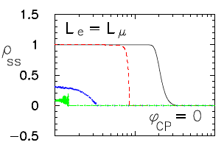
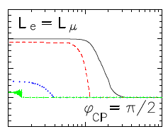
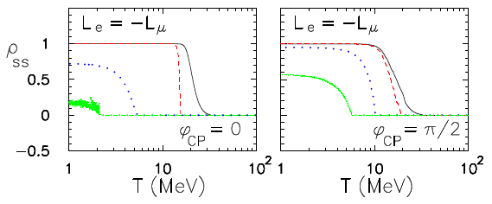
2 + 1 Scenario
Mirizzi, N.S., Miele, Serpico 2012
L = 0
L = -10⁻⁴
L = -10⁻³
L = -10⁻²
L~10⁻³ conservative limit → Suppression crucially depends on the scenario considered
Neutrinos at the forefront, 24 Oct 2012
Ninetta Saviano

Slide 38
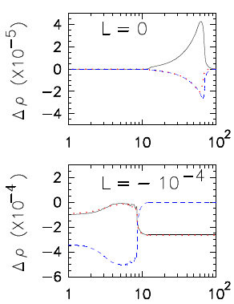
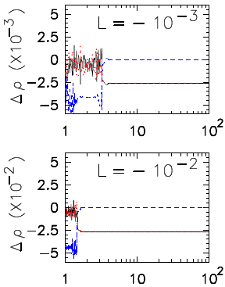
Neutrino asymmetry evolution
(2+1) with L=L_{e}=L_{μ} and φ_{cp} = 0
Δρ L
Mirizzi, N.S., Miele, Serpico 2012
ν_{e}
ν_{μ}
ν_{s}
Neutrinos at the forefront, 24 Oct 2012
Ninetta Saviano

Slide 39
Conclusions
Current precision cosmological data show a preference for extra relativistic degrees of freedom (beyond 3 active neutrinos).
ν_{s} interpretation of lab neutrino anomalies does not quite fit into the simplest picture. Necessary to suppress the sterile neutrino production in the Early Universe.
A possibility to reconcile cosmological and laboratory data would be the introduction of
a neutrino asymmetry.
Solving the non-linear EOM for ν_{a}-ν_{s} oscillations in a 3+1 scenario, we find that L >10⁻³ necessary to suppress the sterile neutrino production.
(Suppression crucially depends on the scenario considered).
However, L> 10⁻³ could leave a significant imprint on BBN trough the depletion of ν_{e} and ν_{e}
(multi-momentum treatment of the EOM necessary)
Neutrinos at the forefront, 24 Oct 2012
Ninetta Saviano

Slide 40
Conclusions
Current precision cosmological data show a preference for extra relativistic degrees of freedom (beyond 3 active neutrinos).
ν_{s} interpretation of lab neutrino anomalies does not quite fit into the simplest picture. Necessary to suppress the sterile neutrino production in the Early Universe.
A possibility to reconcile cosmological and laboratory data would be the introduction of
a neutrino asymmetry.
Solving the non-linear EOM for ν_{a}-ν_{s} oscillations in a 3+1 scenario, we find that L >10⁻³ necessary to suppress the sterile neutrino production.
(Suppression crucially depends on the scenario considered).
However, L> 10⁻³ could leave a significant imprint on BBN trough the depletion of ν_{e} and ν_{e}
(multi-momentum treatment of the EOM necessary)
Not too easy to mask sterile neutrinos in cosmology!
Neutrinos at the forefront, 24 Oct 2012
Ninetta Saviano

Slide 41
Thank you

Slide 42
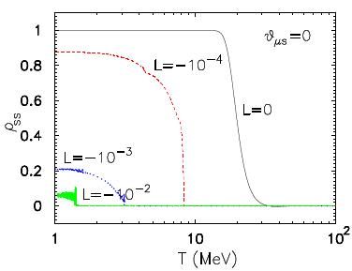


Slide 43
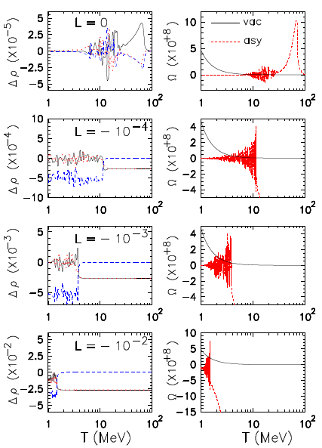



Slide 44
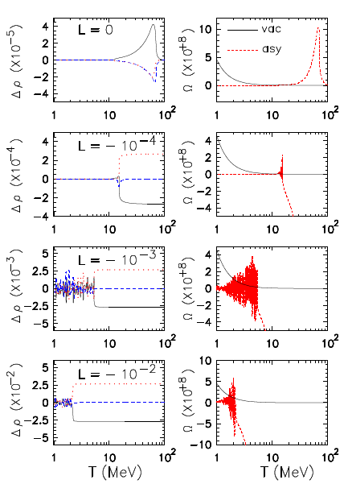



Slide 45
