Slide 1
Neutrinos at the forefront of elementary particle physics and astrophysics
October 22, 2012
Notes:
On m’a dit un jour, le GDR c’est bien ça permet de faire causer les jeunes…alors un grand merci aux organisateurs
When GDR was created, I asked organizers what is the use of it. The answer was : it allows young physicists to speak in public and become known. So I want to thant the present organisers : I feel younger

Slide 2
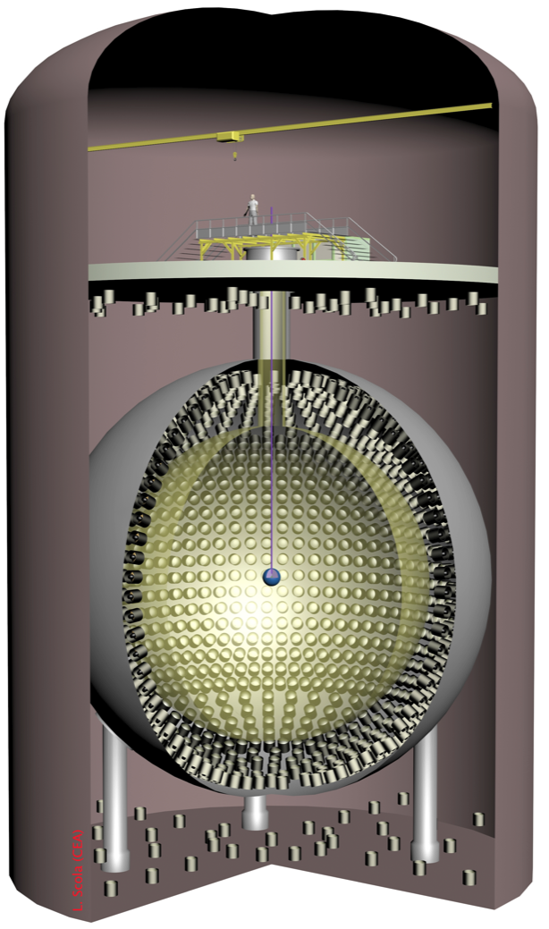
Searches for sterile neutrinos
Neutrinos at the forefront of elementary particle physics and astrophysics, October 22, 2012
Michel Cribier
CEA/DSM Irfu/SPP & APC-Paris
Notes:
CeLAND : Cerium in LArge Neutrino Detector
Everything is on this 1st slide and I could stop here or you can start sleeping, but

Slide 3
Need ?
Need a fourth neutrino ?

Slide 4
The Reactor Antineutrino Anomaly
G. Mention et al. Phys. Rev. D83, 073006 (2011)
New antineutrino flux from nuclear reactors : + 3,5 %
Th. Mueller et al. Phys. Rev C 83, 054615 (2011)
Neutron lifetime ➴ … …Cross section ➶ : + 1%
Long lived isotopes in reactors : + 1%
An overall deficit : 7.3 ± 2.3 %

Slide 5
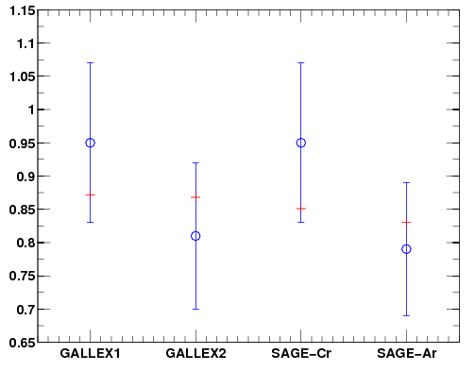
The Gallium Anomaly
C. Giunti & M. Laveder Phys. Rev C 83, 065504 (2011)
Calibration of solar neutrino experiments
Distance <≈ 1 m
Gallex
2 ⁵¹Cr ν sources
Sage
1 ⁵¹Cr ν source
1 ³⁷Ar ν source
Overall deficit : 14 ± 6 %*
data
Measured / predicted
Best fit
Not using reevaluation of ⁷¹Ga(ν_{e},e)⁷¹Ge cross section
following D.Frekers et al. Phys. Lett. B 706 (2011) 134

Slide 6
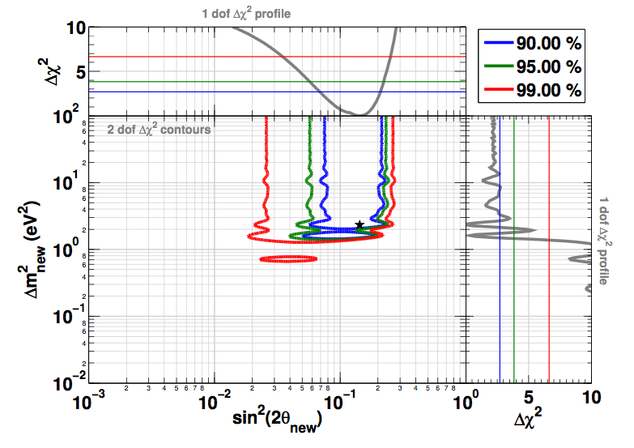
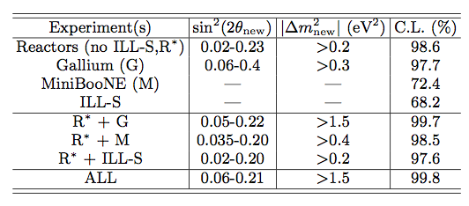
Reactors and Gallium
allowed
excluded
area
Best values
1.5 eV² < Δm² < 3.0 eV²
sin²(2θ) = .14±.08
The no-oscillation hypothesis is disfavored at 99.8% CL
Notes:
Global fit prenant en comptes toutes les corrélations entre expériences

Slide 7
An intriguing result 1st ILL experiment
Performed in 1980 at ILL reactor in Grenoble @ < 9 m
Reevaluation in 1990 by 9.5 % of the reactor power
Reanalysed in 1995
Fit with
Δm² = 2.3 eV²
sin²(2θ) = .24

Slide 8
We need new experimental input !
Need experiences at short distance ≈ few meters
Notes:
Et un lieu de production des antineutrinos beaucoup moins étendu que les longueurs d’oscillation attendues sinon on délave tout

Slide 9
Many experimental projects
Sources | Reactors | Beams
CeLAND ¹⁴⁴Ce 75 kCi@ KamLAND funded | Nucifer 7 m from Osiris reactor Data taking | IsoDAR Cycloton to produce ⁸Li arXiv:1205.4419
Borexino ⁵¹Cr > 5 MCi & ¹⁴⁴Ce funded | Stereo 8m @ ILL | OscSNS New « Karmen type » exp. arXiv:0810.3175
Baksan ⁵¹Cr 3 MCi unlikely funded | Mars 8m @ ILL | MicroBoone
SNO+ / LENS ⁵¹Cr 10 MCi R & D | Scraam, Neutrino-4, DANNS, Poseidon | Icarus/Nessie 2 liq. Ar detec @ CERN
Katrin ^{3He} ^{in construction}

Slide 10
Good test ?
Some of the proposed experiments

Slide 11
The Daya Bay proposal
D. Dwyer et al. arXiv:1109.6036
Based on our PRL paper
500 kCi ¹⁴⁴Ce-¹⁴⁴Pr source in the Daya Bay FD pool
Realisation ?
no fuel reprocessing in the US
activity impossible to reach in Russia

Slide 12
⁵¹Cr
Used in Gallex & Sage
Calibration solar ν experiments
Need enriched Cr in ⁵⁰Cr
Irradiation in intense thermal neutron flux
In Russia, Oak-Ridge ?
Mean-life : 40 days
In liquid scintillator detector
Elastic scattering
⁷Be solar ν as bkgd

Slide 13
The Baksan proposal
New Gallium experiment
well known technology
zone 1 : 8 t
zone 2 : 42 t
Source
⁵¹Cr - 3 Mci
50 days irradiation in research reactor SM3
Well known background
Solar neutrinos
Partial sensitivity to the reactor anomaly
arXiv:1006.2103

Slide 14
The Borexino proposal
Significant Effort
Planned experiments
1st ⁵¹Cr > 5 MCi in pit A
Gallex enriched Cr still available in Saclay
Compatible with existing program
2nd ¹⁴⁴Ce in center C
need major work on detector
After end of solar ν program
ERC funding : 3.5 M€

Slide 15
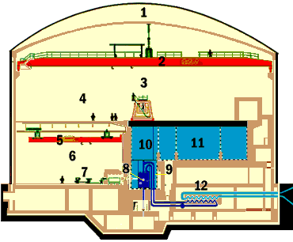
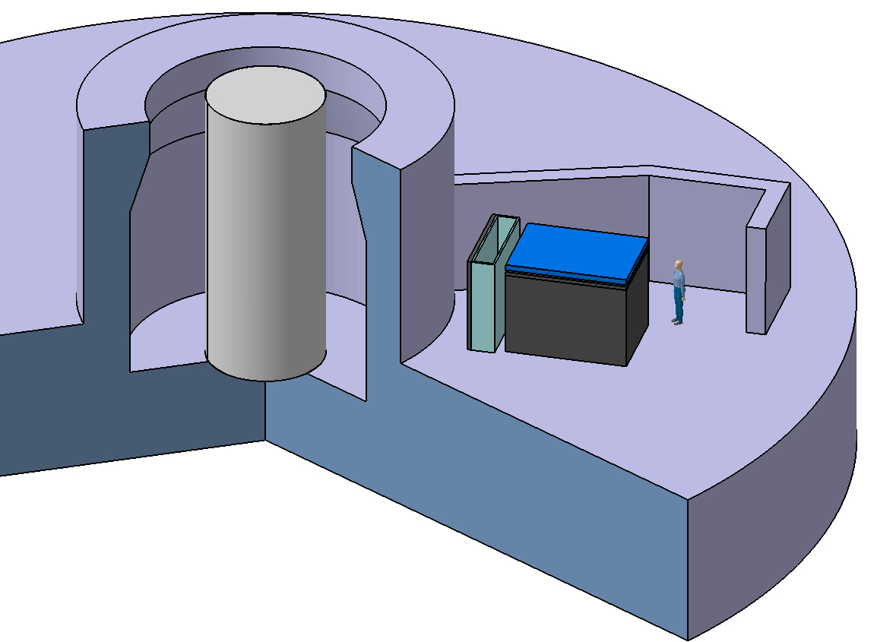
Stereo @ ILL
50 MW compact core (φ=40cm, h=80 cm)
Short baseline = [7-9] m
Pure ²³⁵U spectrum
Core
Large passive and active shielding
15 m.w.e. overburden
Pulse Shape Discrimination
Segmented detector
Front shielding
Stereo Detector in the shadow of front wall

Slide 16
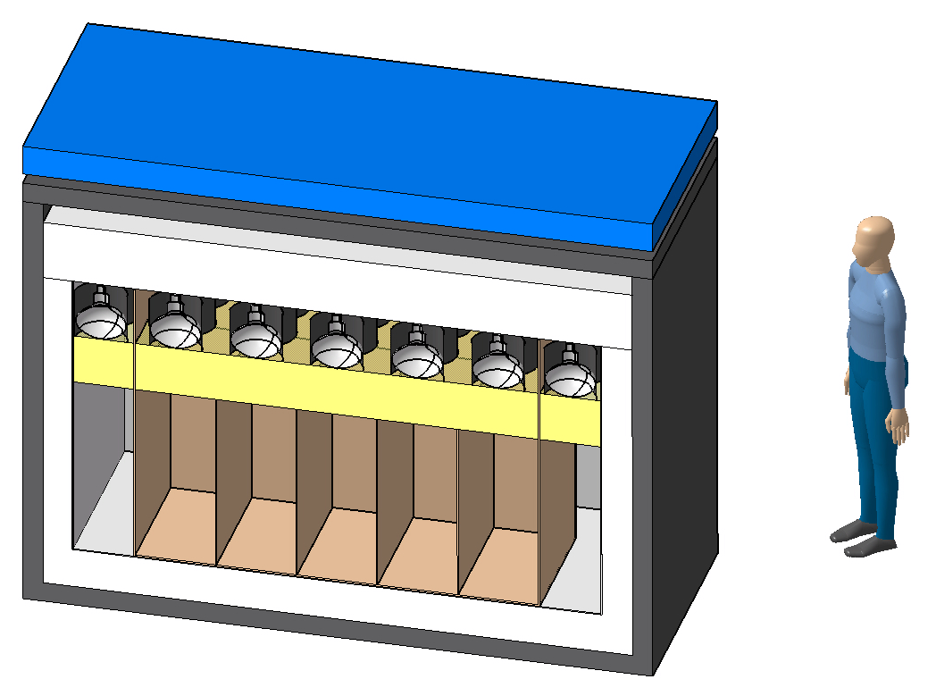
Stereo detector
15 cm Boron doped CH₂
Water Cerenkov μ Veto
10 cm lead
Light readout from top
20 cm acrylic buffer
5 independent cells filled with Gd-doped LS
Crown of 30 cm of LS for leakage reduction + active shielding

Slide 17
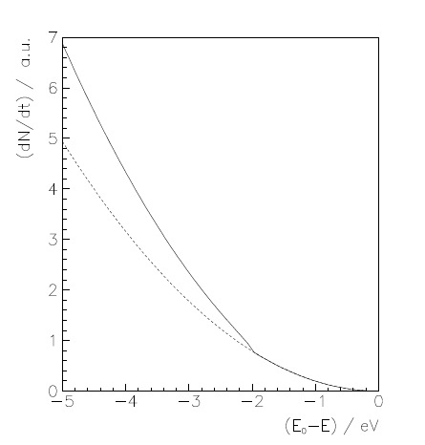
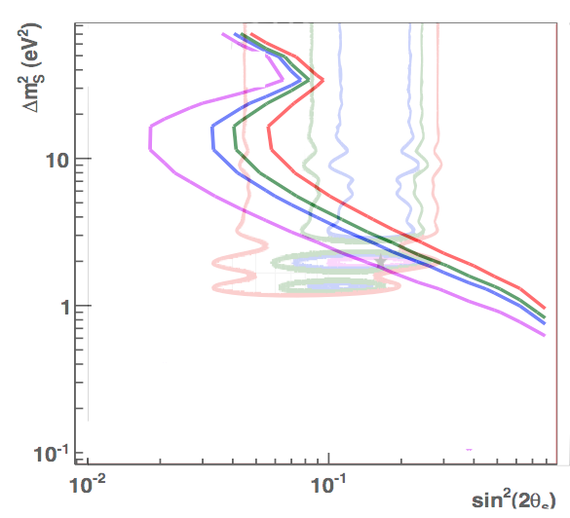
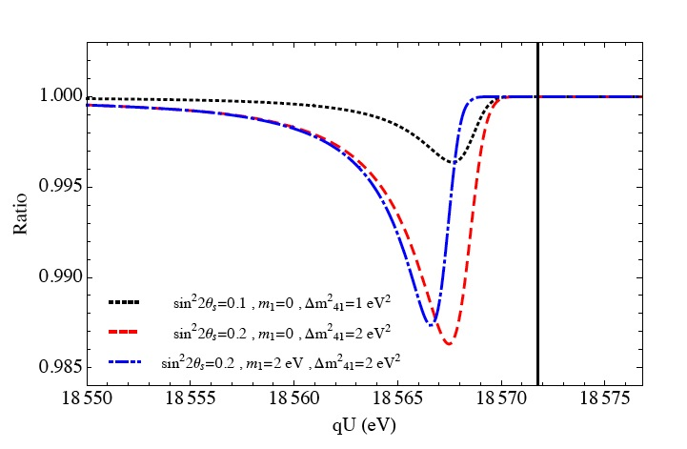
Katrin
a 4th neutrino :
- displacement of end point
95% CL
sensitivity after 3 years

Slide 18
Publication
CeLAND
A proposed search for a fourth neutrino with a PBq anti-neutrino source
M. Cribier, M. Fechner, T. Lasserre, D. Lhuillier, A. Letourneau, G. Mention, D. Franco, S. Schoenert, V. Kornoukhov
Phys. Rev. Lett. 107, 201801 (2011)
Notes:
Less than a year ago we published this proposition
PBq : 10^15 Bq

Slide 19
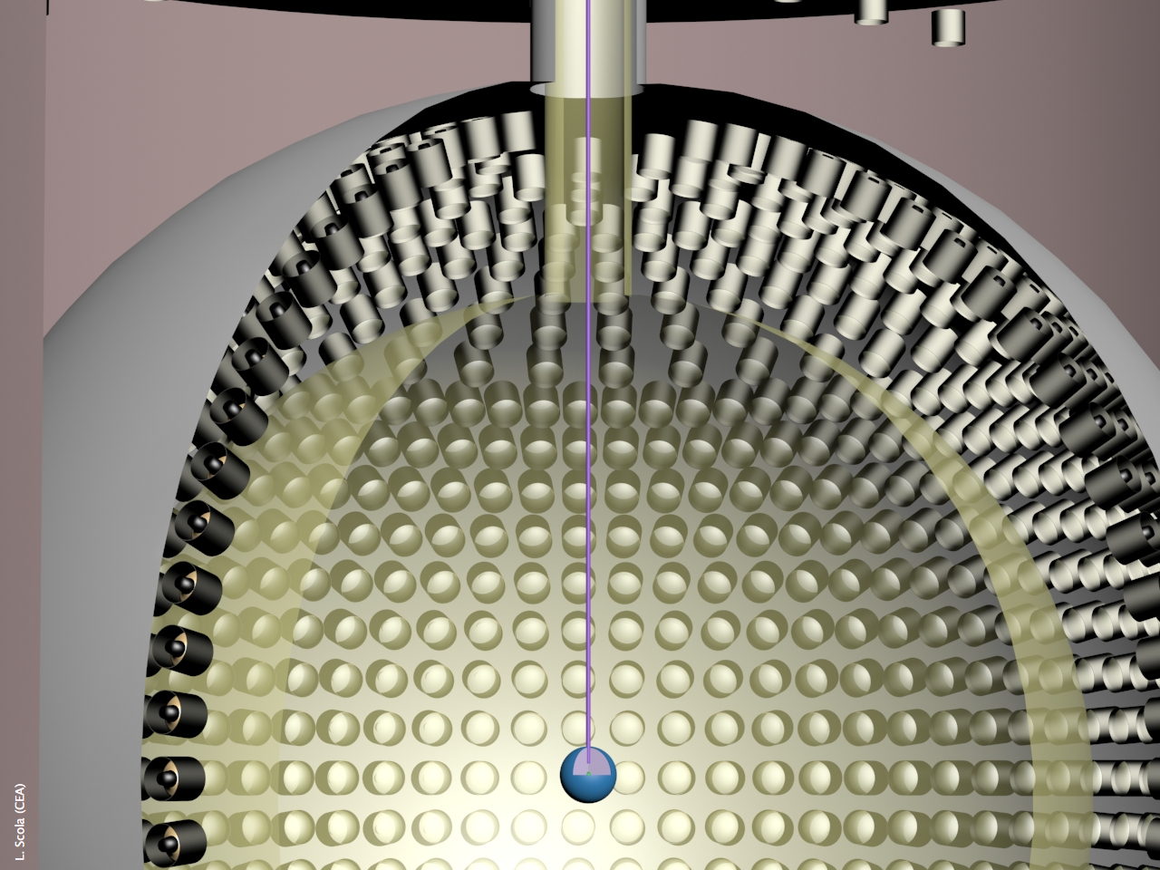
Concept
acrylics/nylon sphere
R=6.5 m
Chimney
Ø = 0.55 m
Suspension
6.5 m
Antineutrino Generator (R=4cm)
& Passive Shielding (R=40 cm)

Slide 20
An Unambiguous Proof
no oscillation
¹⁴⁴Ce (50 kCi – 1 y)
Neutrino Generator
sin²(2θ_{new})=0.1
Detector Center
1 m

Slide 21
Advantages of antineutrinos
Antineutrino detection via inverse beta-decay
High cross section (≈10⁻⁴³ cm²) : from MCi to kCi !
Antineutrino must have E_{ν}>1.8 MeV
Long Lifetime for production, transport and measurement
e⁺-n delayed coincidence : background free experiment
Antineutrino source must involve
a long-lived low-Q nucleus…
… that decays into a short-lived high-Q nucleus
Possible candidates
⁹⁰Sr-⁹⁰Y , ¹⁴⁴Ce-¹⁴⁴Pr , ¹⁰⁶Ru-¹⁰⁶Rb , ⁴²Ar-⁴²K
Easy to produce
Notes:
Une source de neutrino n’interagit que par diffusion élastique et est donc beaucoup plus sensible aux bruits de fonds (radioactivité, neutrinos solaires)

Slide 22
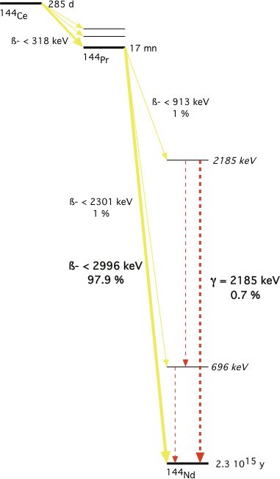
¹⁴⁴Ce-¹⁴⁴Pr
Ce : Cerium
Pr : Praseodymium
Mean life : 411.01 d
50 kCi (1.85 PBq)
16 g of ¹⁴⁴Ce
50 kCi => 382 W
<power>1y = 225 W
7.64 W/kCi
A well identified background
γ @ 2.185 MeV ; BR: 7 ‰
Need a 10⁻¹² reduction
Notes:
The PMTs in KamLAND produce ≈ 1000 W

Slide 23
Good utilisation of antineutrinos
48.75 % of antineutrinos emitted above IBD threshold
useful part of
the spectrum
Inverse Beta Decay Threshold

Slide 24
2-D imprint in E_{ν} ,R space
Notes:
Dépendance en temps connue qui aide à la détermination du fond

Slide 25
Making of
Making an antineutrino generator

Slide 26
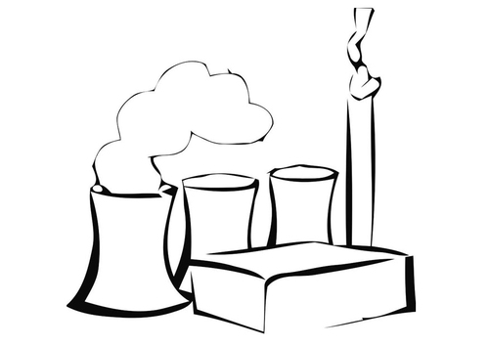
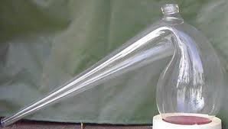
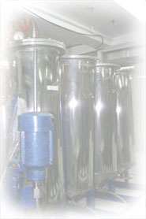
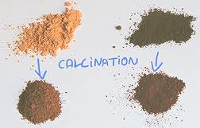
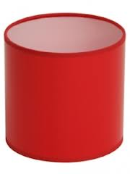
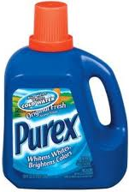
Scheme of production
¹³⁷Cs, precip. REE
« Canyon »
VVR-440, storage
Displacement Chromatography
TUK-6
Pressing
CeO₂ calcination
Cutting, digestion Purex
W-Shield

Slide 27
Cerium an abundant fission product
1 ton of spent fuel
Fission products : 44 kg
Rare earth : 15 kg
Cerium : 4 kg
¹⁴⁴Ce : 22 g ie 80 kCi
Extraction process
Displacement chromatography
French experts tested at lab scale
Need the required industrial capability
La Hague type
Constraint on radioactive impurities

Slide 28
Caracteristics of the antineutrino generator
Cerium is in the chemical form of CeO₂
¹⁴⁴Ce remain mixed with stable Cerium isotope
A powder of apparent density ≈ 2-3 g/cm³
Operations
Mixing of the ≈ 3 kg of powder
Cold or hot pressing to reach ≈ 3-4 g/cm³
In hot cell with remote handling
The ¹⁴⁴Ce-¹⁴⁴Pr antineutrino generator (AνG)
a spherical object of 7.1 cm in radius R
Cerium powder enclosed in a steel enveloppe
Compact : R « L_{osc}

Slide 29
Activity measurements
Differential calorimetry in hot cells
1.5 % accuracy
Needs 3-4 days for thermalization and counting
Technique used in Sage
Sampling and counting @ Saclay
Sampling, dissolution, large dilution
Shipment to external labs
Counting in Ge-counter
needs << 1/% mass measurements
Not a limiting factor for the experiment

Slide 30
Exp. constraints
Solving experimental constraints

Slide 31
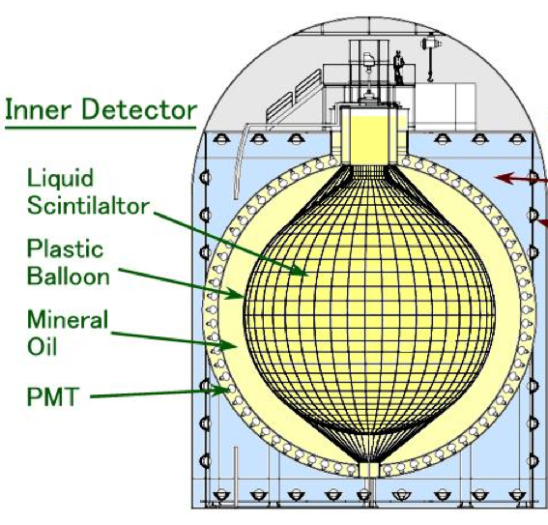
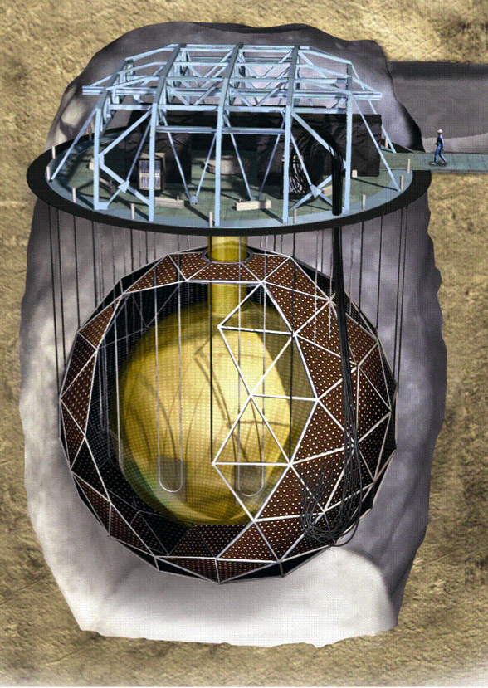
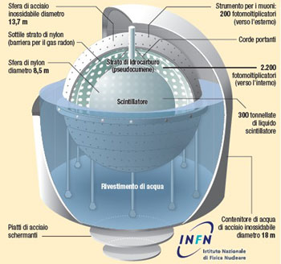
Large liquid scintillator detectors ?
3 possible candidates : Borexino, KamLAND, SNO+
Interferences with the present experimental programs
Technical issues : size of chimney, liquid purity, electronics…
Good energy resolution : 5 %
Good position resolution : ≈ 15 cm << L_{osc}
+ internal initiative
by Borexino Collaboration
50 kCi ¹⁴⁴Ce-¹⁴⁴Pr source

Slide 32
Shielding : the first idea
Two separate goals
usual biological protection
Could be achieved with ≈ 15 cm of W
minimisation of accidental background during the experiment
need an extra 20 cm of W or equivalent attenuation for 10⁻¹² reduction
experimental requirements well above legal safety constraints
7 pieces to insert and assemble through chimney
Like a boat in a bottle…
Impurities in tungsten ?
Test @ Saclay
Previous tests for Gerda
Discussion with industry (Plansee)
Looks possible

Slide 33
Shielding : 2nd solution
Central part in Densimet
diameter 54 cm to fit through chimney
central cavity to host ¹⁴⁴Ce Ø ≈ 8 cm
weight : 2.3 tons
more than enough for biological protection
A balloon in nylon containing heavy liquid : Sodium paraTungstate
density : 2.82 g/cm³
viscosity better than olive oil
interaction length @ 2.2 MeV : 8.1 cm
external radius : 107 cm
weight : 14.2 tons (10.5 t. with buoyancy)

Slide 34
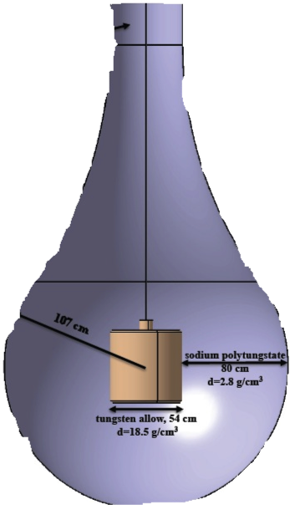
CeLAND in KamLAND
Ranked #1 for future projects
a 75 kCi ¹⁴⁴Ce source in spring 2015
Several constraints
an existing underground detector
full of an extra pure mineral oil
Avoid contaminations
The entrance hole
50 cm in diameter
delicate operations to insert the source in center
Planned operations
1st 6 months in water buffer
≈ 16 000 evts
if hints of oscillation signal
move it in the center with an extra shielding
18 more months : ≈ 56 000 evts
≈ 15 m

Slide 35
Backgrounds
Analysis Threshold
Source Induced Backgrounds
Detector + Reactor + Geoneutrinos
Induced Bkg

Slide 36
Good test ?
Fourth neutrino the decisive test

Slide 37
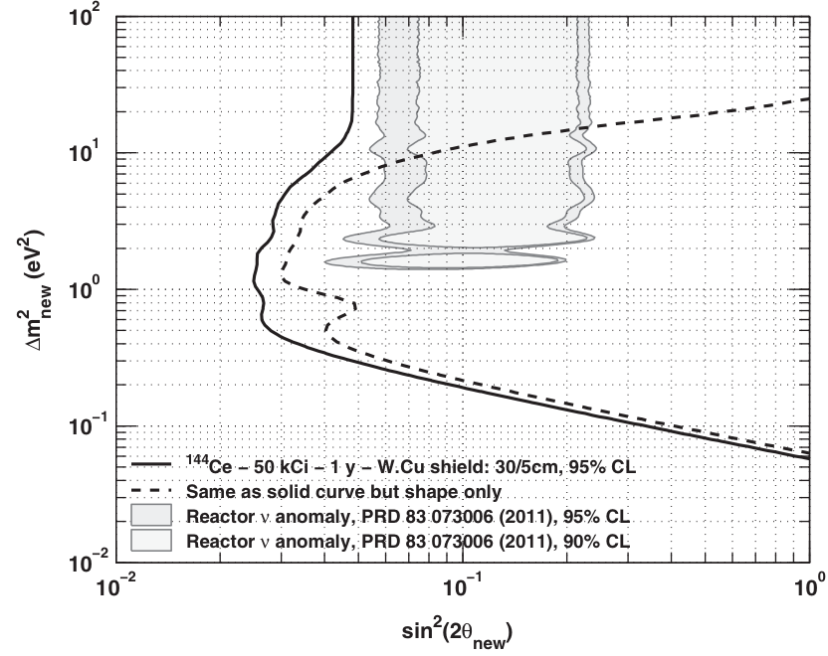
Full range of parameters
1 y – 50 kCi
¹⁴⁴Ce-¹⁴⁴Pr
95%CL

Slide 38
Discovery potential
sin²2θ=0.1 & Δm²=2.2 eV² tagged at 3σ
1 y – 50 kCi
¹⁴⁴Ce-¹⁴⁴Pr
3σ contours

Slide 39
Proposal sensitivities
Compil. G. Mention

Slide 40
Conclusion
Do we need a fourth neutrino ?
Intriguing anomalies in reactors experiments, Gallium,…
A possible revolution in physics
A hot topic : ERC put 5 M€ in this subject
Several experimental ideas / a hard competition
Sources of neutrinos and antineutrinos
CeLAND and Borexino
Use of antineutrinos from reactors
Stéreo or Mars @ ILL
Direct observation with Katrin
A clear answer in a few years

Slide 41
Conclusions
Do we need a fourth neutrino ?
Intriguing anomalies in reactors experiments, Gallium,…
A possible revolution in physics
An elegant experimental answer : ¹⁴⁴Ce-¹⁴⁴Pr
Able to cover the full range of expected parameters
Rather easy to realise
Advance contacts with russian nuclear industry
Contacts for tungsten shielding encouraging
Discussions with Borexino and KamLAND
Could be made in the 3-4 years to come
Few technical uncertainties
Mainly regulation issues to solve
Five years funding from European Research Council granted to Thierry Lasserre

Slide 42
Nike
Just do it.

Slide 43
Backup slides
Backup slides

Slide 44
Mayak
Маяк
Production association « Mayak »
State corporation of atomic energy « Rosatom »
Main russian center for nuclear fuel reprocessing
Host also « Ludmila », a 1000 MW heavy water reactor
Restricted access on main site, but also « clean » parts accessible
Former important military sites
Several severe nuclear accidents

Slide 45
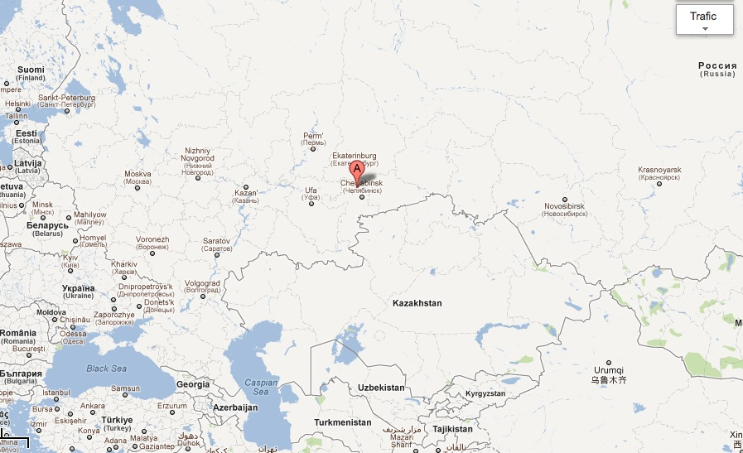
In the Oural mountains
Маяк

Slide 46
Production at Mayak
Facility to produce kCi ¹⁴⁴Ce already existing
Dedicated mainly to ⁶⁰Co
main world producer : 8 MCi/y
¹⁴⁷Pm production :1 prod. per ≈ 5 years
Used for antistatic purpose and emergency lights
Reprocess fuel elements from VVER-440
After 3-5 years of cooling : favorable for ¹⁴⁷Pm
For ¹⁴⁴Ce : better to have less than 3 y cooling with the maximal burn-up possible => increase ¹⁴⁴Ce content in final Ce product.

Slide 47
¹⁴⁴Ce production technology
Produced already 30 kCi of ¹⁴⁴Ce in 1965
Line is « still almost ready » but needs « slight » upgrades
« Standard » unit to feed the reprocessing line : 1 ton of spent nuclear fuel (SNF) ie 8 elements
Usual operations : cutting, dissolution in HNO₃ acid, Purex, evaporation, stripping ¹³⁷Cs
13 kg of REE (rare earth) and trans-uranium (250 g Am, 10g Cu) : total ≈ 3 m³
Separation of REE by displacement chromatography in facility used for ¹⁴⁷Pm
7 columns (5 m high) in series called « Canyon »
Ce is one of the last element, between Nd and La.
Moreover Ce only REE with a valence 4
1 ton of SNF => 2.8 kg of Ce with 22 g of ¹⁴⁴Ce (> 60 kCi)

Slide 48
Signal and Backgrounds
75 kCi ¹⁴⁴Ce-¹⁴⁴Pr
15 600 evts in 1st 6 months
56 000 evts in 1.5 year
1 mHz
Inverse ß-decay coinc.
E_{prompt} > 0.9 MeV
E_{delayed} > 2.0 MeV
Δt < 750 µs
ΔV < 10 m³
Background from ¹⁴⁴Pr
After 1m in liquid. scint.
R_{promt} = 2.5 Hz
R_{delayed} = 0.6 Hz
R_{accident} = 1 mHz S/B ≈ 1
After 1.5 m : S/B = 100
3 cm of tungsten bkgd rate divided by 10
W induced bkgd
From measures by Gerda
Bkgd << γ from ¹⁴⁴Pr
to be rechecked with actual W
Notes:
Computations made for KamLAND but very similar for other neutrino detector (scale with R)

Slide 49
Shielding
Pure tungsten impossible to manufacture
Must use alloys (Ni, Fe)
Densimet® from Plansee company
Densimet 185, the highest density
18.5 g/cm3 (pure W : 19.3 g/cm³ )
97 % W + Ni, Fe
Used already for the ⁵¹Cr neutrino source in Gallex
Used in nuclear medecine
Radioactive impurities content ?
Meeting next Friday @ Saclay with Plansee engineers

Slide 50
Shielding - 2
Radiation length in Densimet
≈ 1.2 cm for 2.2 MeV
We need a reduction of 10⁻¹²
To reach 13 γ/s entering the liquid scintillator
≈ 80 cm from the center, Signal/Bkg > 10
Total width of the W shielding : 33 cm
Inner radius : 8 cm ; outer radius : 41 cm
Weight : 5300 kg

Slide 51
Radioprotection
At least 16 cm of W
Dose rate
Basic formula for a γ point source
In water (µ_{en}/ρ = .025 cm²/g)
Attenuation in W
exp(-16/1.2) = 1.6 10⁻⁶
=> 50 kCi (¹⁴⁴Ce) -> 350 Ci (2.2 MeV)
Result : 5.2 µSv/h
Not to scale

Slide 52
Samples
Physicist’s concern : high energy gamma emitters
We ask to receive samples at Saclay
Use the next production of ¹⁴⁷Pm
Early 2013
Russian propose to make measurement @ « clean » Mayak with us
Usually mainly concern with ß lines
Interesting to met local people involved in the project
We insist to have samples (also) checked @ Saclay
Required activity of the sample
≈ 100 kBq total ie 1 kBq for the 2.2 MeV line
Modest, makes shipment easier

Slide 53
The Antineutrino generator
Holder
R=8 cm
3 kg of CeO₂
width=33 cm
Tungsten
R=2 cm
Ultrapure Copper
mass ≈ 5.5 tons
Total diameter ≈ 82 cm

Slide 54
Transport to Japan
Mayak send ⁶⁰Co worldwide
By plane, normal or dedicated flight
Present ideas under consideration
Ship the W shielding to « clean » Mayak
Fit on site the AνG inside the shielding
Fit in the certified transport container (rented)
Dedicated flight to an airport close to Kamioka
Transport by truck to detector
Think to the return from Japan to Russia

Slide 55
Thermal problems
¹⁴⁴Ce-¹⁴⁴Pr, mainly a ß emitters
Heat deposition localised only (99%) in the CeO₂ or in the 1st few mm of shielding.
50 kCi ¹⁴⁴Ce-¹⁴⁴Pr produce 382 W
Decrease as lifetime of 144Ce
157 W after one year
Densimet
Density : 18.5 g/cm³
Heat capacity : 130 J/kg.K
Thermal conductivity : 82 W/m.K (much smaller than pure W)
Linear expansion : 5.2 10⁻⁶ m/m
Young modulus : 380 GPa

Slide 56
Thermal problems - 2
Time to heat the shielding
Surface temperature at equilibrium in air
h_{air} : heat exchange coefficient with air
Exchange with liquid scintillator
h_{LS} : heat exchange with liquid scintillator (convection)

Slide 57
Thermal problems - 3
Try to avoid active cooling
Very modest water flow needed ≈ 60 lit./hour
Huge complication in the shielding, operations
Comparison with the PMT’s in KamLAND
1325 PMT’s in the inner detector
500 W ?
Impact on the liquid scintillator
914 tons
w/o thermal leaks => increase of 4 °C in a year
Possible slight convection

