Slide 1
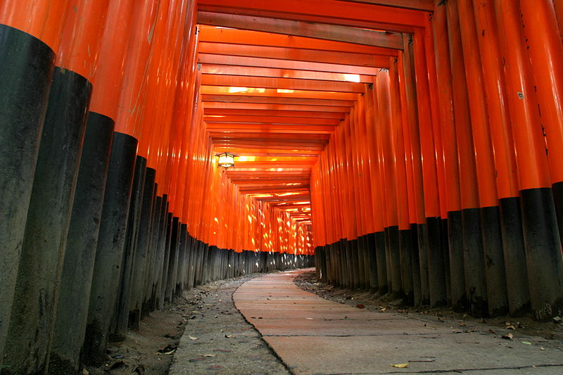
Experimental Status of
Neutrino Oscillations
Neutrinos at the Forefront
Lyon
Oct. 22, 2012
Dave Wark
Imperial College/RAL

Slide 2
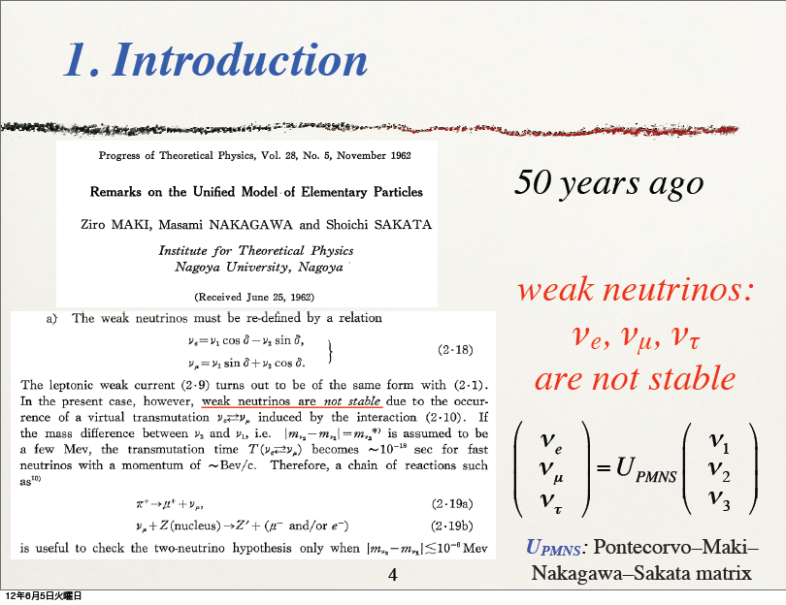
Slide from Nakaya-san’s presentation in Kyoto

Slide 3
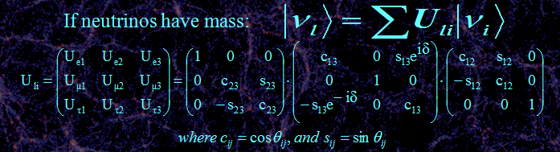
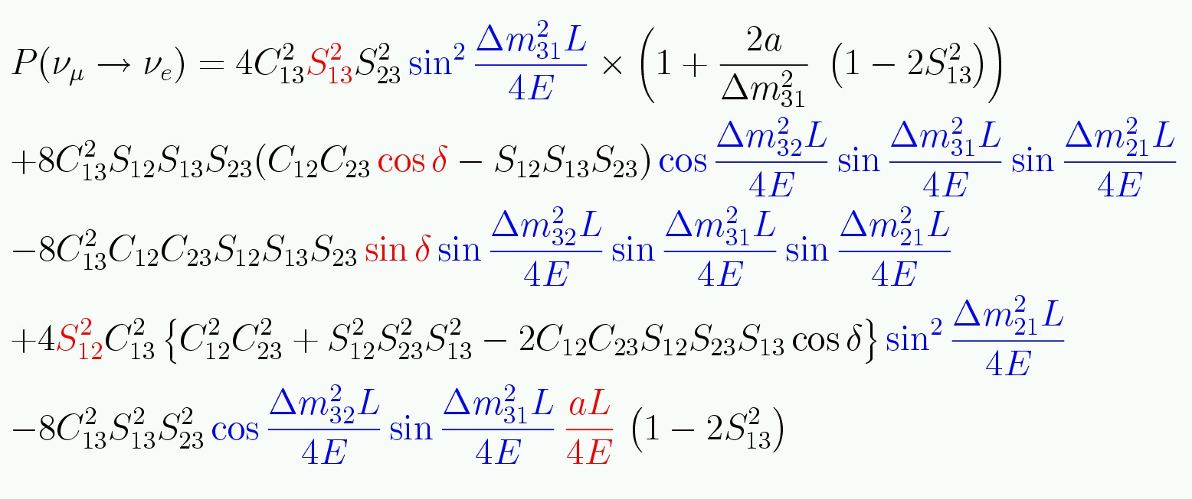
Three neutrino mixing.
Complicated equation means
covariances and degeneracies!.
If only two neutrinos contribute:

Slide 4
Neutrino Oscillations Ancient History
1957 – Bruno Pontecorvo, wondering if there are any other particles which could undergo oscillations analogous to K⁰ ↔ K⁰ oscillations, hit upon the idea of neutrino ↔ anti-neutrino oscillations (more about this later).
1962 – Maki, Nakagawa, and Sakata (in the context of what looks today like a very odd model of nucleons) proposed that the weak neutrinos known at the time were superpositions of “true” neutrinos with definite masses, and that this could lead to transitions between the different weak neutrino states.
1967 – Pontecorvo then considered the effects of all different types of oscillations in light of what was then known, and pointed out before any results from the Davis experiment were known that the rate in that experiment could be expected to be reduced by a factor of two!
1972 – Pontecorvo is informed by John Bahcall that Davis does indeed see a reduced rate, and responds with a letter….
—

Slide 5
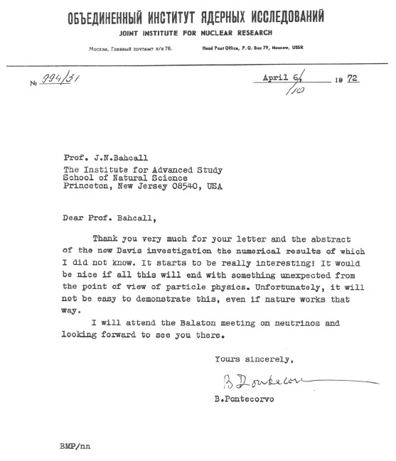
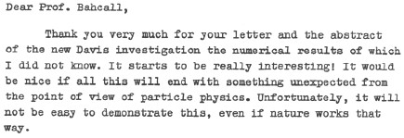

Slide 6
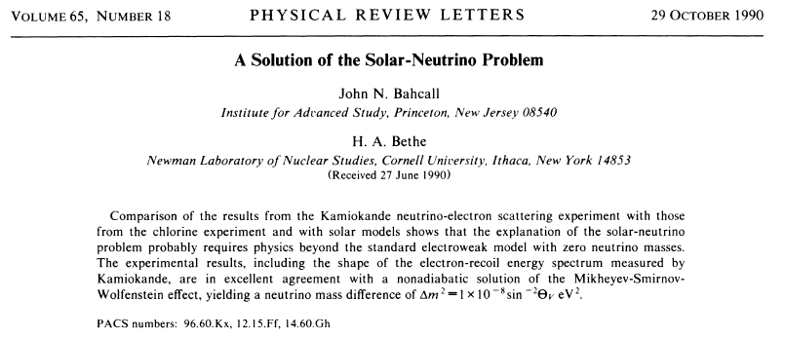
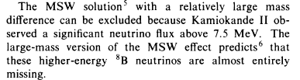
Neutrino Oscillations
  What do we really know in October 2012?
  How will we learn more?

Slide 7
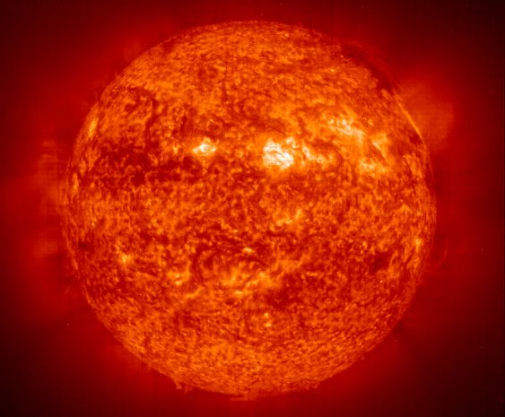
Solar Neutrinos

Slide 8
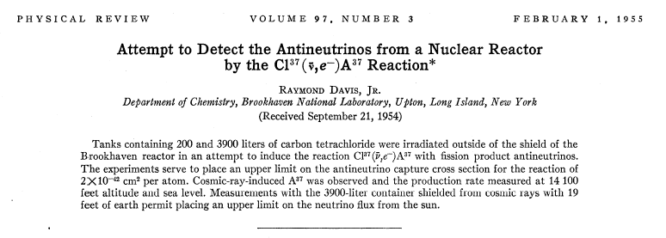
Ray deployed large tanks containing carbon tetrachloride near reactors.
If‾ν = ν you would expect to see ³⁷Ar produced by this reaction.
By 1957 enough sensitivity had been reached to show that the rate was too small, from which it was concluded that ‾ ν ≠ ν .
This is wrong, because P is violated in weak interactions!

Slide 9
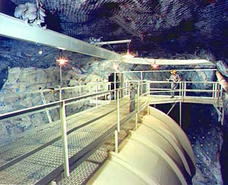
Where it all began – the Davis Experiment

Slide 10
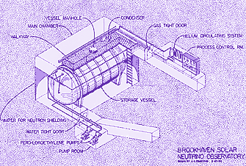
Where it all began – the Davis Experiment

Slide 11
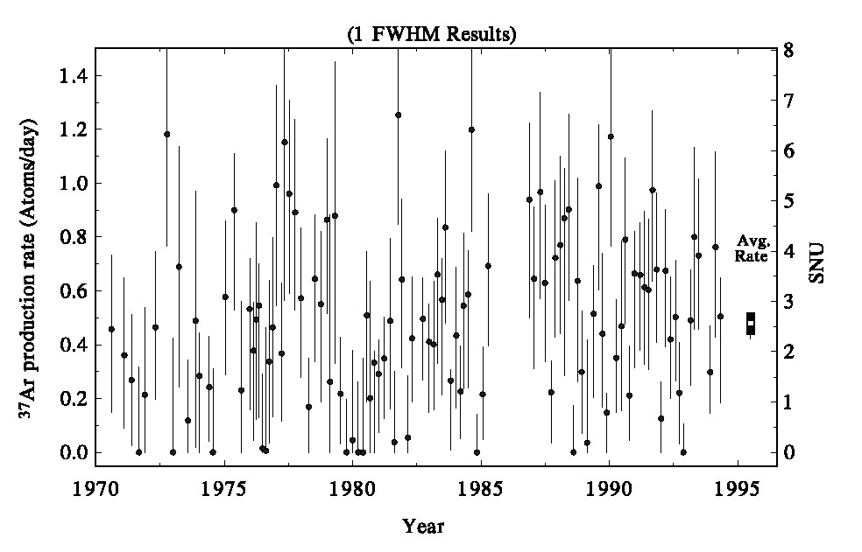
Where it all began – the Davis Experiment
SSM
Prediction!
•
Maybe the experiment is wrong…
Dave Wark
Imperial College/RAL

Slide 12
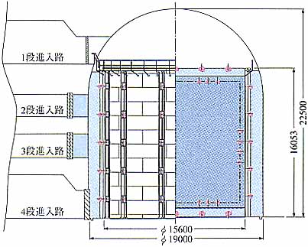
Kamiokande
Translation –
“Do not fill above this line”

Slide 13
ν_{x}+ e⁻→ ν_{x}+ e⁻
Translation –
“Do not fill above this line”

Slide 14
ν_{x}+ e⁻→ ν_{x}+ e⁻
ν_{x}
Translation –
“Do not fill above this line”
ν_{x}
Ĉ
e⁻

Slide 15
ν_{x}+ e⁻→ ν_{x}+ e⁻
ν_{x}
Translation –
“Do not fill above this line”
ν_{x}
Ĉ
e⁻

Slide 16
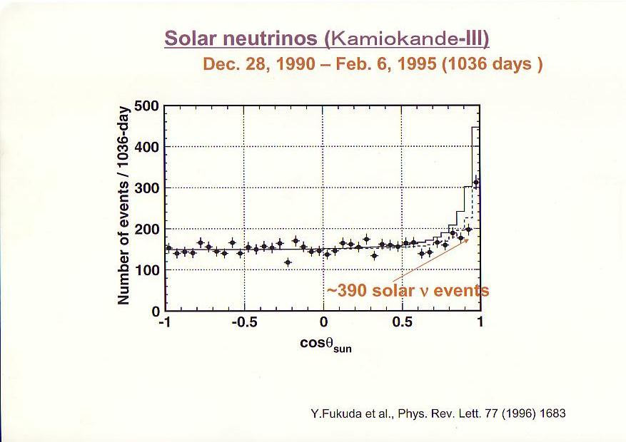
Kamiokande
Translation –
“Do not fill above this line”

Slide 17
Plot adapted from http://www.sns.ias.edu/~jnb/

Slide 18
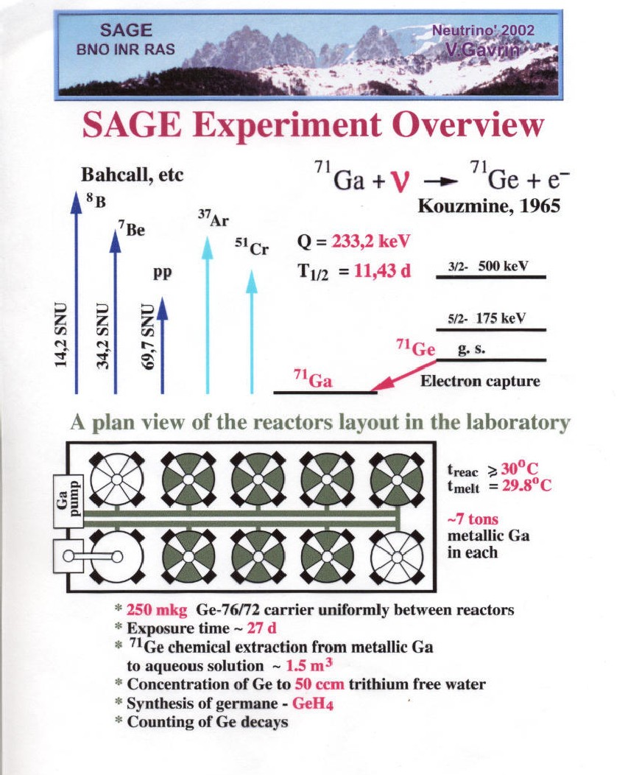

Slide 19
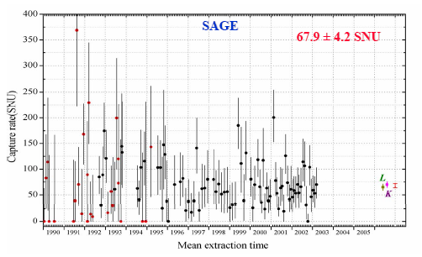
SAGE Results

Slide 20
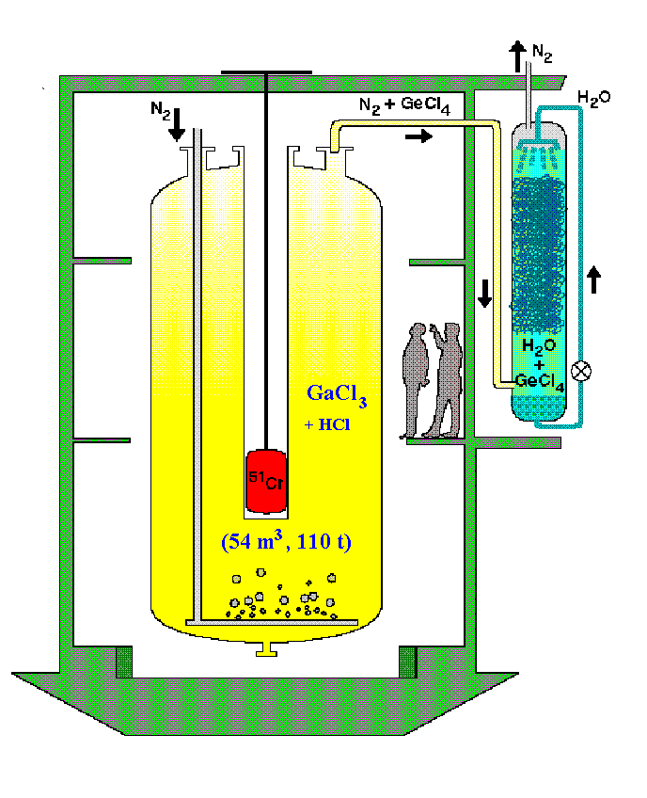

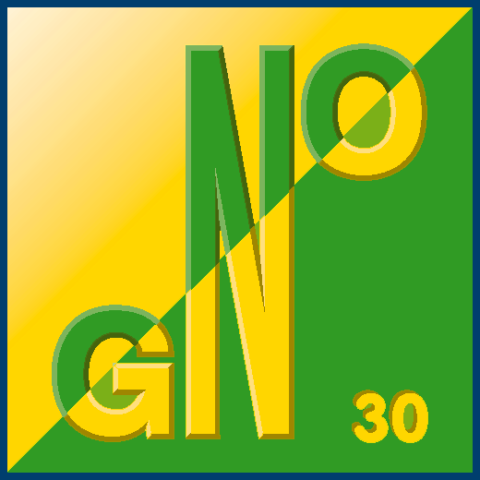
GALLEX/GNO had:
Very different chemistry
Many detailed differences

Slide 21
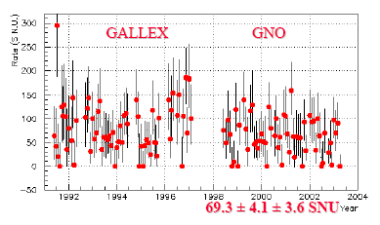
GALLEX/GNO Results

Slide 22
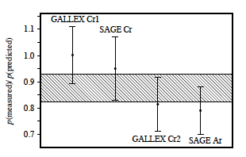
GALLEX/GNO had:
Very different chemistry
Many detailed differences
Extraction/counting of both experiments verified using ~1 MCi ⁵¹Cr sources, and SAGE also used ³⁷Ar

Slide 23
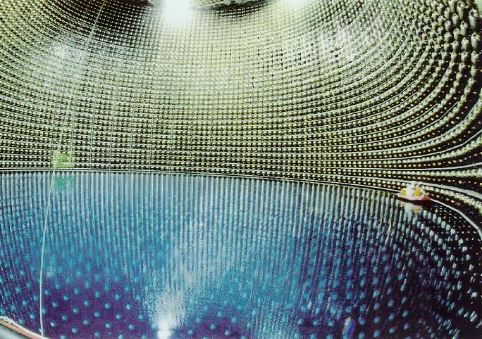

Slide 24
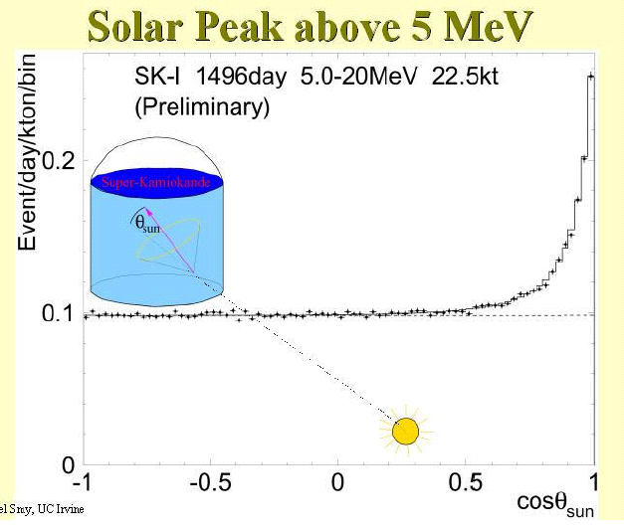
22,400 solar neutrino events!
“Flux” is

Slide 25
22,400 solar neutrino events!

Slide 26
70±4
70±5
But no “smoking gun” for oscillations…

Slide 27
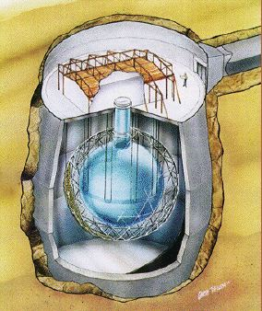
The Sudbury Neutrino Observatory
CC
ν
+
d
→
p
+
p
+
e⁻
e
  Q = 1.445 MeV
  good measurement of ν_{e} energy spectrum
  some directional info ∝ (1 – 1/3 cosθ)
  ν_{e} only
NC
ν
+
d
→
p
+
n
+
ν
x
x
  Q = 2.22 MeV
  measures total ⁸B ν flux from the Sun
  equal cross section for all ν types
ES
ν
+
e⁻
→
ν
+
e⁻
x
x
  low statistics
  mainly sensitive to ν_{e}, some ν_{μ} and ν_{τ}
  strong directional sensitivity
Imperial College/RAL

Slide 28
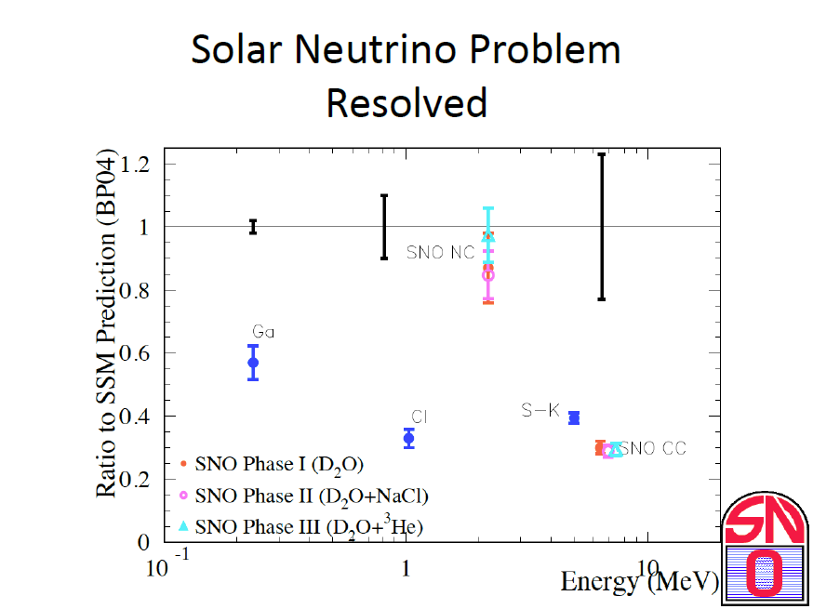
Doesn’t prove
mechanism!
From Art McDonald’s Nu2012 talk...

Slide 29
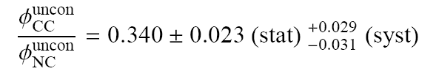
Global Solar Analysis with SNO 391-day salt data
Best fit implies L_{v} ~ 100km
SNO finds:
SNO suppression factor > 2 for L >> L_{v} ⇒ MSW effect
Possible to observe on Earth?
Dave Wark
Imperial College/RAL

Slide 30
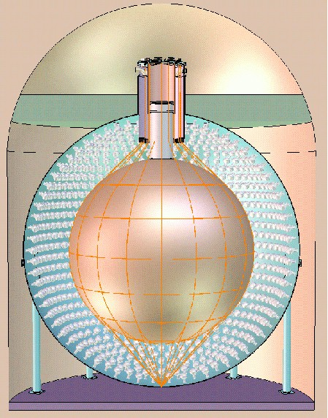
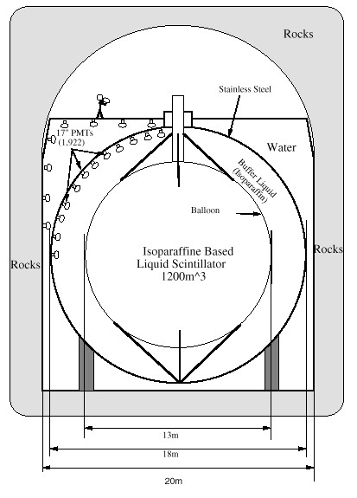
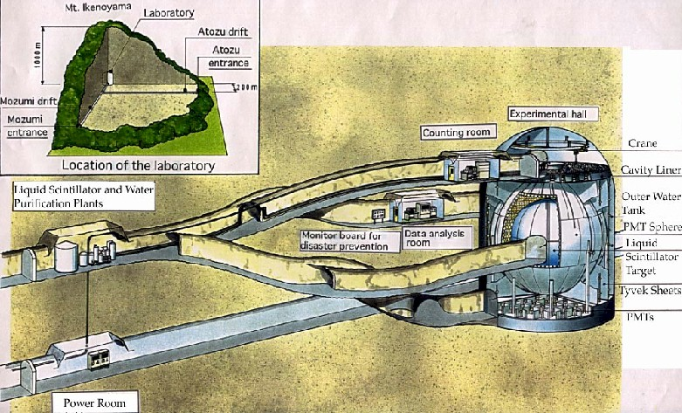
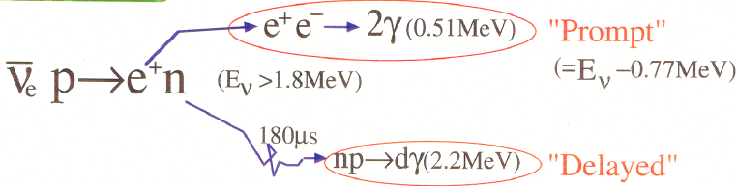
KamLAND
Sum over all Japanese power reactors...
Dave Wark
Imperial College/RAL

Slide 31
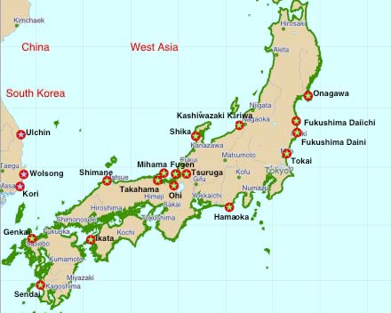
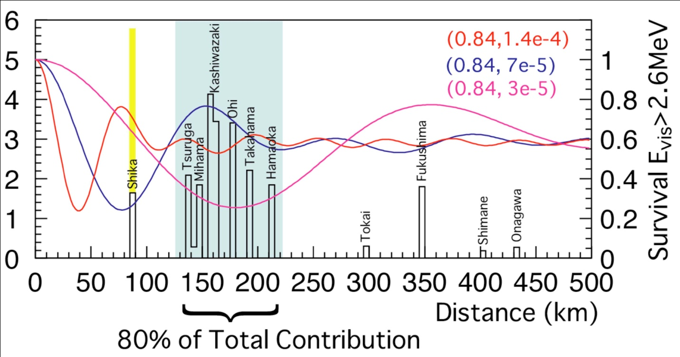
KamLAND
80% of total contribution comes from 130~220km distance
Dave Wark
Imperial College/RAL

Slide 32
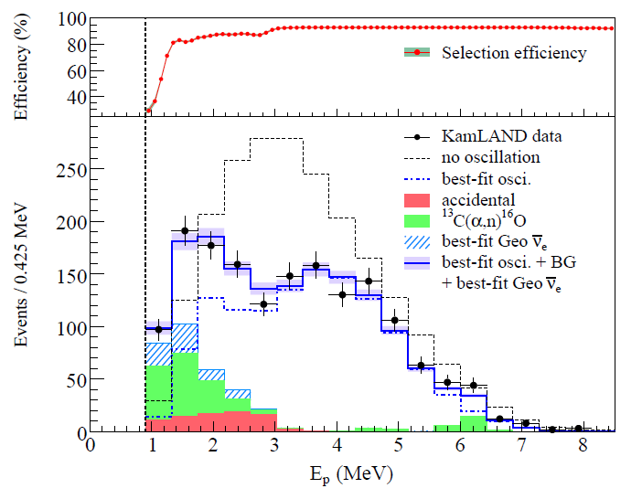
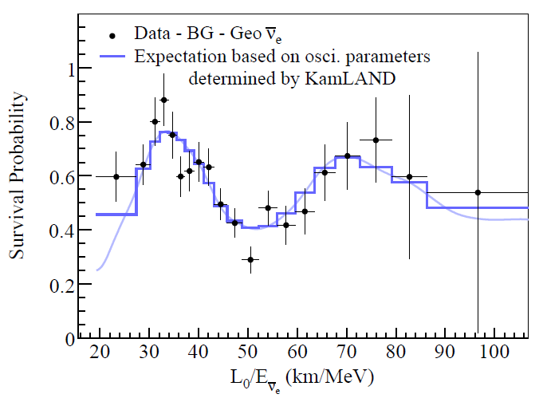
KamLAND
Proved (with other results) that neutrinos oscillate…
…or at least do a damned fine impression.
Dave Wark
Imperial College/RAL

Slide 33
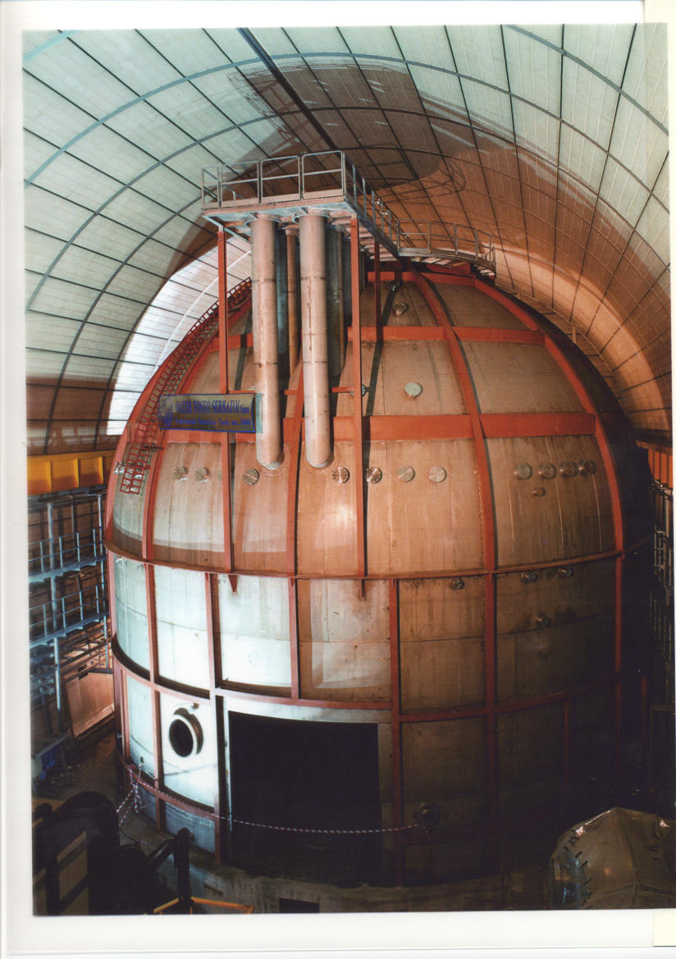
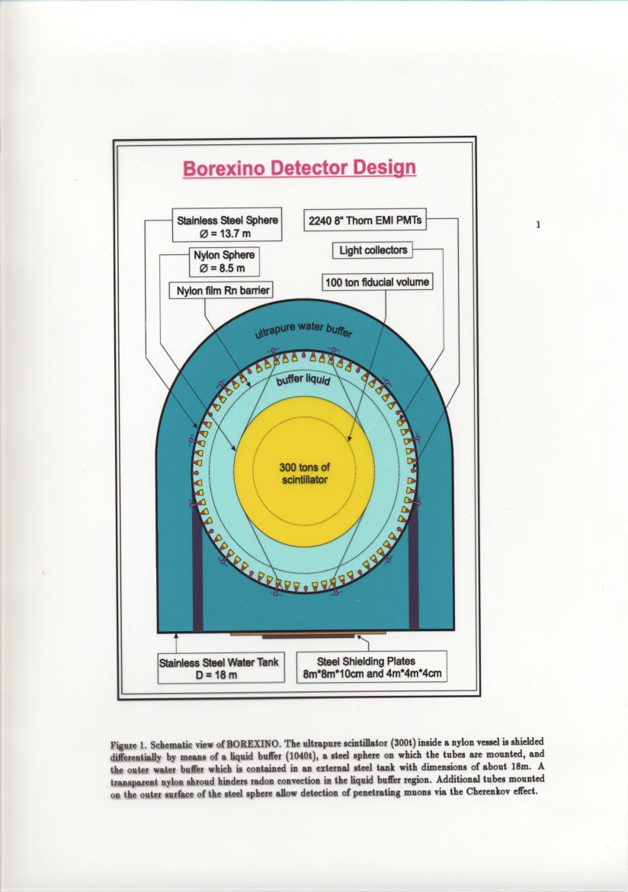
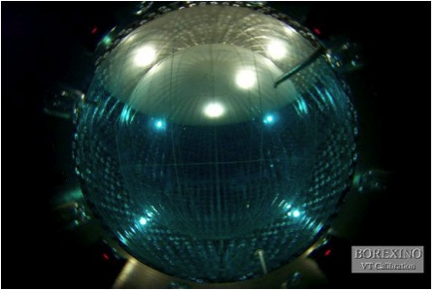
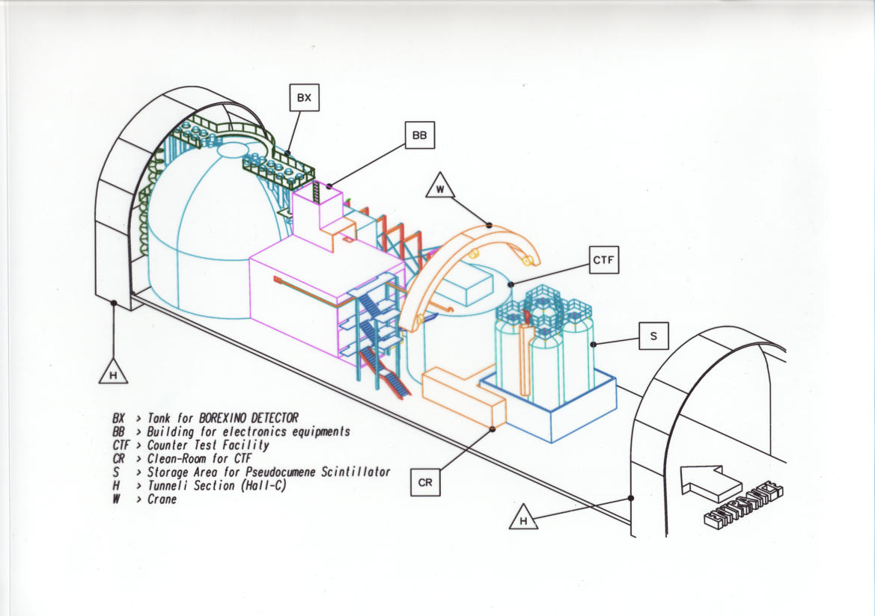
Borexino

Slide 34
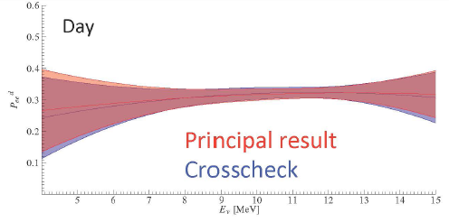
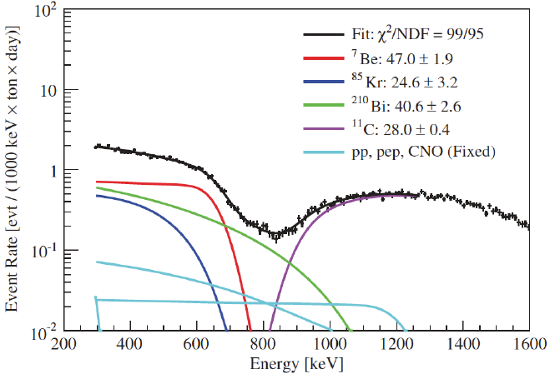
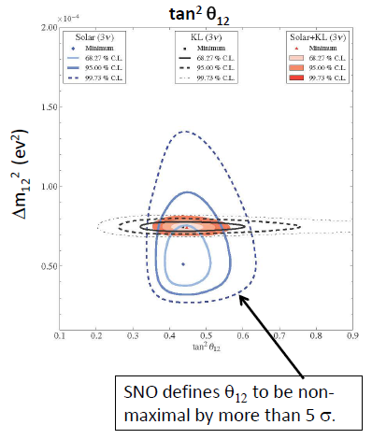
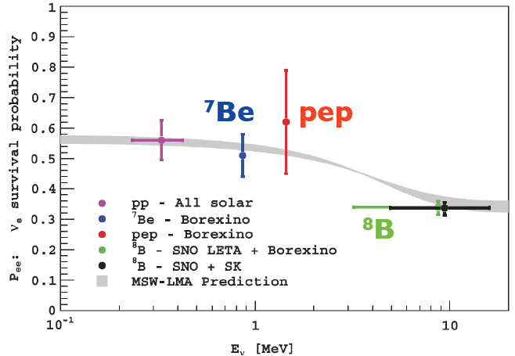
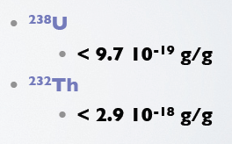
Solar Neutrinos
Turn-up not observed?
SNO
Borexino

Slide 35
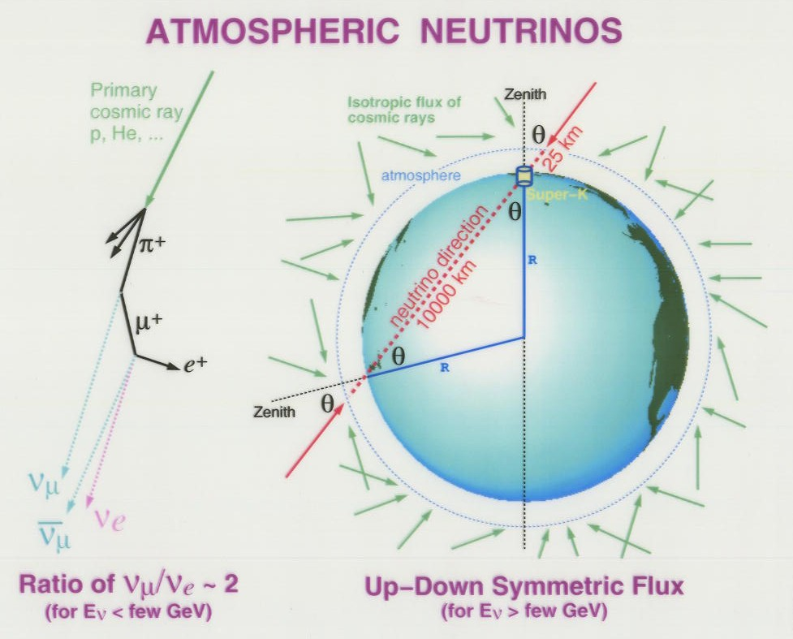

Slide 36
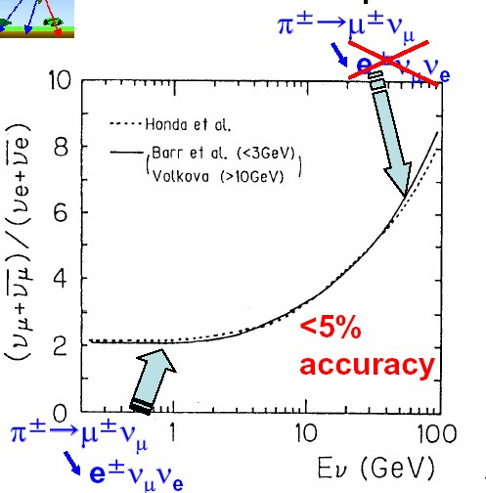
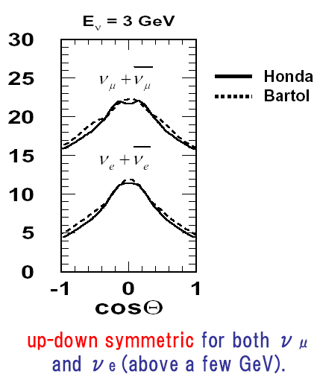
Plots from Y. Suzuki

Slide 37
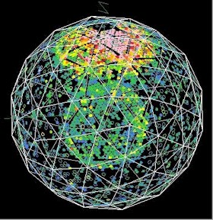
Background to Proton Decay Experiments

Slide 38
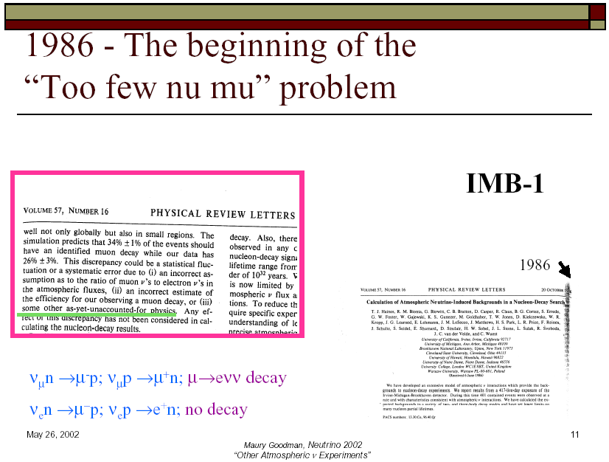

Slide 39
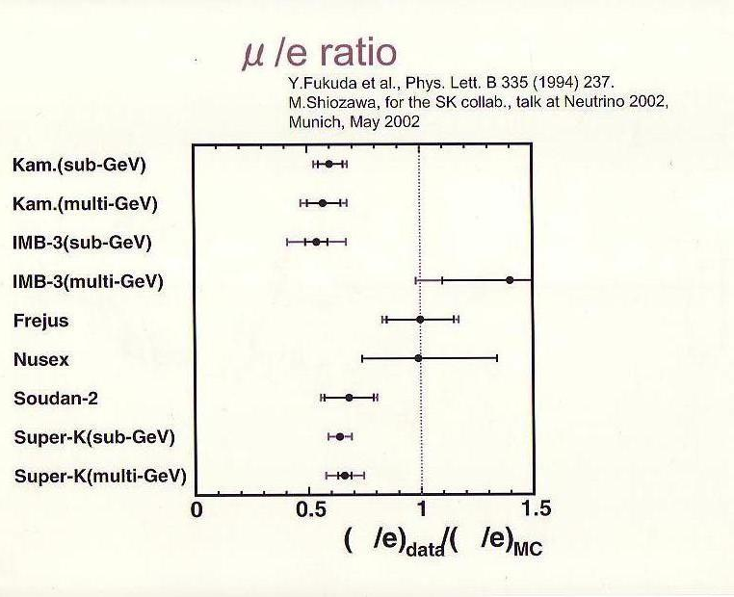
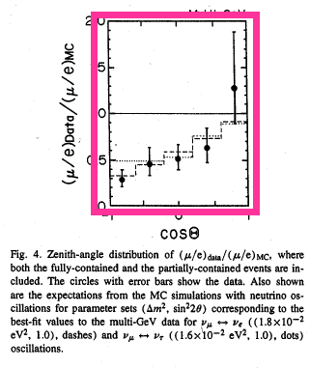
Also seen by Kamiokande

Slide 40

The Super-Kamiokande
Detector

Slide 41
ν_{μ} produces a μ,
which produces a
sharp ring
e
μ
ν_{e} produces
an electron,
which produces
a “fuzzy” ring

Slide 42

SK atmospheric ν data as a function of zenith angle

Slide 43

Atmospheric Neutrinos (plots from Itow-san’s talk at Kyoto)

Slide 44

Atmospheric Neutrinos

Slide 45

Atmospheric Neutrinos

Slide 46

Atmospheric Neutrinos

Slide 47

Atmospheric Neutrinos

Slide 48

Atmospheric Neutrinos

Slide 49


Slide 50


The first long baseline experiment – K2K

Slide 51


Slide 52
Final K2K Statistics
1R-μ Energy spectrum
 | N_{sk}^{obs} | N_{sk}^{pred}
All | 112 | 155.9
1 ring | 67 | 99.0
μ-like | 58 | 90.8
e-like | 9 | 8.2
multi-ring | 45 | 56.8
Oscillation – disappearance – two flavors analysis
sin²2θ = 1.19 ± 0.23 Δm² = (2.55 ± 0.40)x10⁻³eV²
1.88×10⁻³ ≤ Δm² ≤ 3.48×10⁻³ eV² (90%CL) for sin²2θ=1
Plots from Pier Loverre’s talk at TAUP05.
Dave Wark
Imperial College/RAL

Slide 53





ICHEP talk by Justin Evans
735km
MINOS

Slide 54




MINOS NuMI

Slide 55


Reactor Summary
Impressive performance from
a detector not designed for this

Slide 56





SK Atmospheric ν_{τ}

Slide 57





#

Slide 58


Slide 59




Slide 60


Slide 61


Slide 62





What are we trying to measure?
ν_{μ} disappearance
No oscillation
sin²2θ₂₃
Δm²= 2.5 x10⁻³ eV²
Δm²= 2.0 x10⁻³ eV²
Δm₂₃²
Precision measurements

Slide 63


Slide 64


In the systematics dominated era
support measurements are essential!
One slide on hadron production

Slide 65

Slides from Sakashita-san’s presentation at ICHEP12

Slide 66


Slide 67


Slide 68




Double Chooz Results
Currently only far detector, so
use Bugey results for norm.

Slide 69




New Daya Bay Results!

Slide 70




RENO Results

Slide 71

Reactor Summary
Issues:
  Near detector spectra deviate from prediction.
  RENO spectrum claimed to deviate from oscillation prediction – significant?
Experiments executed at amazing speed – early days, but tremendous experimental feats!
Show the wisdom of near/far.
Near-term plans for reactors:
  Far detector for Double Chooz
  Two more modules for Daya Bay
  Still statistically limited, so run!
  Work more on systematics.
  Measure reactor spectrum - input to solving Reactor Anomaly?

Slide 72

Solar ν fits prior to SNO/KamLAND

Slide 73


These are 99% c.l. contours!

Slide 74

What is
the MH?
Is θ₂₃
maximal?
If θ₂₃≠45º
what is
the octant?
What is
δ?
Gonzalez-Garcia,Maltoni,Salvado,Schwetz

Slide 75



Slide 76


Global Fits (NB: post Neutrino 2012)

Slide 77

Sterile Neutrinos
LSND Starts it all...

Slide 78

New MiniBooNE Results (from C. Polly’s talk)
LSND Starts it all...

Slide 79


Other Indications of Sterile ν
(or underestimates of systematics)
Gallium Anomaly
Must include all data (CDHS, atmos. ν, MINOS, etc.)

Slide 80


Slide 81

Atmospheric Neutrinos

Slide 82

Atmospheric Neutrinos
Adding more sterile ν’s doesn’t help!

Slide 83

Atmospheric Neutrinos
Plenty of chaff, is there any wheat?

Slide 84
Conclusions
We have now measured all three mixing angles in the MNSP matrix!
Reactor θ₁₃ experiments convincingly show disappearance.
T2K has strong evidence for appearance, need more data.
We now move on to the next targets, non-maximal θ₂₃, MH and CP violation.
Many experiments claim some sensitivity to MH, however when considered in detail only LBNO can convincingly claim 5σ sensitivity for all values of δ.
Do we need it? Are a bunch of 2-3σ enough?
Situation on sterile neutrinos is confused and confusing.
We need overwhelming experiments – these will not be cheap, easy, or fast.
The absolute mass question is at least as important, and a rich experimental programme exists there.
Astrophysics also offers a wide range of fascinating ν topics.
The field continues to grow (630 participants in Kyoto).
I look forward to a fascinating conference!
Dave Wark
Imperial College/RAL

