Slide 1
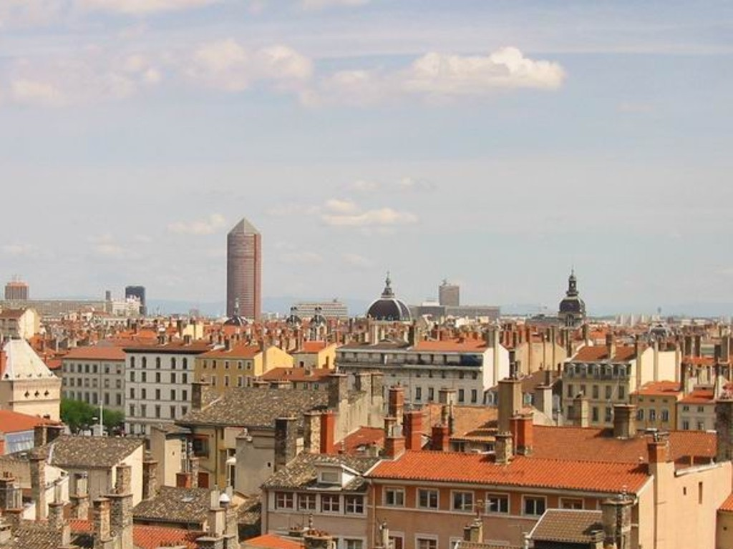
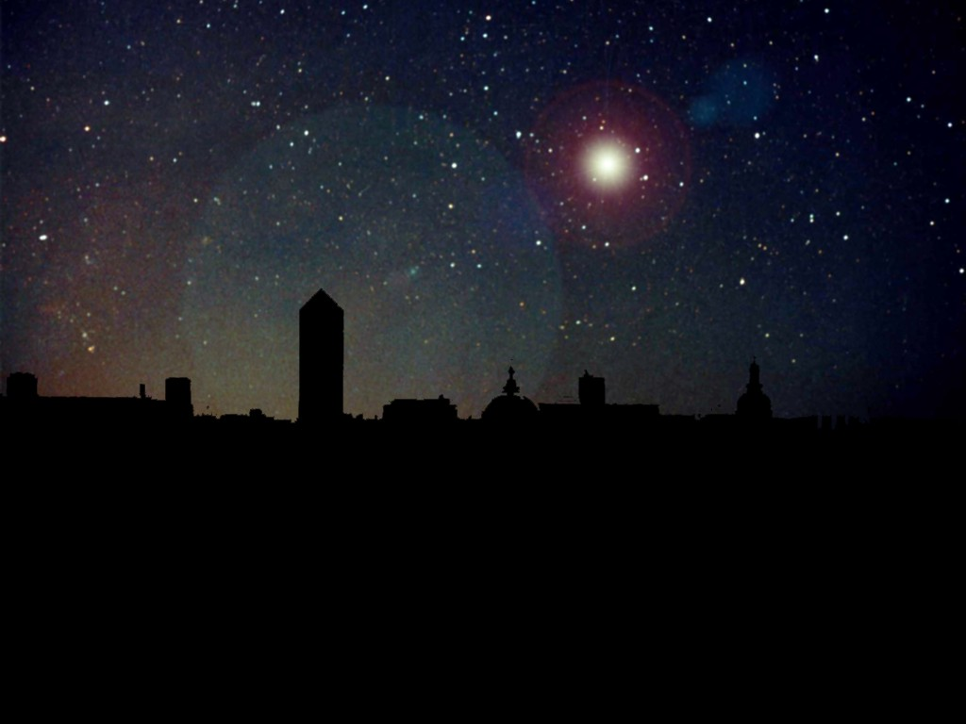
Supernova Neutrinos
Physics Opportunities with
Supernova Neutrinos
Georg Raffelt, Max-Planck-Institut für Physik, München

Slide 2
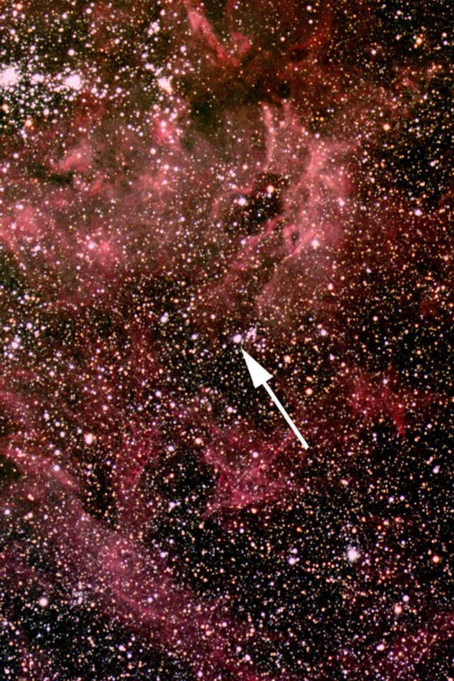
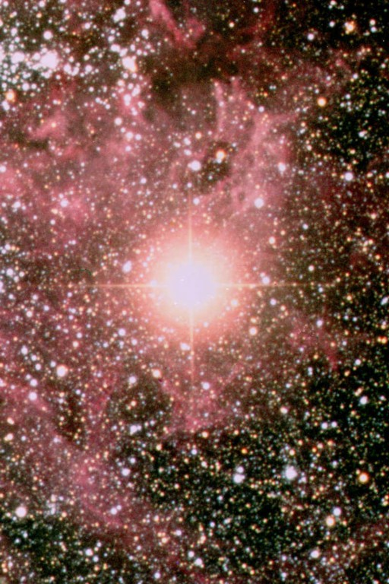
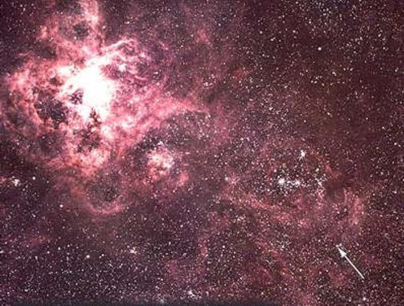
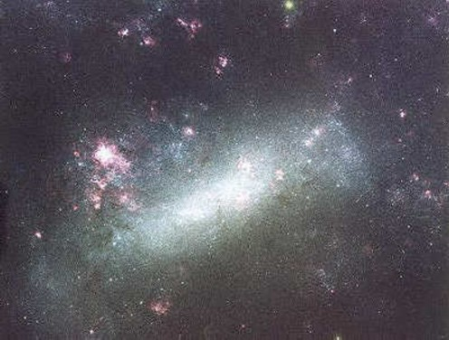
Sanduleak -69 202
Sanduleak −69 202
Supernova 1987A
23 February 1987
Tarantula Nebula
Large Magellanic Cloud
Distance 50 kpc
(160.000 light years)

Slide 3
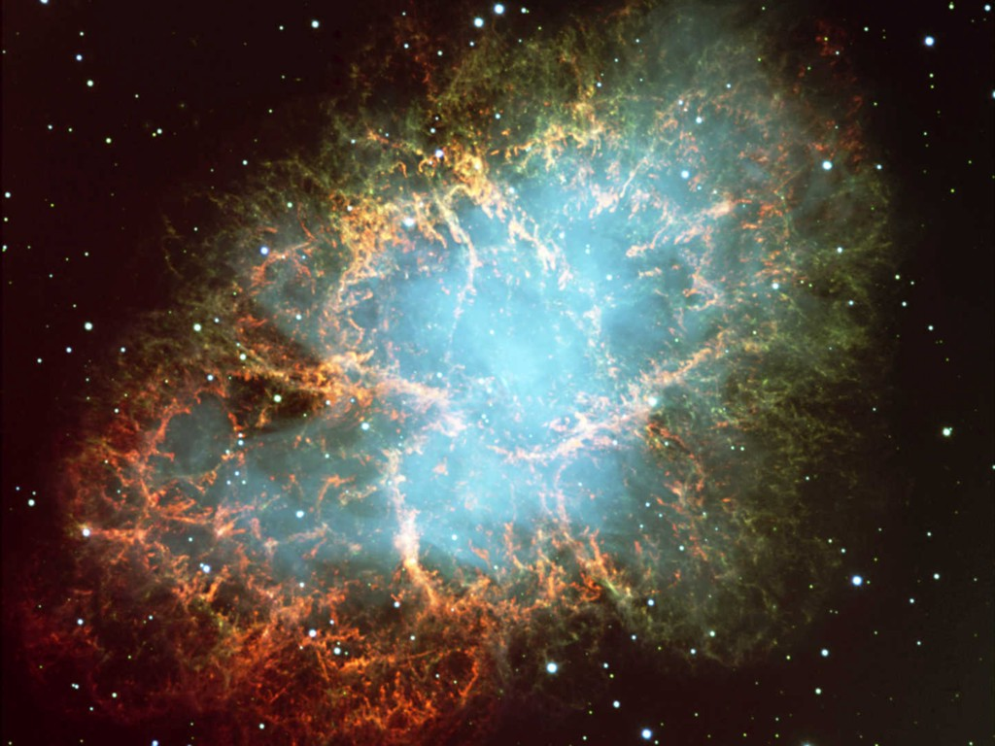
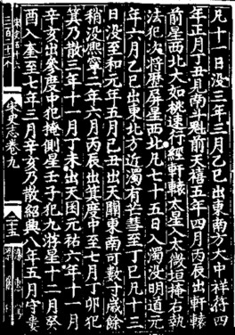
Crab Nebula

Slide 4
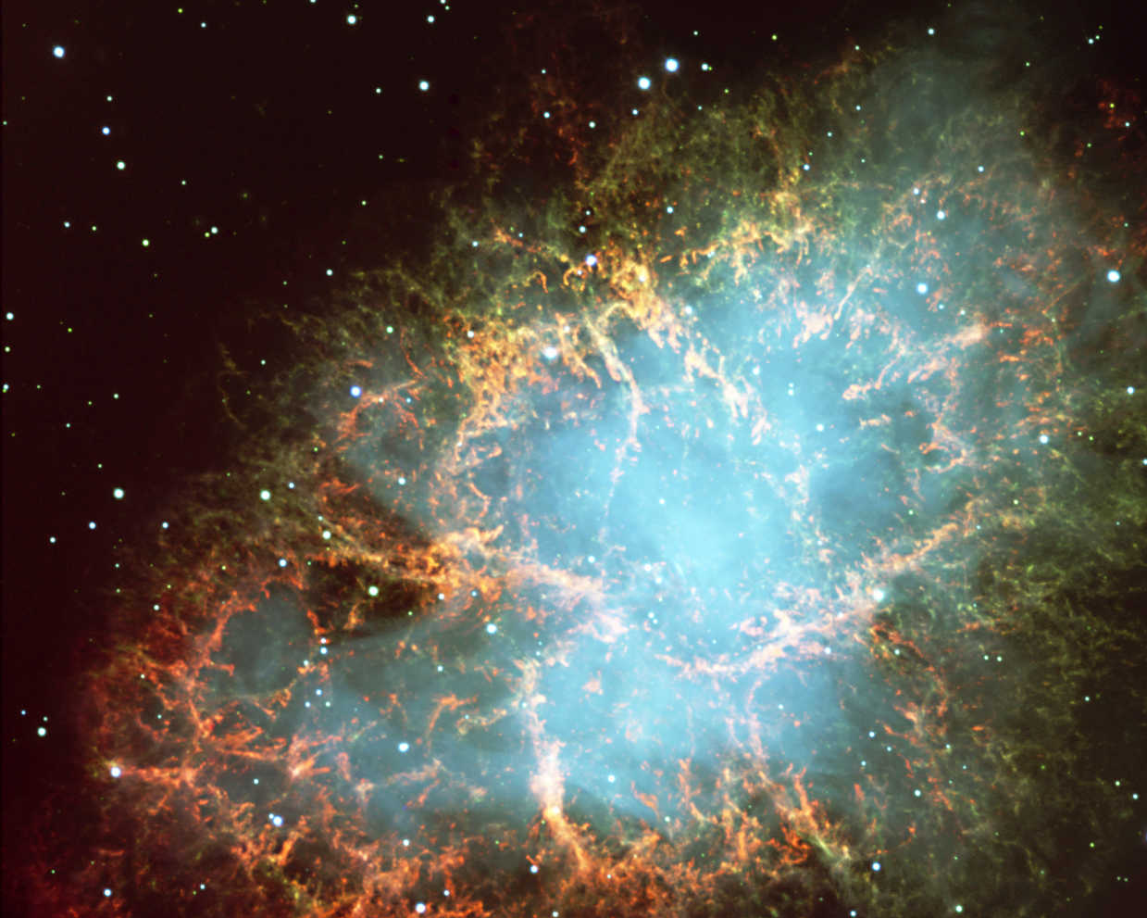
The Crab Pulsar
Chandra x-ray images

Slide 5
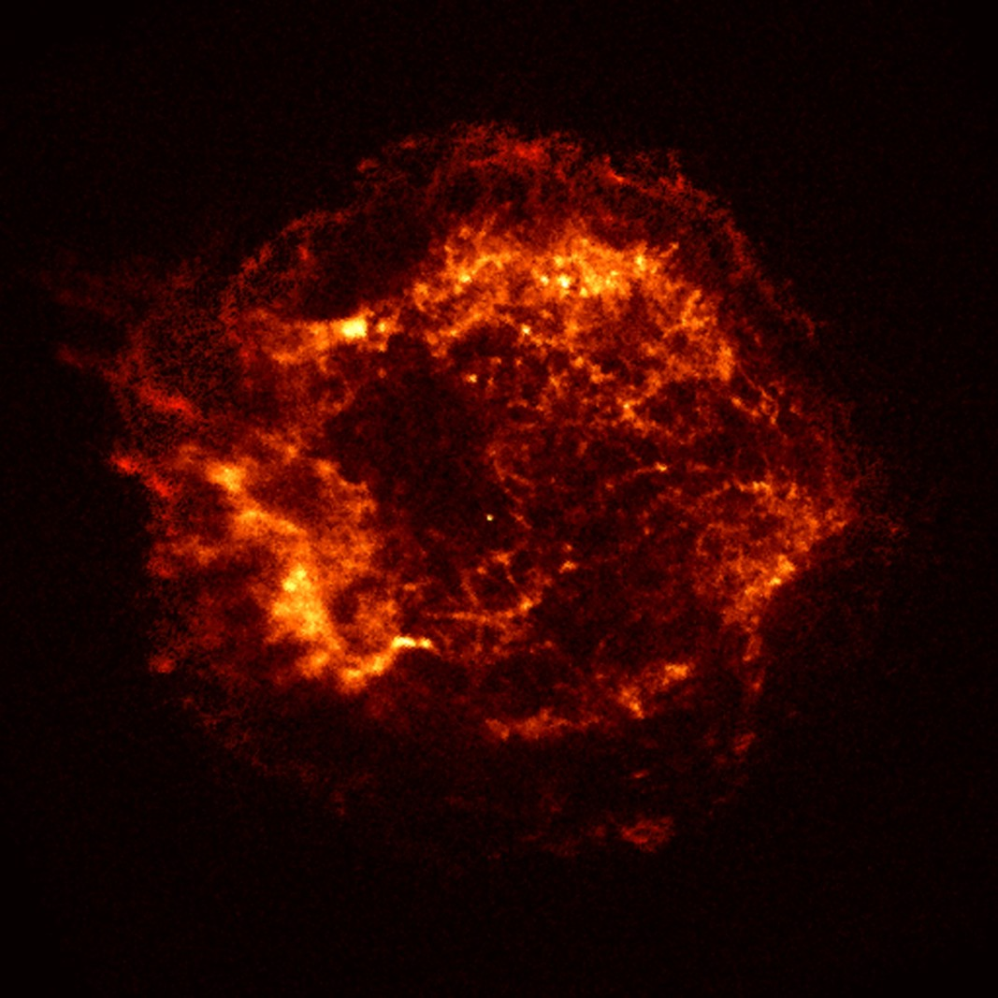
Supernova Remnant in Cas A (SN 1667 ?)
Chandra
x-ray image
Non-pulsar
compact remnant

Slide 6
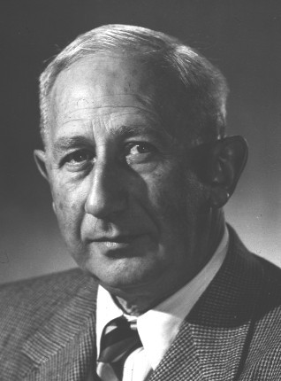
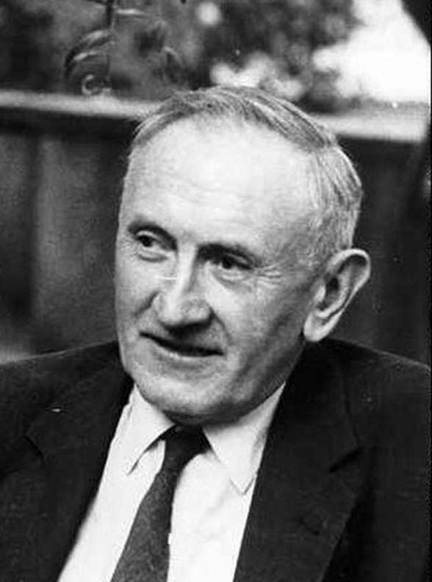
Baade and Zwicky
Walter Baade (1893–1960)
Fritz Zwicky (1898–1974)
Baade and Zwicky were the first to speculate about a connection
between supernova explosions and neutron-star formation
[Phys. Rev. 45 (1934) 138]

Slide 7
Stellar Collapse and Supernova Explosion
Onion structure
Collapse (implosion)
Main-sequence star
Helium-burning star
Degenerate iron core:
ρ ≈ 10⁹ g cm⁻³
T ≈ 10¹⁰ K
M_{Fe} ≈ 1.5 M_{sun}
R_{Fe} ≈ 3000 km
Hydrogen Burning
Helium
Burning
Hydrogen
Burning

Slide 8
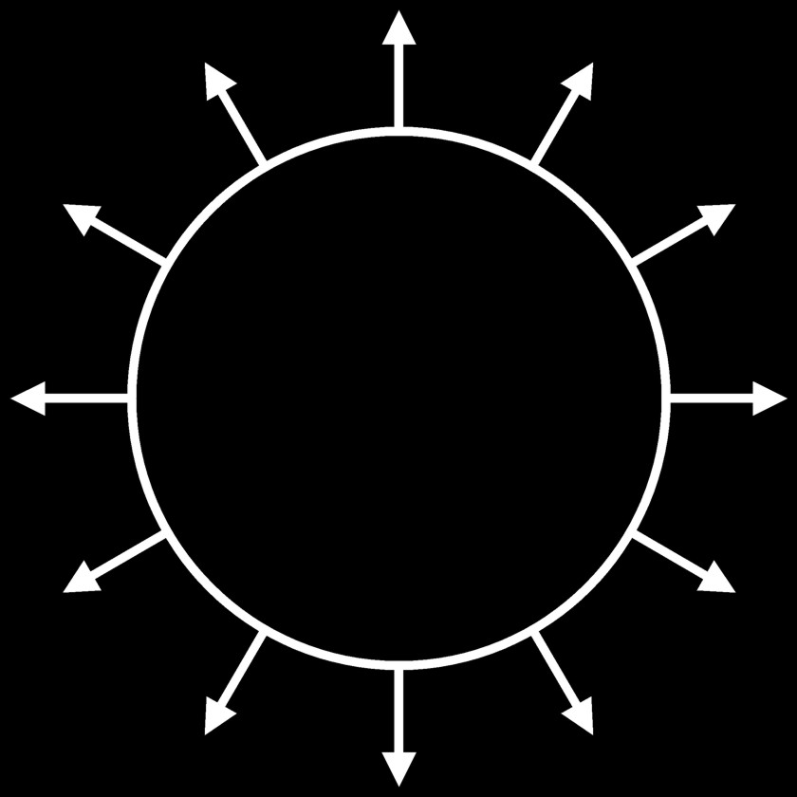
Stellar Collapse and Supernova Explosion
Newborn Neutron Star
Collapse (implosion)
Explosion
$\sim$ 50 km
Proto-Neutron Star
ρ $\sim$ ρ_{nuc} = 3 × 10¹⁴ g cm⁻³
T $\sim$ 30 MeV

Slide 9
Stellar Collapse and Supernova Explosion
Newborn Neutron Star
$\sim$ 50 km
Gravitational binding energy
E_{b} ≈ 3 × 10⁵³ erg ≈ 17% M_{SUN} c²
This shows up as
99% Neutrinos
1% Kinetic energy of explosion
0.01% Photons, outshine host galaxy
Neutrino luminosity
L_{ν} $\sim$ 3 × 10⁵³ erg / 3 sec
$\sim$ 3 × 10¹⁹ L_{SUN}
While it lasts, outshines the entire
visible universe
Neutrino
cooling by
diffusion
Proto-Neutron Star
ρ $\sim$ ρ_{nuc} = 3 × 10¹⁴ g cm⁻³
T $\sim$ 30 MeV

Slide 10
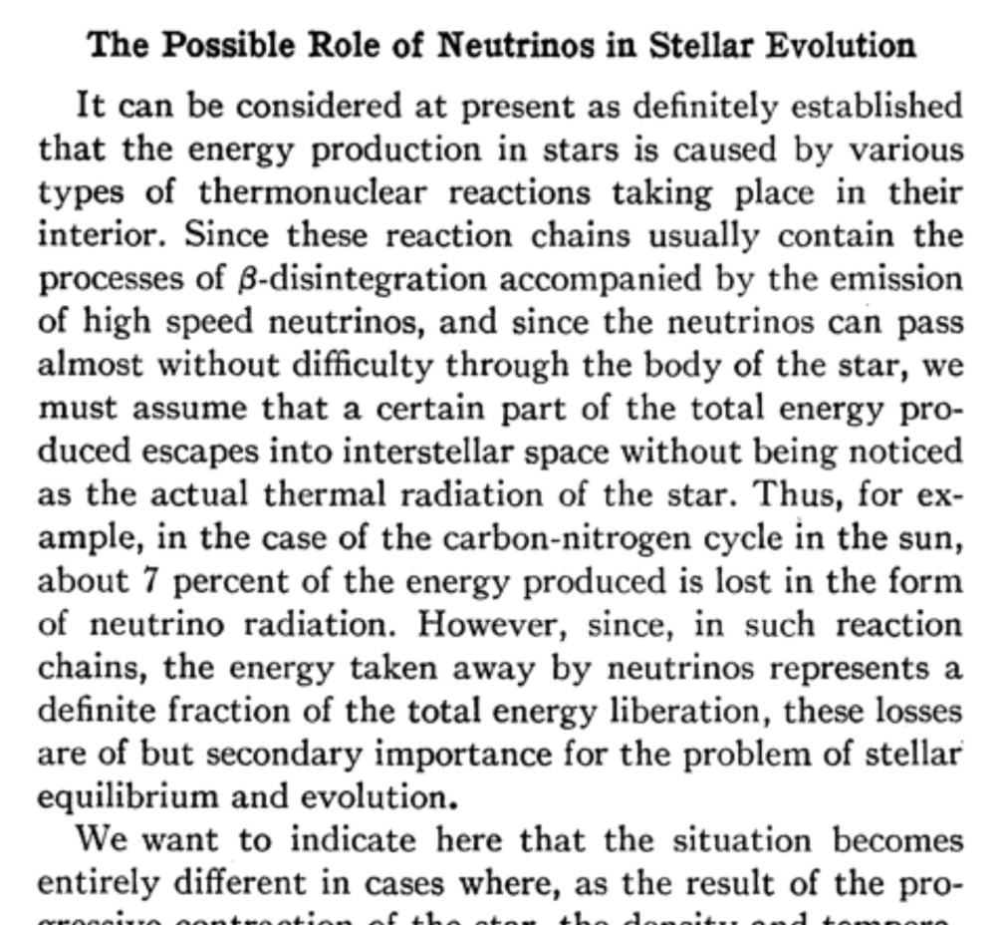
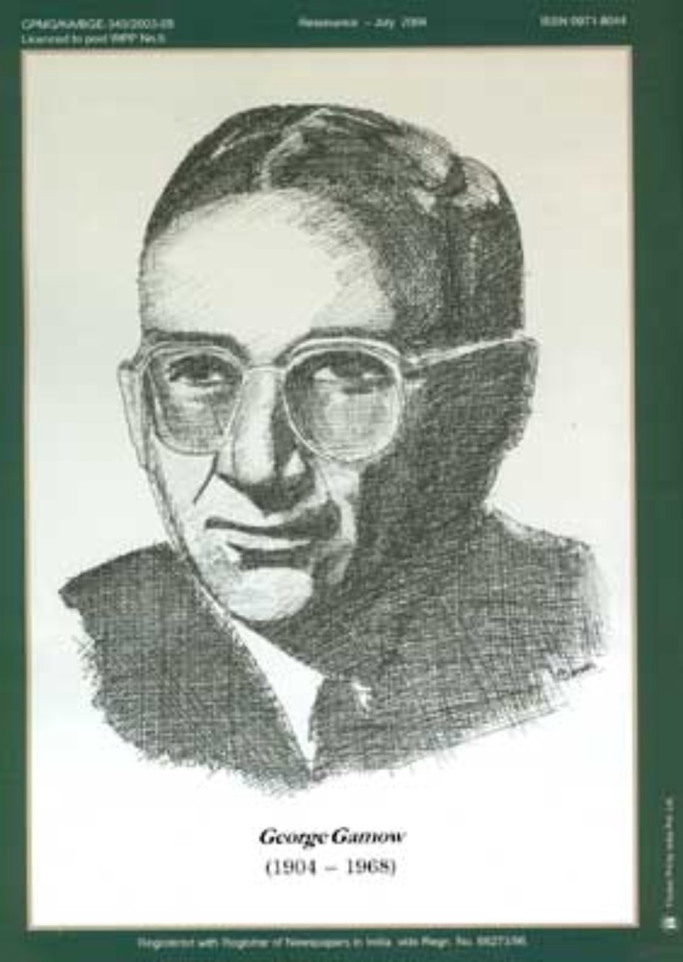
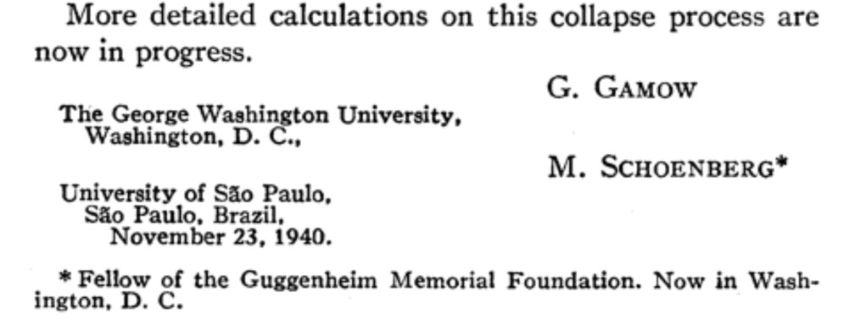
Predicting Neutrinos from Core Collapse
Phys. Rev. 58:1117 (1940)

Slide 11
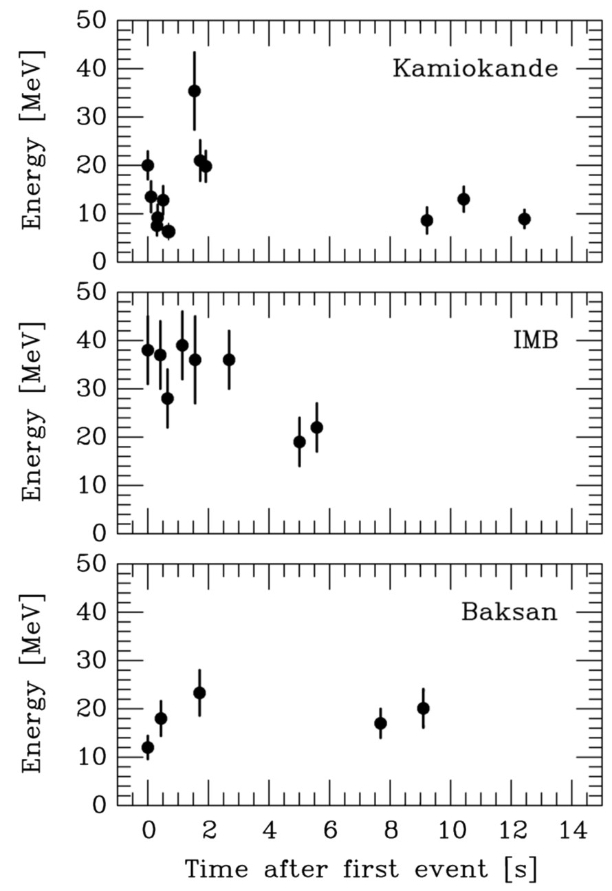
Neutrino Signal of Supernova 1987A
Kamiokande-II (Japan)
Water Cherenkov detector
2140 tons
Clock uncertainty ±1 min
Irvine-Michigan-Brookhaven (US)
Water Cherenkov detector
6800 tons
Clock uncertainty ±50 ms
Baksan Scintillator Telescope
(Soviet Union), 200 tons
Random event cluster $\sim$ 0.7/day
Clock uncertainty +2/−54 s
Within clock uncertainties,
all signals are contemporaneous

Slide 12
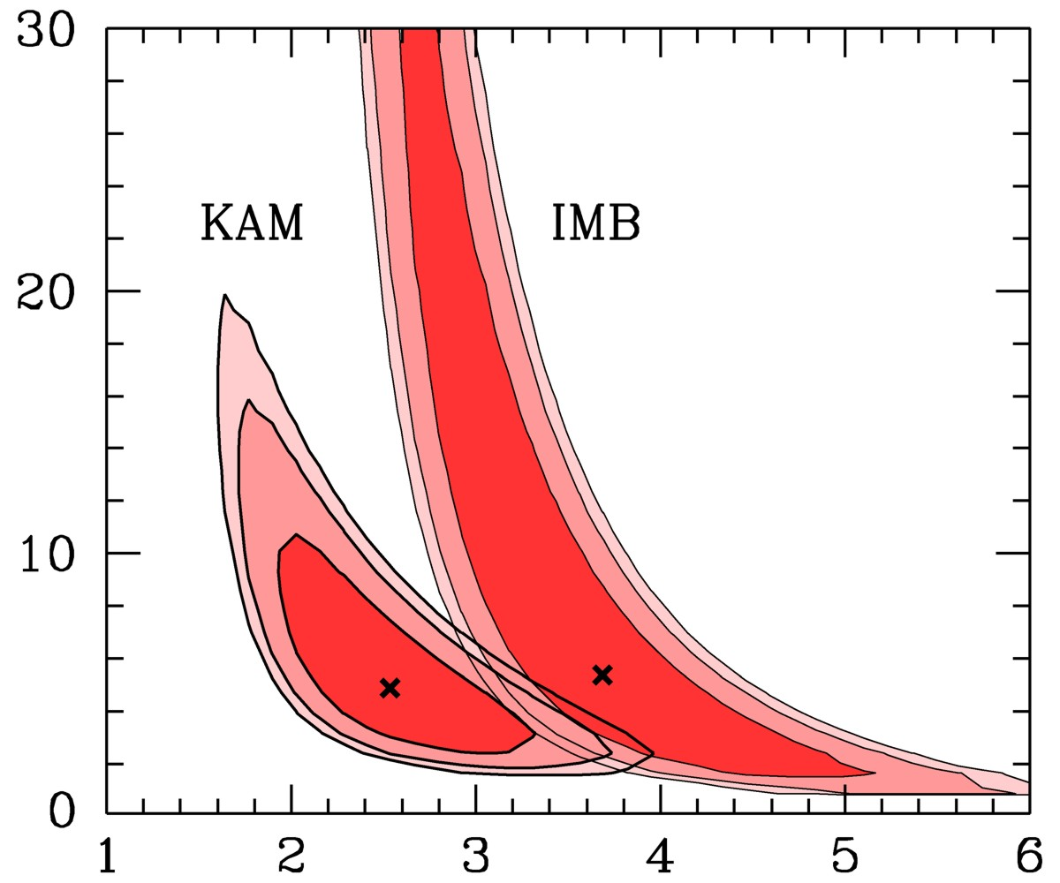
Interpreting SN 1987A Neutrinos
Assume
• Thermal spectra
• Equipartition of
energy between
$ν_{e}$, ${\overline{ν}}_{e}$, $ν_{μ}$, ${\overline{ν}}_{μ}$, $ν_{τ}$
and ${\overline{ν}}_{τ}$
Contours at CL
68.3%, 90% and 95.4%
Recent long-term
simulations
(Basel, Garching)
Binding Energy [${10}^{53}$ erg]
Jegerlehner,
Neubig & Raffelt,
PRD 54 (1996) 1194
Theory
Spectral ${\overline{ν}}_{e}$ temperature [MeV]

Slide 13
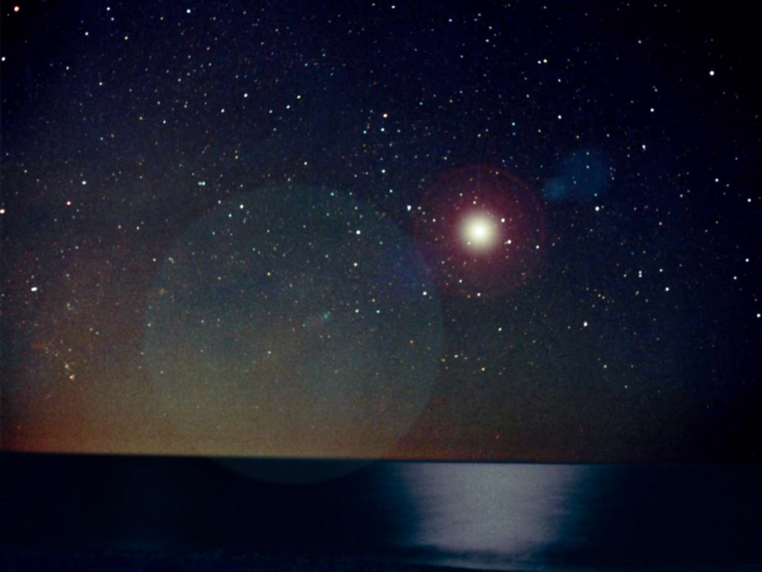
Flavor Oscillations
Explosion Mechanism

Slide 14
Why No Prompt Explosion?
0.1 M_{sun} of iron has a
nuclear binding energy
≈ 1.7 × 10⁵¹ erg
Comparable to
explosion energy
Undissociated Iron
Collapsed Core
Shock Wave
Dissociated
Material
(n, p, e, ν)
Shock wave forms
within the iron core
Dissipates its energy
by dissociating the
remaining layer of
iron

Slide 15
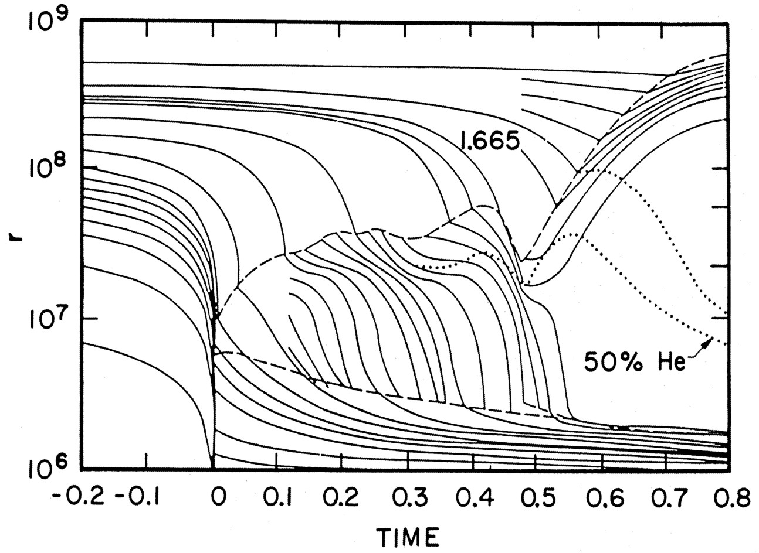
Delayed (Neutrino-Driven) Explosion
Wilson, Proc. Univ. Illinois Meeting on Num. Astrophys. (1982)
Bethe & Wilson, ApJ 295 (1985) 14

Slide 16
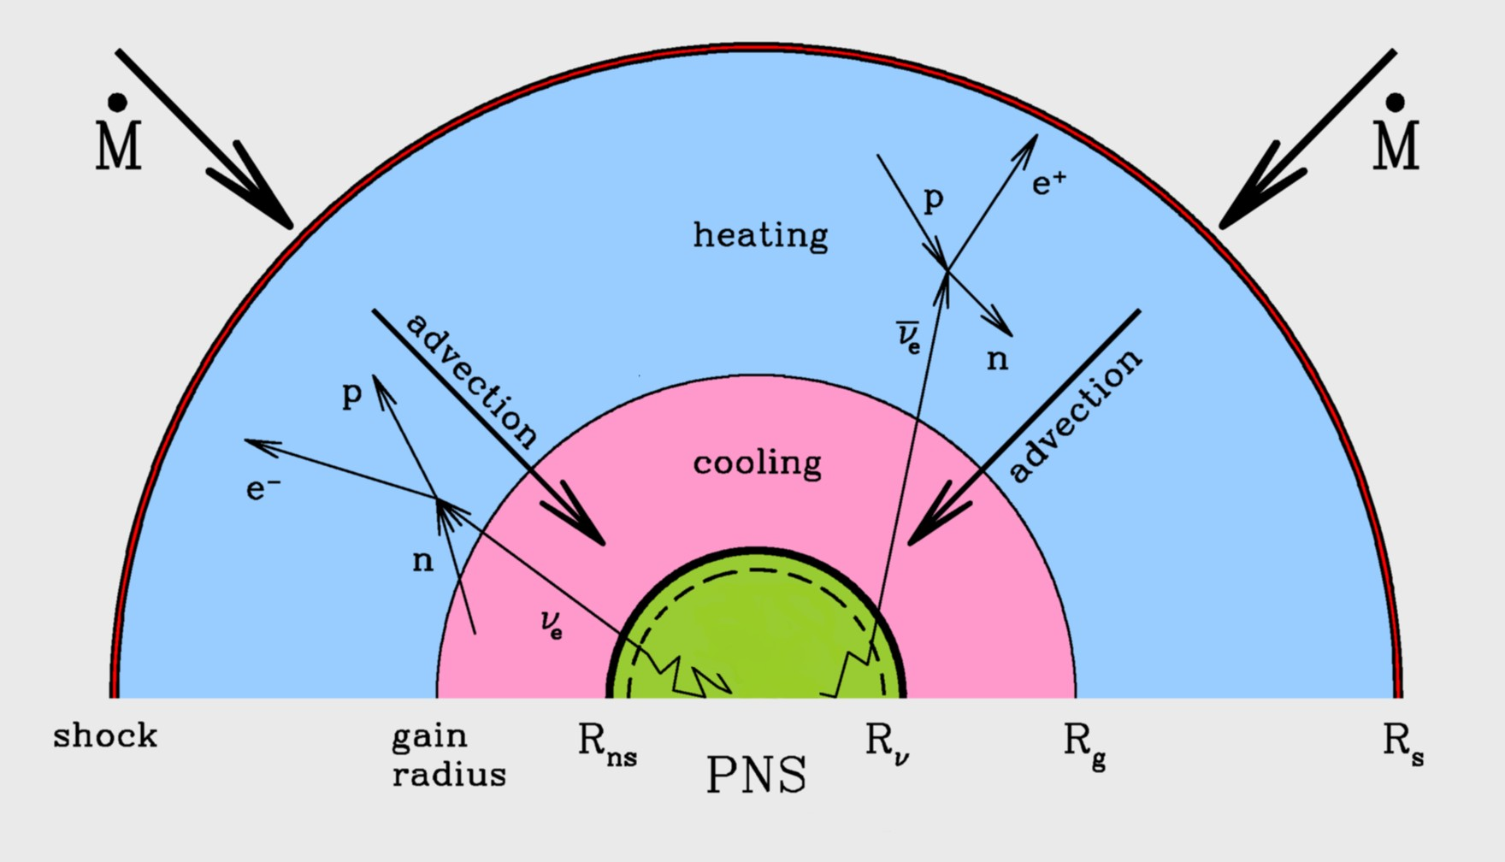
Neutrinos Rejuvenating Stalled Shock
Neutrino heating
increases pressure
behind shock front
Picture adapted from Janka, astro-ph/0008432

Slide 17
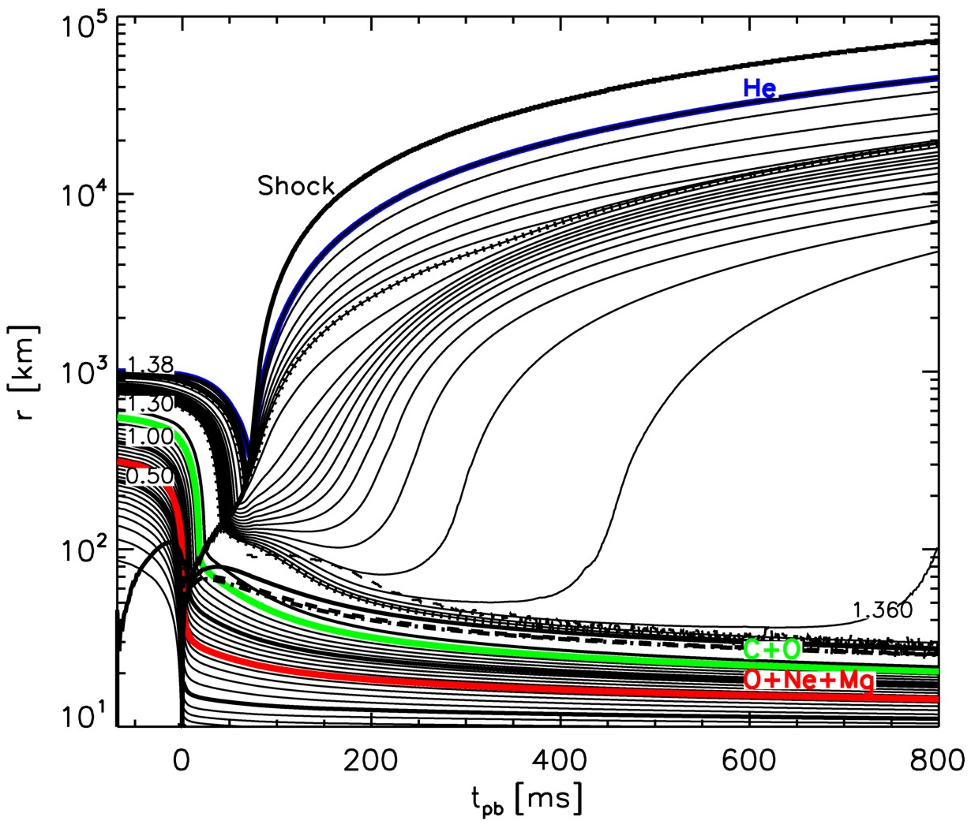
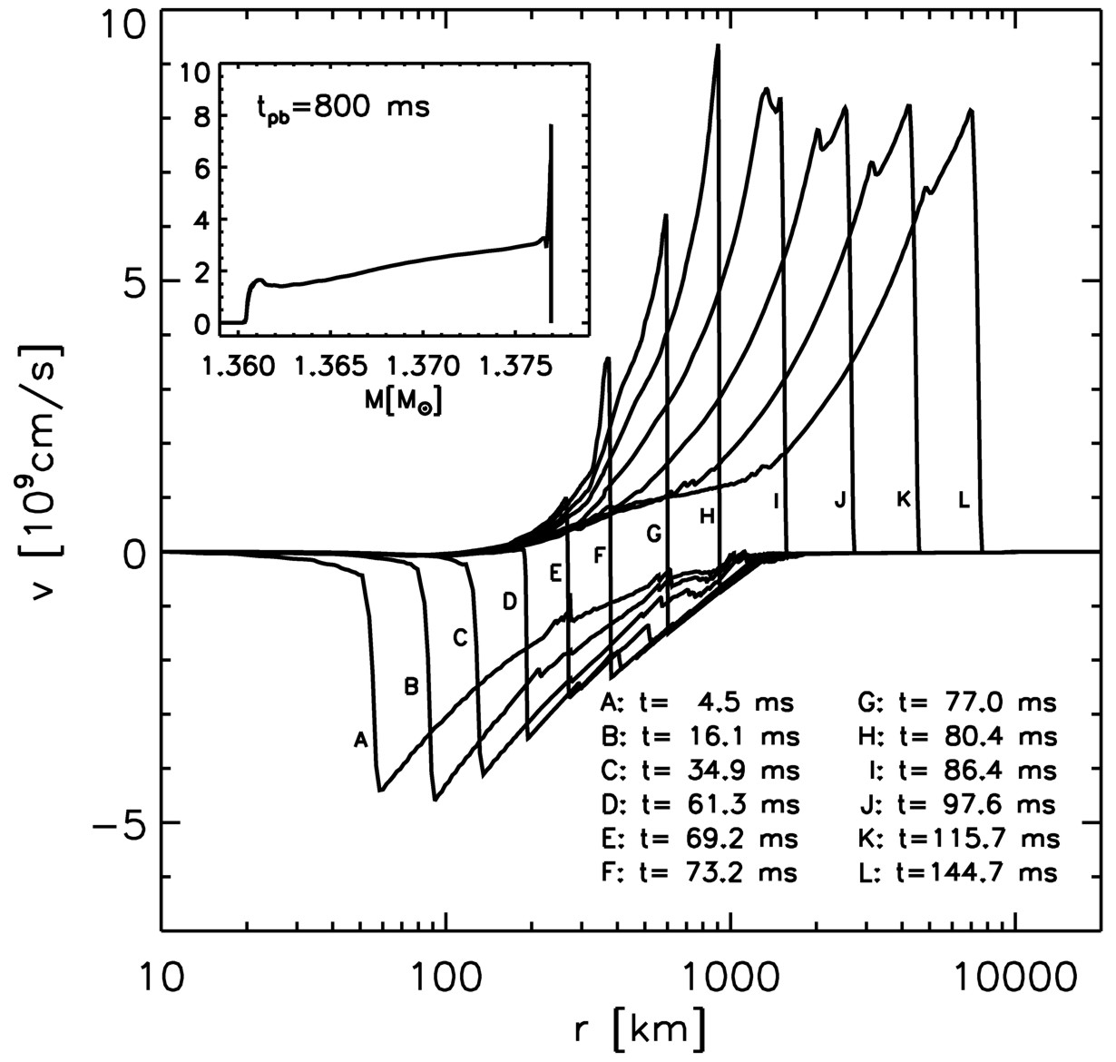
Exploding Models (8–10 Solar Masses)
Kitaura, Janka & Hillebrandt: “Explosions of O-Ne-Mg cores, the Crab supernova,
and subluminous type II-P supernovae”, astro-ph/0512065

Slide 18
Parametric 3D Simulation (Garching group)

Slide 19
Standing Accretion Shock Instability (SASI)
Mezzacappa et al., http://www.phy.ornl.gov/tsi/pages/simulations.html

Slide 20
Neutrino-Driven Mechanism – Modern Version
• Stalled accretion shock pushed out
to ~150 km as matter piles up on the PNS
• Heating (gain) region develops within
some tens of ms after bounce
• Convective overturn & shock
oscillations (SASI) enhance efficiency
of ν-heating, finally revives shock
• Successful explosions in 1D and 2D
for different progenitor masses
(e.g. Garching group)
• Details important (treatment of GR,
ν interaction rates, etc.)
• Role of 3D not yet clear,
only parametric studies
• 3D simulations with Boltzmann ν-transport
being developed (e.g. in Garching)
Shock oscillations
(SASI)
ν heating
Convection
ν cooling
Shock
Adapted from B. Müller

Slide 21
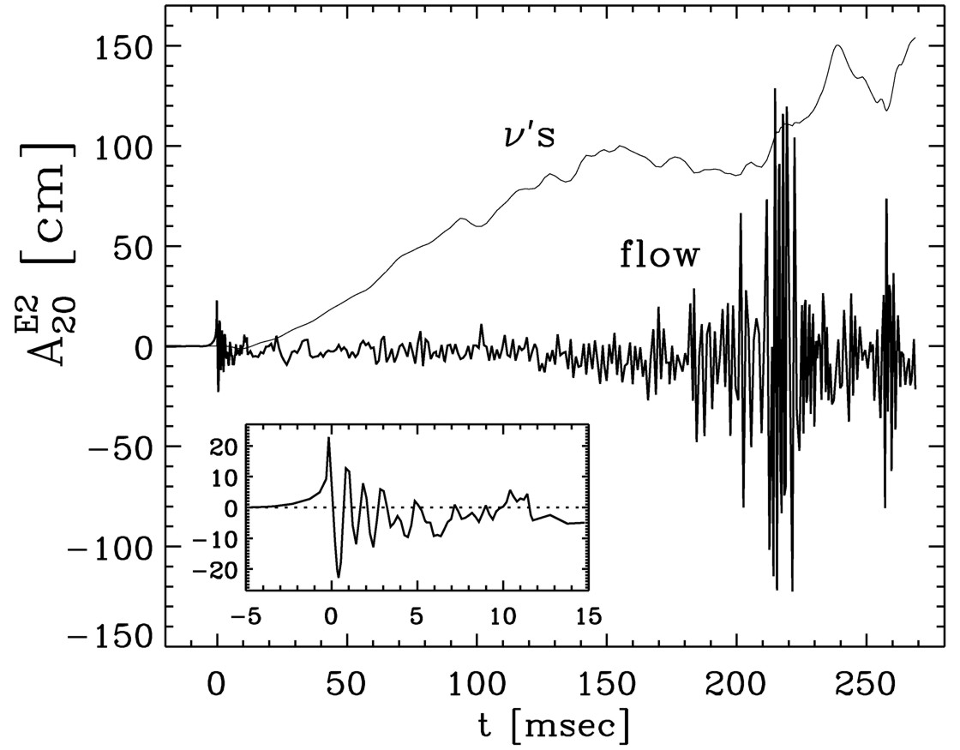
Gravitational Waves from Core-Collapse Supernovae
GWs from asymmetric
neutrino emission
GWs from convective mass flows
Bounce
Müller, Rampp, Buras, Janka, & Shoemaker, astro-ph/0309833
“Towards gravitational wave signals from realistic core collapse supernova models”

Slide 22
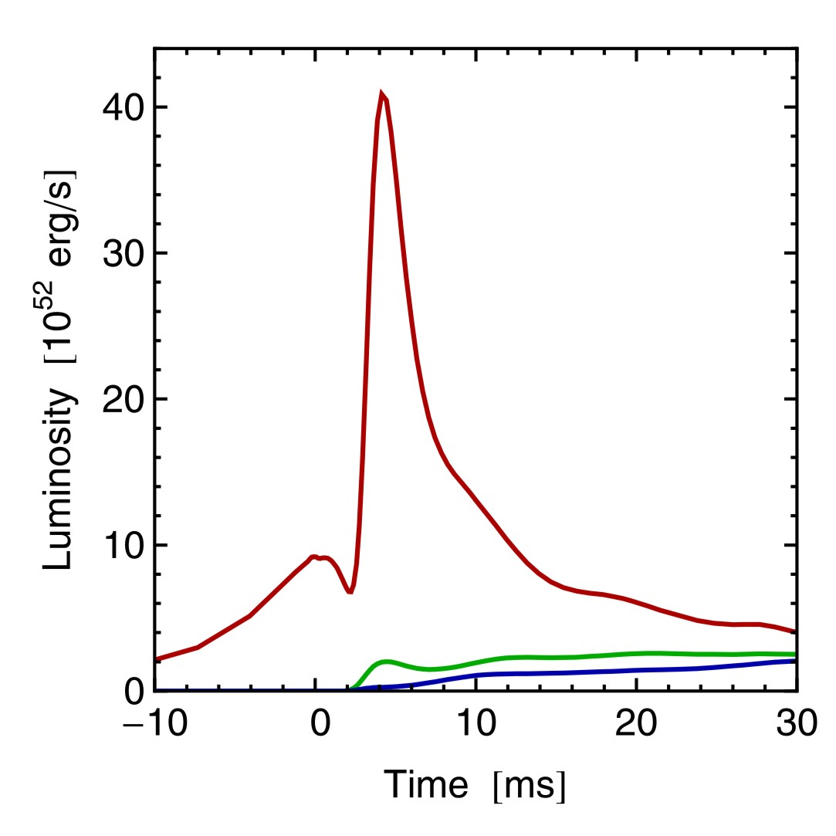
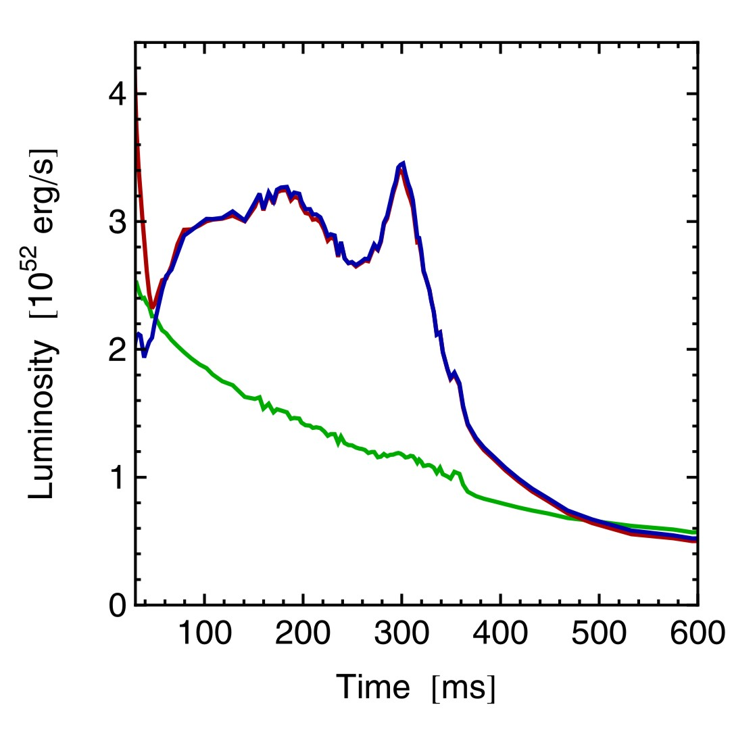
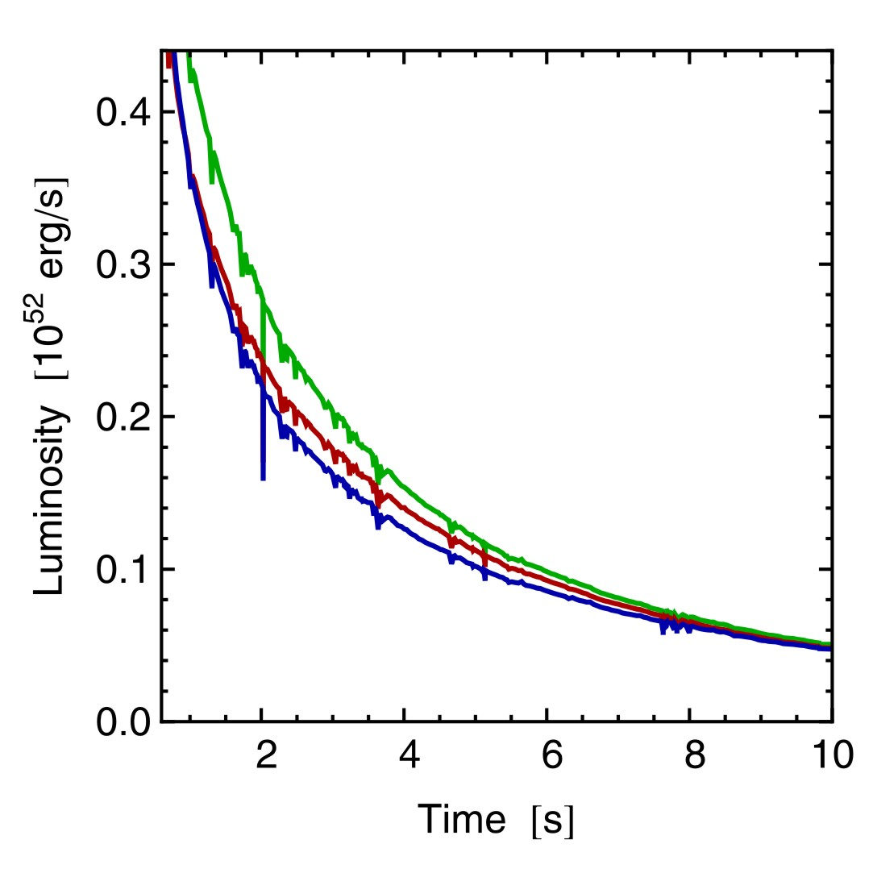
Three Phases of Neutrino Emission
Prompt ν_{e} burst
Accretion
Cooling
$$ν_{e}$$
$$ν_{e}$$
$${\overline{ν}}_{e}$$
$$ν_{x}$$
$$ν_{x}$$
$$ν_{e}$$
$${\overline{ν}}_{e}$$
Shock breakout
De-leptonization of
outer core layers
Shock stalls $\sim$ 150 km
Neutrinos powered by
infalling matter
Cooling on neutrino
diffusion time scale
Spherically symmetric model (10.8 M⊙) with Boltzmann neutrino transport
Explosion manually triggered by enhanced CC interaction rate
Fischer et al. (Basel group), A&A 517:A80, 2010 [arxiv:0908.1871]

Slide 23
Flavor Oscillations
Neutrinos from Next Nearby SN

Slide 24
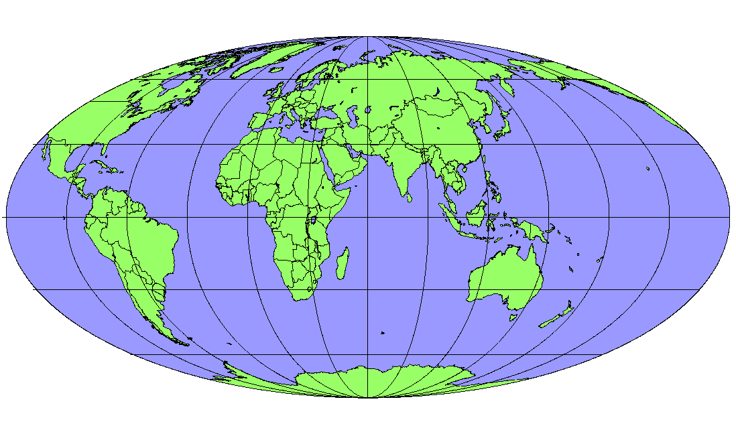
Operational Detectors for Supernova Neutrinos
MiniBooNE
(200)
HALO
(tens)
LVD (400)
Borexino (100)
Baksan
(100)
Super-K (10⁴)
KamLAND (400)
Daya Bay
(100)
In brackets events
for a “fiducial SN”
at distance 10 kpc
IceCube (10⁶)

Slide 25
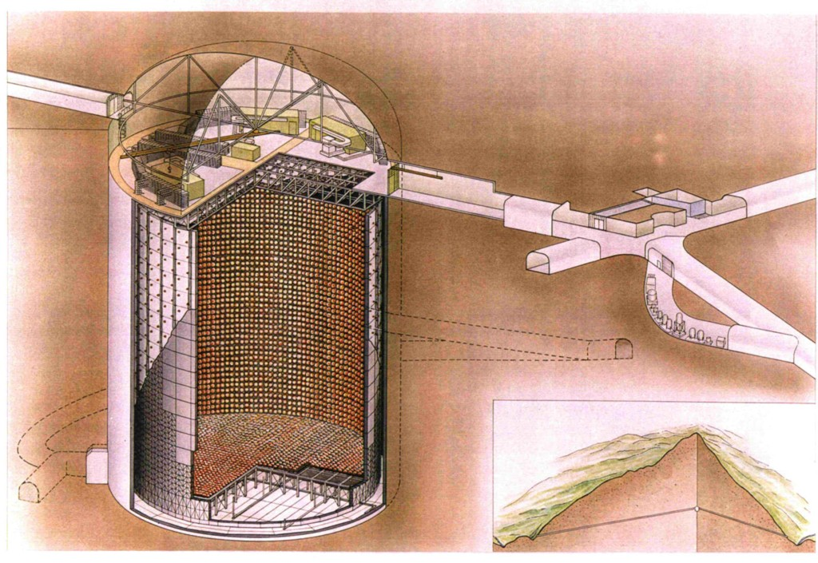
Super-Kamiokande Neutrino Detector

Slide 26
Simulated Supernova Burst in Super-Kamiokande
Movie by C. Little, including work by S. Farrell & B. Reed,
(Kate Scholberg’s group at Duke University)
http://snews.bnl.gov/snmovie.html

Slide 27
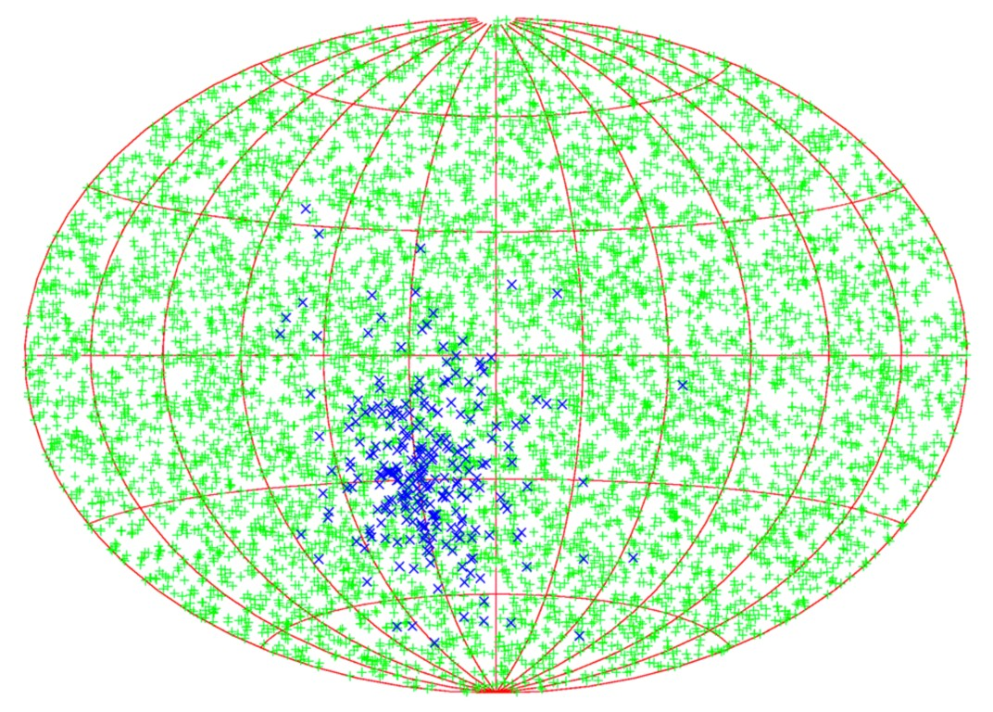
Supernova Pointing with Neutrinos
${\overline{ν}}_{e}p→ne^{+}$
Neutron tagging
efficiency
None
90 %
7.8°
3.2°
SK
1.4°
0.6°
SK × 30
$$νe→νe$$
95% CL half-cone
opening angle
Beacom & Vogel: Can a supernova be located by its neutrinos? [astro-ph/9811350]
Tomàs, Semikoz, Raffelt, Kachelriess & Dighe: Supernova pointing with low- and
high-energy neutrino detectors [hep-ph/0307050]

Slide 28
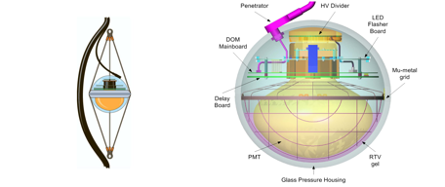
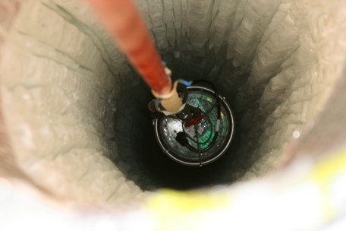
IceCube Neutrino Telescope at the South Pole
Instrumentation of 1 km³ antarctic
ice with $\sim$ 5000 photo multipliers
completed December 2010

Slide 29
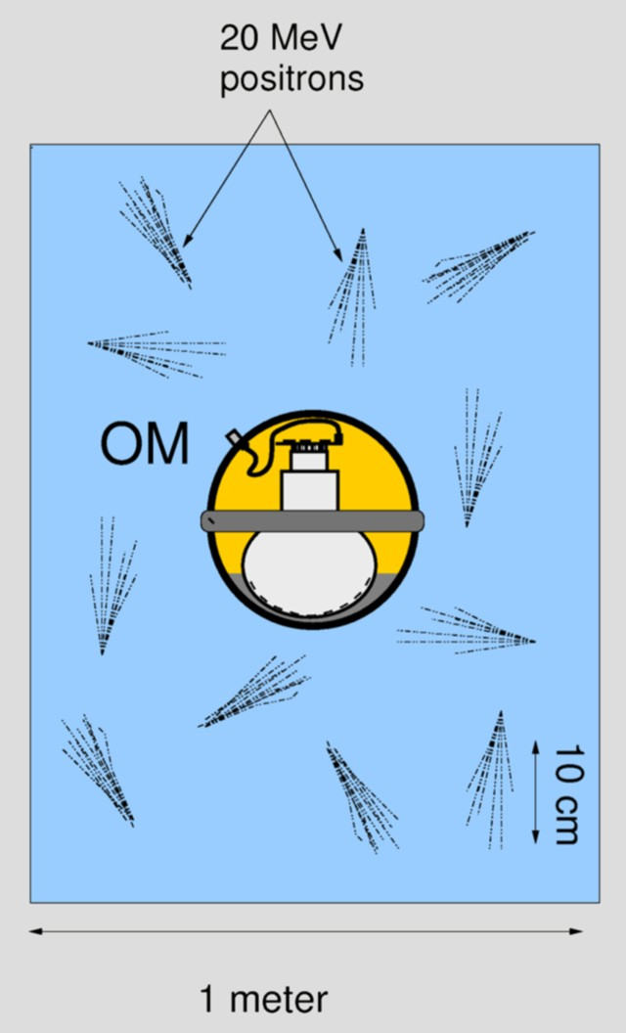
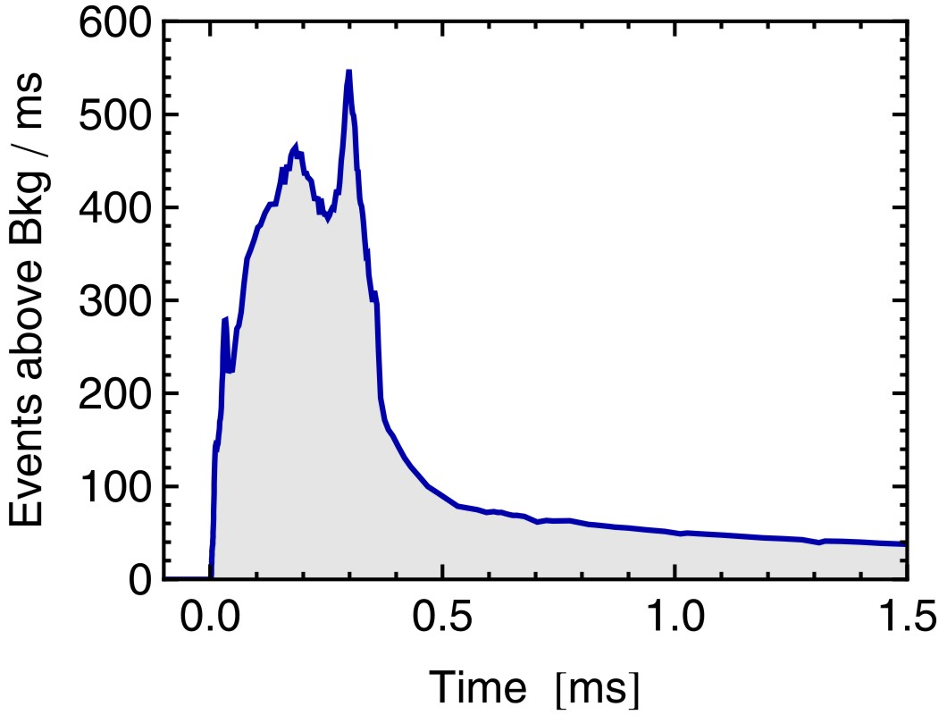
IceCube as a Supernova Neutrino Detector
Each optical module (OM) picks up Cherenkov light
from its neighborhood
$\sim$ 300 Cherenkov photons per OM from SN at 10 kpc
Bkgd rate in one OM < 300 Hz
SN appears as “correlated noise” in $\sim$ 5000 OMs
Accretion
SN signal at 10 kpc
10.8 M_{sun} simulation
of Basel group
[arXiv:0908.1871]
Cooling
Pryor, Roos & Webster (ApJ 329:355, 1988), Halzen, Jacobsen & Zas (astro-ph/9512080)

Slide 30
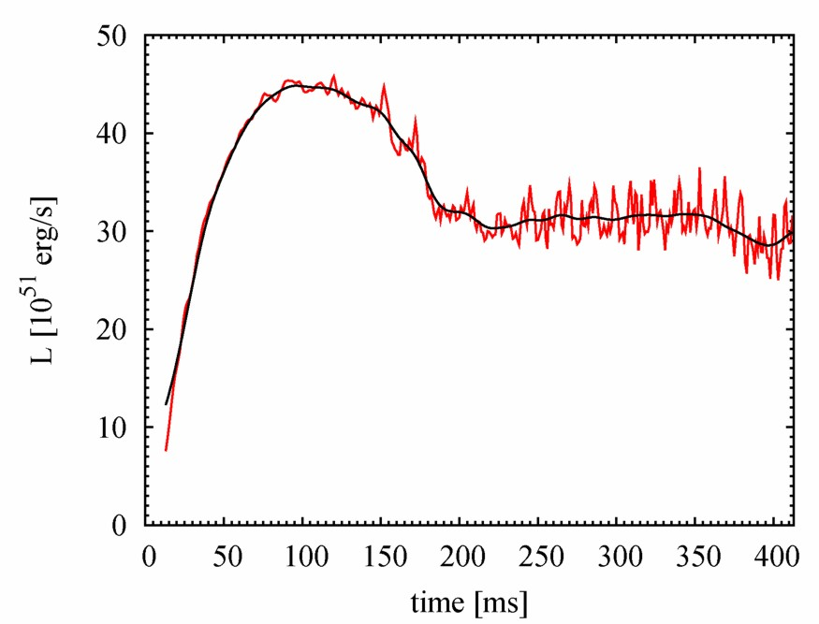
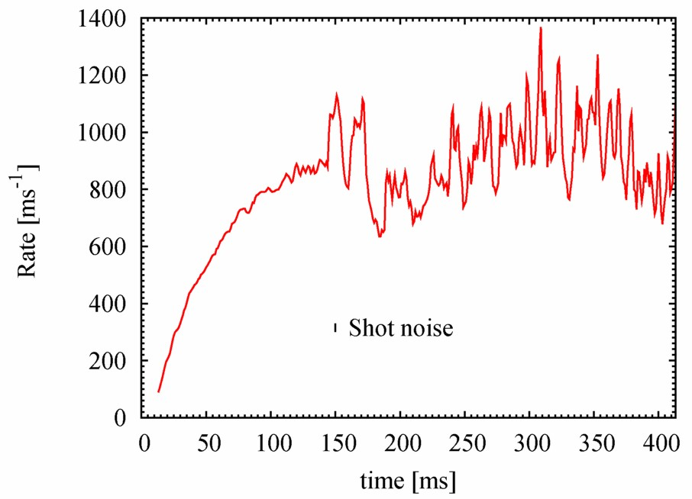
Variability seen in Neutrinos
Luminosity
Detection rate in IceCube
Smaller in realistic 3D models
if SASI is not strongly developed
Lund, Marek, Lunardini, Janka & Raffelt, arXiv:1006.1889
Using 2-D model of Marek, Janka & Müller, arXiv:0808.4136

Slide 31
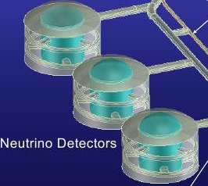
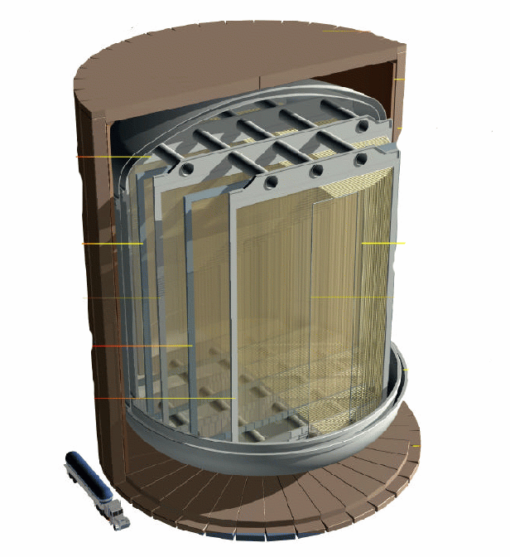
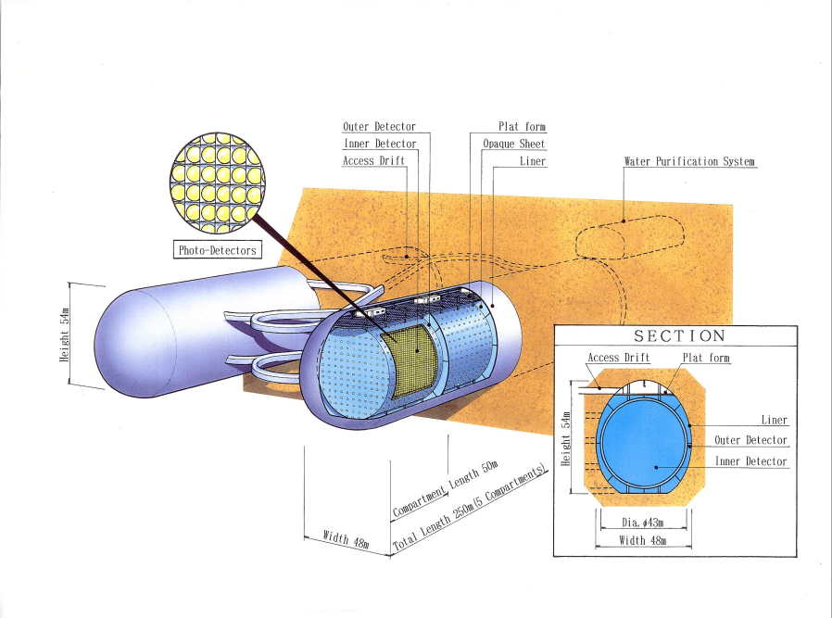
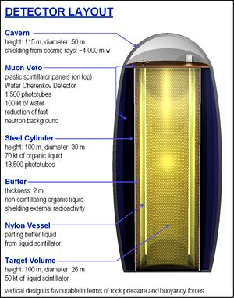
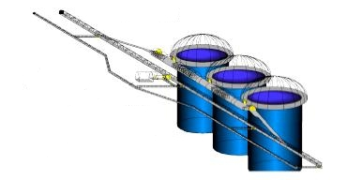
Next Generation Large-Scale Detector Concepts
5-100 kton
liquid Argon
DUSEL
LBNE
100 kton scale
scintillator
Hyper-K
Memphys
LENA
HanoHano
Megaton-scale
water Cherenkov

Slide 32
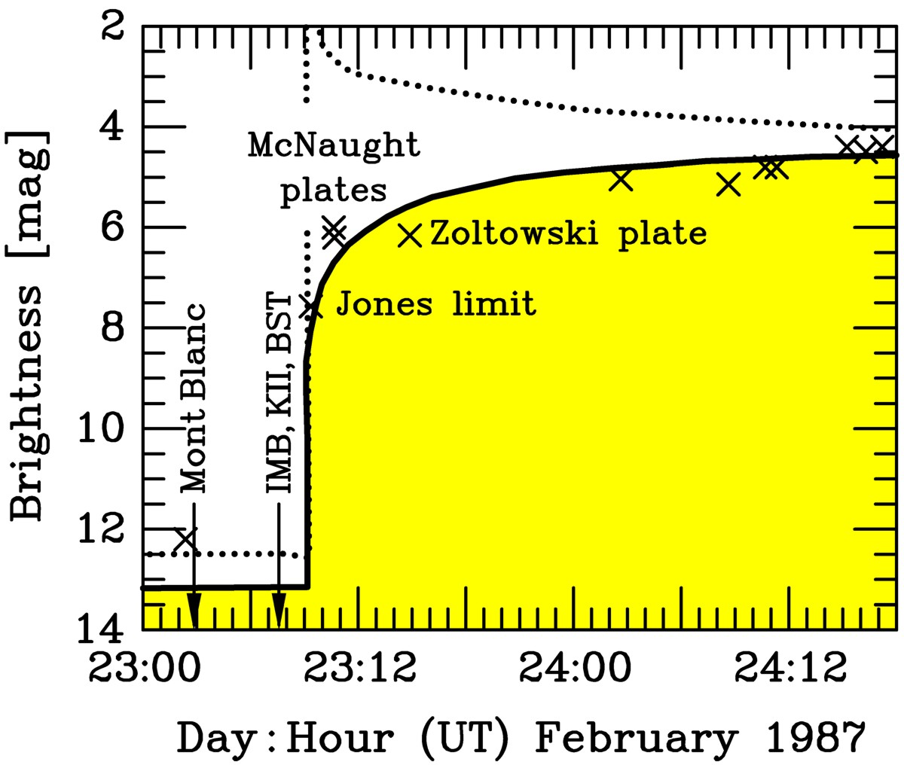
SuperNova Early Warning System (SNEWS)
Early light curve of SN 1987A
http://snews.bnl.gov
Super-K
• Neutrinos arrive several hours
before photons
• Can alert astronomers several
hours in advance
IceCube
Coincidence
Server
@ BNL
Alert
LVD
Borexino

Slide 33
Flavor Oscillations
Supernova Rate

Slide 34
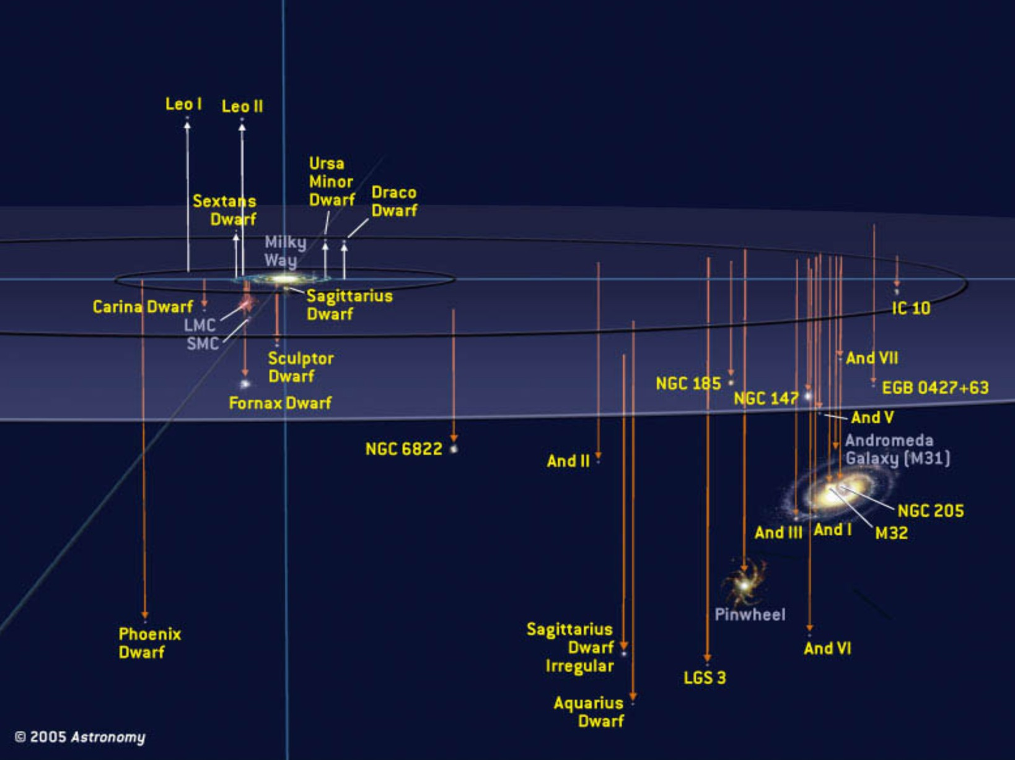
Local Group of Galaxies
With megatonne class (30 x SK)
60 events from Andromeda
Current best neutrino detectors
sensitive out to few 100 kpc

Slide 35
Core-Collapse SN Rate in the Milky Way
SN statistics in
external galaxies
van den Bergh & McClure
(1994)
Cappellaro & Turatto (2000)
Gamma rays from
²⁶Al (Milky Way)
Diehl et al. (2006)
Historical galactic
SNe (all types)
Strom (1994)
Tammann et al. (1994)
No galactic
neutrino burst
90 % CL (30 years)
Alekseev et al. (1993)
Core-collapse SNe per century
0
1
2
3
4
5
6
7
8
9
10
References: van den Bergh & McClure, ApJ 425 (1994) 205. Cappellaro & Turatto,
astro-ph/0012455. Diehl et al., Nature 439 (2006) 45. Strom, Astron. Astrophys. 288 (1994) L1.
Tammann et al., ApJ 92 (1994) 487. Alekseev et al., JETP 77 (1993) 339 and my update.

Slide 36
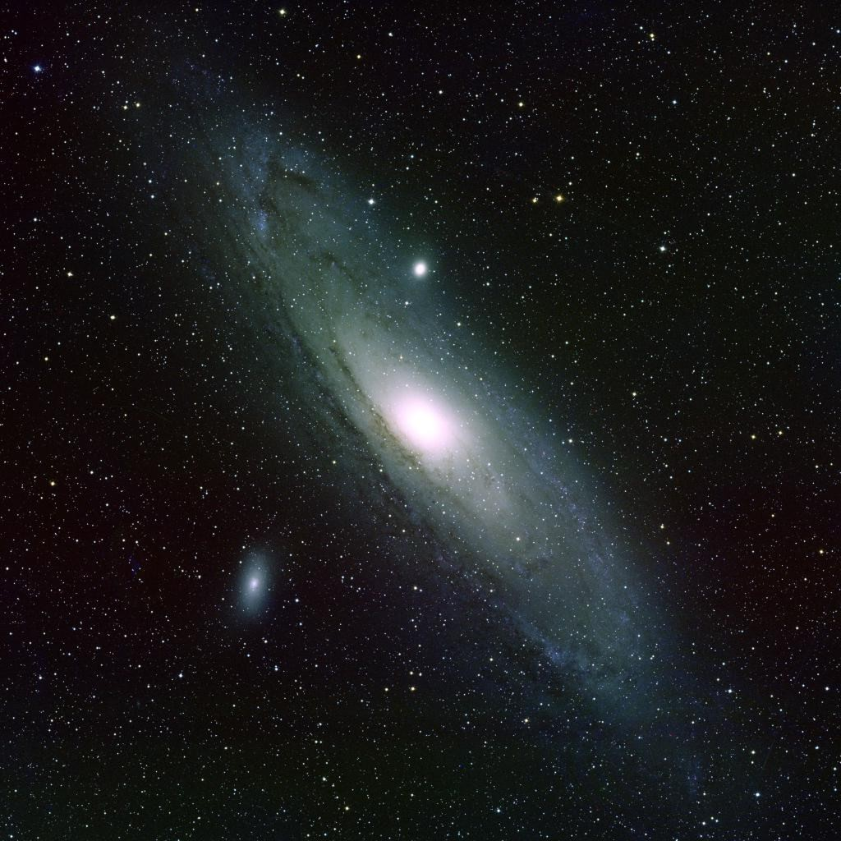
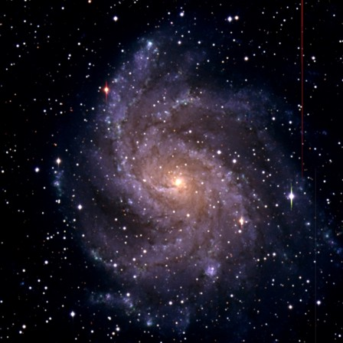
High and Low Supernova Rates in Nearby Galaxies
M31 (Andromeda) D = 780 kpc
NGC 6946 D = (5.5 ± 1) Mpc
Last Observed Supernova: 1885A
Observed Supernovae:
1917A, 1939C, 1948B, 1968D, 1969P,
1980K, 2002hh, 2004et, 2008S

Slide 37
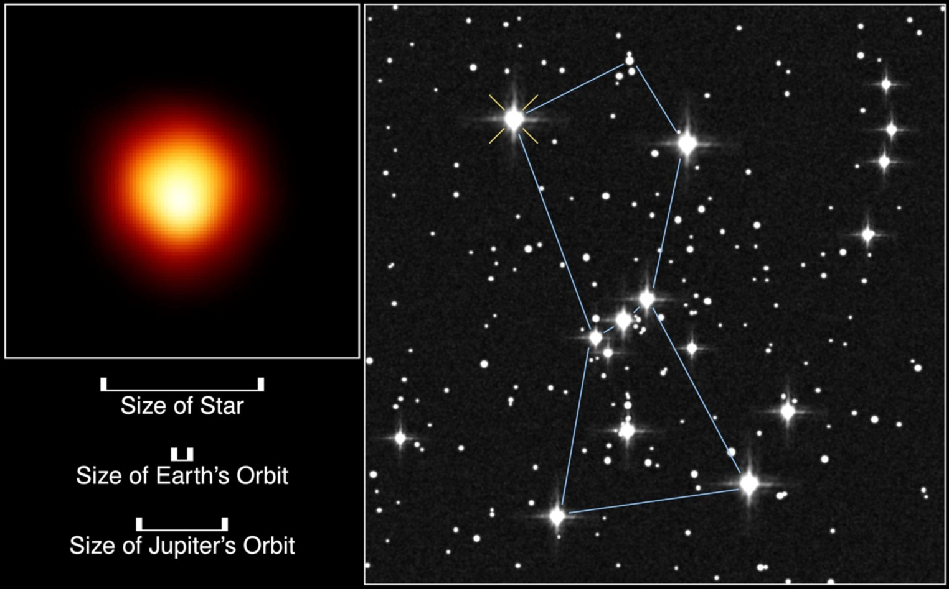
The Red Supergiant Betelgeuse (Alpha Orionis)
First resolved
image of a star
other than Sun
Distance
(Hipparcos)
130 pc (425 lyr)
If Betelgeuse goes Supernova:
6 ×10⁷ neutrino events in Super-Kamiokande
2.4 ×10³ neutrons /day from Si burning phase
(few days warning!), need neutron tagging
[Odrzywolek, Misiaszek & Kutschera, astro-ph/0311012]

Slide 38
Flavor Oscillations
Diffuse SN Neutrino Background

Slide 39
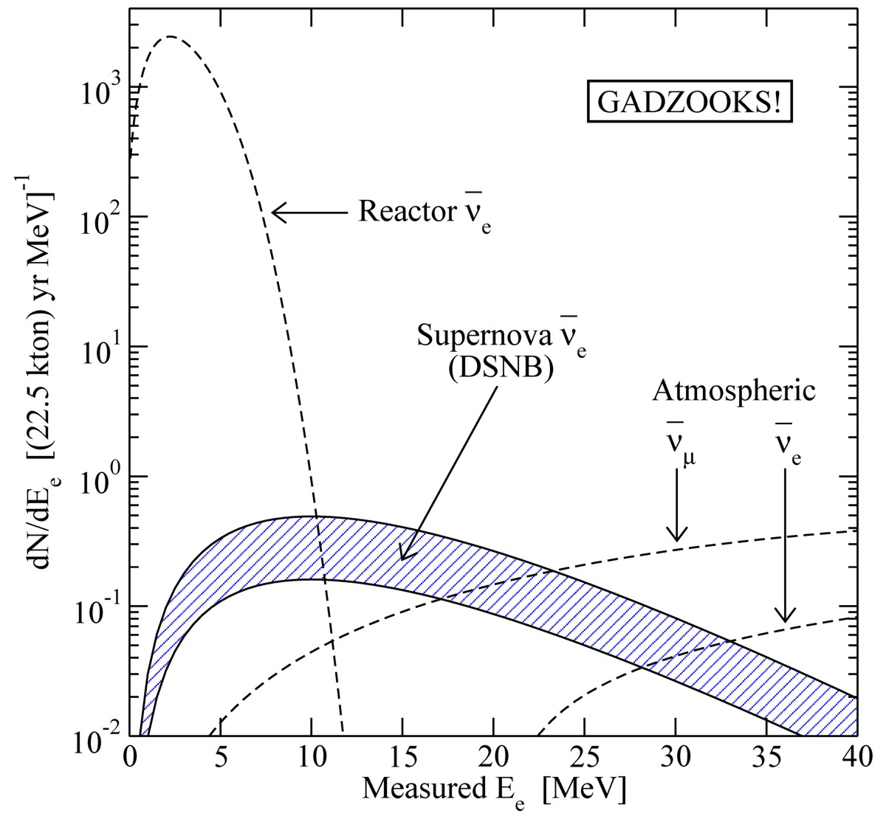
Diffuse Supernova Neutrino Background (DSNB)
• A few core collapses/sec
in the visible universe
• Emitted $ν$ energy density
∼ extra galactic background light
∼ 10% of CMB density
• Detectable ${\overline{ν}}_{e}$ flux at Earth
$∼10 {\text{cm}}^{−2} {\text{s}}^{−1}$
mostly from redshift $z∼1$
• Confirm star-formation rate
• Nu emission from average core
collapse & black-hole formation
• Pushing frontiers of neutrino
astronomy to cosmic distances!
Beacom & Vagins,
PRL 93:171101,2004
Window of opportunity between
reactor ${\overline{ν}}_{e}$and atmospheric $ν$ bkg

Slide 40
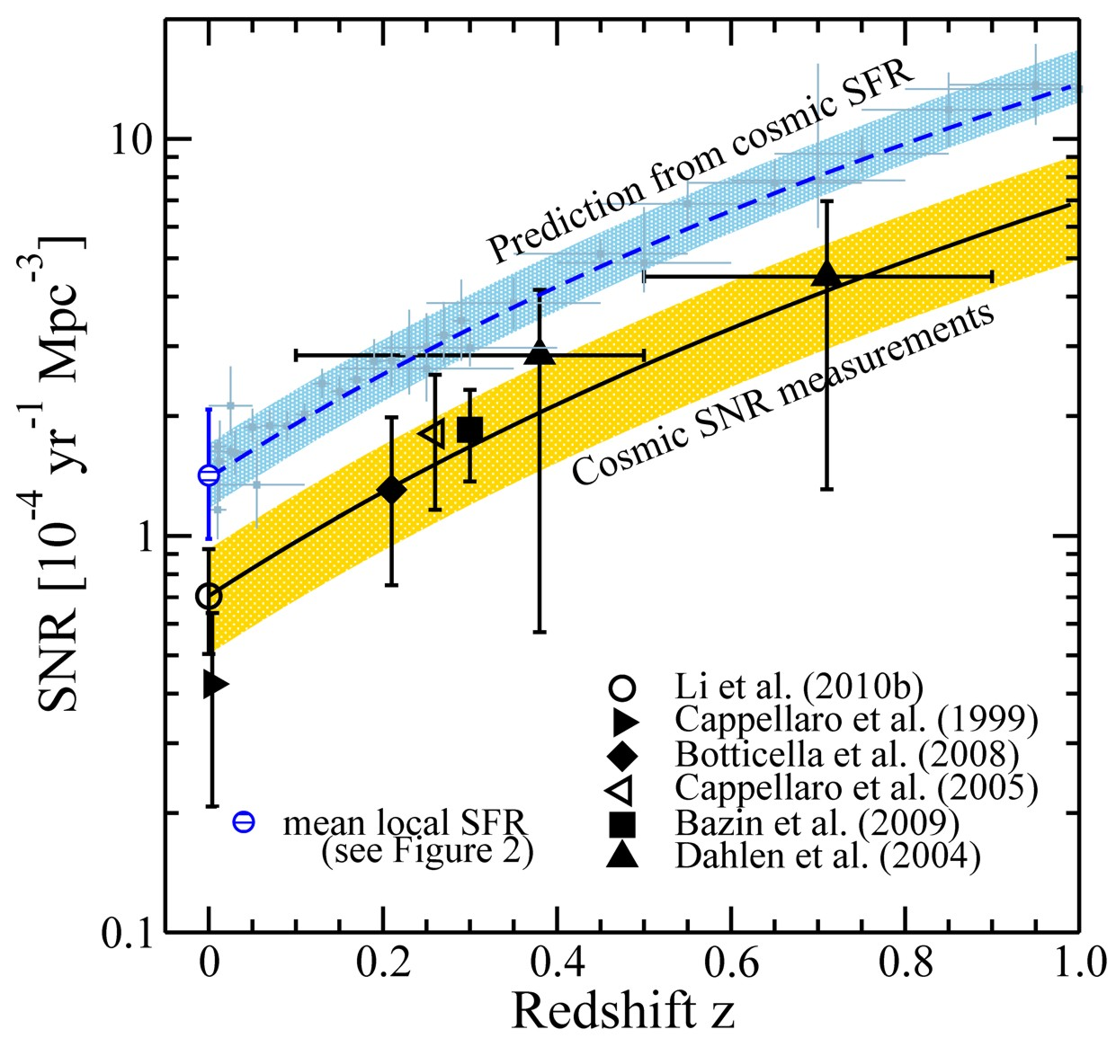
Supernova vs. Star Formation Rate in the Universe
Measured SN rate about
half the prediction from
star formation rate
Many “dark SNe” ?
Horiuchi, Beacom, Kochanek, Prieto, Stanek & Thompson
arXiv:1102.1977

Slide 41
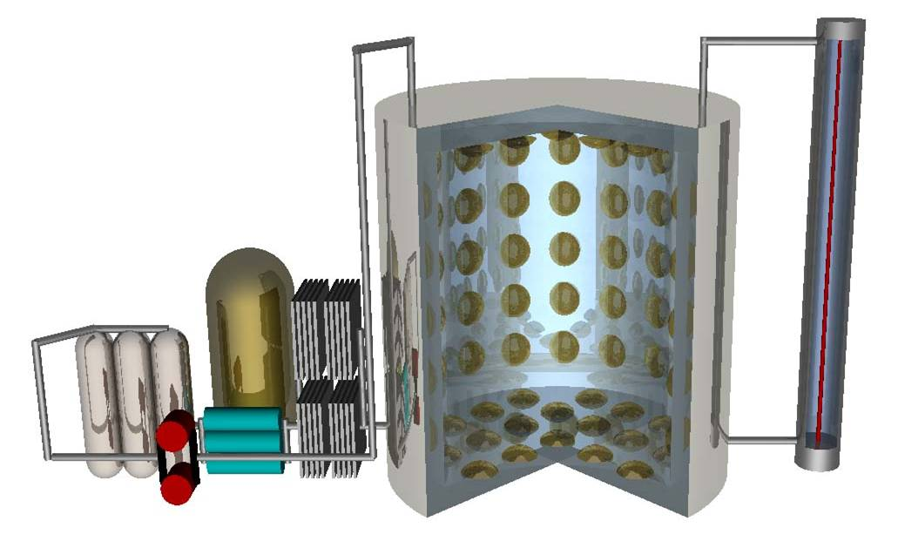
Neutron Tagging in Super-K with Gadolinium
Background suppression: Neutron tagging in ${\overline{ν}}_{e}+p→n+e^{+}$
• Scintillator detectors: Low threshold for γ(2.2 MeV)
• Water Cherenkov: Dissolve Gd as neutron trap (8 MeV γ cascade)
• Need 100 tons Gd for Super-K (50 kt water)
EGADS test facility at Kamioka
• Construction 2009–11
• Experimental program 2011–2013
Mark Vagins
Neutrino 2010
Selective water & Gd
filtration system
200 ton
water tank
Transparency
measurement

Slide 42
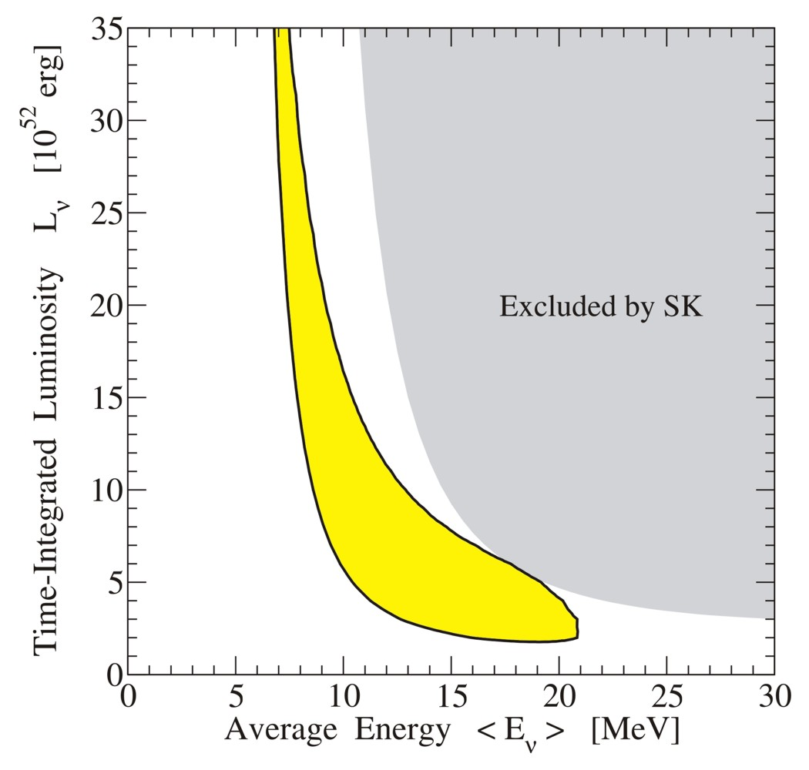
Average spectral properties from DSNB
90% CL sensitivity to
average SN spectrum
from DSNB after 5 years
of Gd enhanced Super-K
Adapted from Yüksel, Ando & Beacom, astro-ph/0509297

Slide 43
Flavor Oscillations
Particle-Physics Constraints

Slide 44
Do Neutrinos Gravitate?
Early light curve of SN 1987A
Shapiro time delay for particles
moving in a gravitational potential
$Δt=−2\int_{A}^{B}{dt}Φ\left[r\left(t\right)\right]$
For trip from LMC to us, depending
on galactic model,
$Δt≈1$–5 months
Neutrinos and photons respond to
gravity the same to within
1–$4×{10}^{−3}$
Longo, PRL 60:173, 1988
Krauss & Tremaine, PRL 60:176, 1988
• Neutrinos arrived several hours
before photons as expected
• Transit time for $ν$ and $γ$ same
($160.000$ yr) within a few hours

Slide 45
Millisecond Bounce Time Reconstruction
Super-Kamiokande
Emission model adapted to
measured SN 1987A data
“Pessimistic distance” 20 kpc
Determine bounce time to
a few tens of milliseconds
IceCube
Onset of neutrino
emission
10 kpc
Pagliaroli, Vissani, Coccia & Fulgione
arXiv:0903.1191
Halzen & Raffelt, arXiv:0908.2317

Slide 46
Neutrino Limits by Intrinsic Signal Dispersion
Time of flight delay by neutrino mass
“Milli charged” neutrinos
G. Zatsepin, JETP Lett. 8:205, 1968
Path bent by galactic magnetic field,
inducing a time delay
$$Δt=2.57\text{s} \frac{D}{50 kpc} {\left(\frac{10 MeV}{E_{ν}}\right)}^{2}{\left(\frac{m_{ν}}{10 eV}\right)}^{2}$$
$$\frac{Δt}{t}=\frac{e_{ν}^{2}{\left(B_{⊥}d_{B}\right)}^{2}}{6E_{ν}^{2}}<3×{10}^{−12}$$
SN 1987A signal duration implies
SN 1987A signal duration implies
$$m_{ν_{e}}≲20 \text{eV}$$
$$\frac{e_{ν}}{e}<3×{10}^{−17} \frac{1μG}{B_{⊥}} \frac{1 kpc}{d_{B}}$$
Loredo & Lamb
Ann N.Y. Acad. Sci. 571 (1989) 601
find 23 eV (95% CL limit) from detailed
maximum-likelihood analysis
Barbiellini & Cocconi,
Nature 329 (1987) 21
Bahcall, Neutrino Astrophysics (1989)
At the time of SN 1987A
competitive with tritium end-point
Today $m_{ν}<2.2 eV$from tritium
Cosmological limit today $m_{ν}≲0.2 \text{eV}$
Assuming charge conservation in
neutron decay yields a more
restrictive limit of about 3×10⁻²¹ e

Slide 47
Supernova 1987A Energy-Loss Argument
SN 1987A neutrino signal
Neutrino
sphere
Volume emission
of new particles
Neutrino
diffusion
Emission of very weakly interacting
particles would “steal” energy from the
neutrino burst and shorten it.
(Early neutrino burst powered by accretion,
not sensitive to volume energy loss.)
Late-time signal most sensitive observable.
Good mesurement of cooling time important!

Slide 48
Axion Bounds and Searches
[GeV] f_{a}
10³
10⁶
10⁹
10¹²
10¹⁵
keV
eV
meV
μeV
neV
m_{a}
Experiments
Tele
scope
CAST
Direct
searches
ADMX
(Seattle & Yale)
Too much
hot dark matter
String/DW
decay
Too much CDM
(misalignment)
Too much cold dark matter
(misalignment with Θ_{i} = 1)
Globular clusters
(a-γ-coupling)
Anthropic
Range
SN 1987A
Too many events
Too much
energy loss
Globular clusters (helium ignition)
(a-e coupling)

Slide 49
Diffuse Supernova Axion Background (DSAB)
Neutrinos from all core-collapse SNe comparable to photons from all stars
Diffuse Supernova Neutrino Background (DSNB) similar energy density as
extra-galactic background light (EBL), approx 10% of CMB energy density
DSNB probably next astro neutrinos to be measured
Axions with $ma \sim \text{10 }\text{meV}$
near SN 1987A energy-loss limit
Provide DSAB with compable
energy density as DSNB and EBL
No obvious detection channel
Raffelt, Redondo & Viaux
arXiv:1110.6397

Slide 50
Flavor Oscillations
Neutrino Flavor Oscillations

Slide 51
Three-Flavor Neutrino Parameters
Three mixing angles $θ_{12}$, $θ_{13}$, $θ_{23}$ (Euler angles for 3D rotation), $c_{ij}=\cos{θ_{ij}}$,
a CP-violating “Dirac phase” $δ$, and two “Majorana phases” $α_{2}$ and $α_{3}$
v
$$\left(\begin{matrix}ν_{e} \\ ν_{μ} \\ ν_{τ}\end{matrix}\right)=\left(\begin{matrix}1 & 0 & 0 \\ 0 & c_{23} & s_{23} \\ 0 & −s_{23} & c_{23}\end{matrix}\right)\left(\begin{matrix}c_{13} & 0 & {e^{−iδ}s}_{13} \\ 0 & 1 & 0 \\ {{−e}^{iδ}s}_{13} & 0 & c_{13}\end{matrix}\right)\left(\begin{matrix}c_{12} & s_{12} & 0 \\ −s_{12} & c_{12} & 0 \\ 0 & 0 & 1\end{matrix}\right)\left(\begin{matrix}1 & 0 & 0 \\ 0 & e^{i\frac{α_{2}}{2}} & 0 \\ 0 & 0 & e^{i\frac{α_{3}}{2}}\end{matrix}\right)\left(\begin{matrix}ν_{1} \\ ν_{2} \\ ν_{3}\end{matrix}\right)$$
$${39}^{∘}<θ_{23}<{53}^{∘}$$
$${7^{∘}<θ}_{13}<{11}^{∘}$$
$${33}^{∘}<θ_{12}<{37}^{∘}$$
Relevant for
0ν2β decay
Atmospheric/LBL-Beams
Reactor
Solar/KamLAND
Normal
Inverted
Tasks and Open Questions
Precision for all angles
CP-violating phase δ ?
Mass ordering ?
(normal vs inverted)
Absolute masses ?
(hierarchical vs degenerate)
Dirac or Majorana ?
3
μ
τ
2
e
μ
τ
$Δm^{2}$
72–80 meV²
Atmosphere
Sun
1
e
μ
τ
Atmosphere
2180–2640 meV²
2
e
μ
τ
Sun
1
e
μ
τ
3
μ
τ

Slide 52
Neutrino Oscillations in Matter
3500 citations
Neutrinos in a medium suffer flavor-dependent
refraction
W
f
ν
ν
ν
Z
ν
f
$V_{\text{weak}}=\sqrt{2}G_{\text{F}}×\left\{\begin{matrix}N_{\text{e}}−{N_{\text{n}}}/2 \\ {{−N}_{\text{n}}}/2\end{matrix} \begin{matrix}\text{f}\text{or} { ν}_{\text{e}} \\ \text{f}\text{or} ν_{μ}\end{matrix}\right.$
Lincoln Wolfenstein
Typical density of Earth: 5 g/cm³
$$ΔV_{\text{weak}}≈2×{10}^{−13} \text{eV}=0.2 \text{peV}$$

Slide 53
Flavor Oscillations in Core-Collapse Supernovae
Flavor eigenstates are
propagation eigenstates
Neutrino flux
Neutrino
sphere
MSW region

Slide 54
Mikheev-Smirnov-Wolfenstein (MSW) effect
Eigenvalue diagram of 2×2 Hamiltonian matrix for 2-flavor oscillations
Antineutrinos
Neutrinos
$${\overline{ν}}_{x}$$
Propagation through
density gradient:
adiabatic conversion
$$ν_{e}$$
$${m_{2}^{2}}/{2E}$$
$${m_{1}^{2}}/{2E}$$
$$ν_{x}$$
$${\overline{ν}}_{e}$$
“Negative density”
represents antineutrinos
in the same diagram
Vacuum
Density

Slide 55
Three-Flavor Eigenvalue Diagram
Normal mass ordering (NH)
Inverted mass ordering (IH)
Vacuum
Vacuum
Dighe & Smirnov, Identifying the neutrino mass spectrum from a supernova
neutrino burst, astro-ph/9907423

Slide 56
SN Flavor Oscillations and Mass Hierarchy
• Mixing angle $Θ_{13}$ has been measured to be “large”
• MSW conversion in SN envelope adiabatic
• Assume collective flavor oscillations are not important
Mass ordering
Normal (NH)
Inverted (IH)
$ν_{e}$ survival prob.
0
$$\sin^{2}{θ_{12}}≈0.3$$
${\overline{ν}}_{e}$ survival prob.
$$\cos^{2}{θ_{12}}≈0.7$$
0
${\overline{ν}}_{e}$Earth effects
Yes
No
• When are collective oscillations important? → Mirizzi’s talk
• How to detect signatures of hierarchy? → Serpico’s talk

Slide 57
Flavor-Off-Diagonal Refractive Index
2-flavor neutrino evolution as an effective 2-level problem
$$\text{i}\frac{∂}{∂t}\left(\begin{matrix}ν_{e} \\ ν_{μ}\end{matrix}\right)=H\left(\begin{matrix}ν_{e} \\ ν_{μ}\end{matrix}\right)$$
$$ν$$
Effective mixing Hamiltonian
ν
Z
ν
$$H=\frac{M^{2}}{2E}+\sqrt{2}G_{F} \left(\begin{matrix}N_{e}−\frac{N_{n}}{2} & 0 \\ 0 & −\frac{N_{n}}{2}\end{matrix}\right)+\sqrt{2}G_{F}\left(\begin{matrix}N_{ν_{e}} & N_{{〈ν}_{e}|ν_{μ}〉} \\ N_{{〈ν}_{μ}|ν_{e}〉} & N_{ν_{μ}}\end{matrix}\right)$$
Mass term in
flavor basis:
causes vacuum
oscillations
Wolfenstein’s weak
potential, causes MSW
“resonant” conversion
together with vacuum
term
Flavor-off-diagonal potential,
caused by flavor oscillations.
(J.Pantaleone, PLB 287:128,1992)
Flavor oscillations feed back on the Hamiltonian: Nonlinear effects!

Slide 58
Flavor Oscillations in Core-Collapse Supernovae
Neutrino-neutrino
refraction causes
a flavor instability,
flavor exchange
between different
parts of spectrum
Flavor eigenstates are
propagation eigenstates
Neutrino flux
Neutrino
sphere
MSW region

Slide 59
Collective Supernova Nu Oscillations since 2006
Two seminal papers in 2006 triggered a torrent of activities
Duan, Fuller, Qian, astro-ph/0511275, Duan et al. astro-ph/0606616
Balantekin, Gava & Volpe [0710.3112]. Balantekin & Pehlivan [astro-ph/0607527]. Blennow, Mirizzi & Serpico [0810.2297]. Cherry, Fuller, Carlson, Duan & Qian [1006.2175, 1108.4064]. Cherry, Wu, Fuller, Carlson, Duan & Qian [1109.5195]. Cherry, Carlson, Friedland, Fuller & Vlasenko [1203.1607]. Chakraborty, Choubey, Dasgupta & Kar [0805.3131]. Chakraborty, Fischer, Mirizzi, Saviano, Tomàs [1104.4031, 1105.1130]. Choubey, Dasgupta, Dighe & Mirizzi [1008.0308]. Dasgupta & Dighe [0712.3798]. Dasgupta, Dighe & Mirizzi [0802.1481]. Dasgupta, Dighe, Raffelt & Smirnov [0904.3542]. Dasgupta, Dighe, Mirizzi & Raffelt [0801.1660, 0805.3300]. Dasgupta, Mirizzi, Tamborra & Tomàs [1002.2943]. Dasgupta, Raffelt & Tamborra [1001.5396]. Dasgupta, O'Connor & Ott [1106.1167]. Duan, Fuller, Carlson & Qian [astro-ph/0608050, 0703776, 0707.0290, 0710.1271]. Duan, Fuller & Qian [0706.4293, 0801.1363, 0808.2046, 1001.2799]. Duan, Fuller & Carlson [0803.3650]. Duan & Kneller [0904.0974]. Duan & Friedland [1006.2359]. Duan, Friedland, McLaughlin & Surman [1012.0532]. Esteban-Pretel, Mirizzi, Pastor, Tomàs, Raffelt, Serpico & Sigl [0807.0659]. Esteban-Pretel, Pastor, Tomàs, Raffelt & Sigl [0706.2498, 0712.1137]. Fogli, Lisi, Marrone & Mirizzi [0707.1998]. Fogli, Lisi, Marrone & Tamborra [0812.3031]. Friedland [1001.0996]. Gava & Jean-Louis [0907.3947]. Gava & Volpe [0807.3418]. Galais, Kneller & Volpe [1102.1471]. Galais & Volpe [1103.5302]. Gava, Kneller, Volpe & McLaughlin [0902.0317]. Hannestad, Raffelt, Sigl & Wong [astro-ph/0608695]. Wei Liao [0904.0075, 0904.2855]. Lunardini, Müller & Janka [0712.3000]. Mirizzi, Pozzorini, Raffelt & Serpico [0907.3674]. Mirizzi & Serpico [1111.4483]. Mirizzi & Tomàs [1012.1339]. Pehlivan, Balantekin, Kajino & Yoshida [1105.1182]. Pejcha, Dasgupta & Thompson [1106.5718]. Raffelt [0810.1407, 1103.2891]. Raffelt & Sigl [hep-ph/0701182]. Raffelt & Smirnov [0705.1830, 0709.4641]. Raffelt & Tamborra [1006.0002]. Sawyer [hep-ph/0408265, 0503013, 0803.4319, 1011.4585]. Sarikas, Raffelt, Hüdepohl & Janka [1109.3601]. Sarikas, Tamborra, Raffelt, Hüdepohl & Janka [1204.0971]. Saviano, Chakraborty, Fischer, Mirizzi [1203.1484]. Wu & Qian [1105.2068].

Slide 60
Looking forward to the next galactic supernova
More theory progress is needed to reliably interpret
neutrino signal of next galactic supernova!

